Slide 1
Introduction to Data Science
Lecture - 1
Sumita Narang

Slide 2
Objectives
Fundamentals of Data Science
Real World applications
Data Science vs BI
Data Science vs Statistics
Roles and responsibilities of a Data Scientist
Software Engineering for Data Science
Data Scientists Toolbox
Data Science Challenges

Slide 3



What is Data?
•
Data are raw facts and figures
that on their own have no
meaning
•
These
can
be
any
alphanumeric
characters
i.e.
text, numbers, symbols
Note the “are” bit above? Why?
The Latin word data is the plural of datum, "(thing) given," neuter past
participle of dare "to give". Data may be used as a plural noun in this sense,
with
some
writers—usually
scientific
writers—in
the
20th
century
using datum in the singular and data for plural.
4
BITS Pilani, Pilani Campus

Slide 4
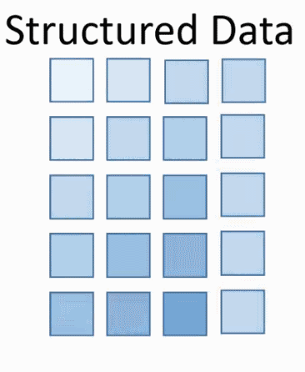
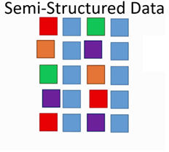
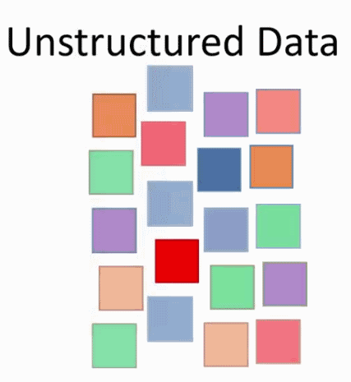
Types of Data
Traditionally, the data that we had was mostly structured and
small in size, which could be analyzed by using the simple BI
tools.
Unlike
data in
the
traditional
systems
which
was
mostly
structured, today most of the data is unstructured or semi-
structured.
5
BITS Pilani, Pilani Campus

Slide 5
Information Ladder
The information ladder was created by education professor
Norman Longworth to describe the stages in human learning.
According to the ladder, a learner moves through the following
progression to construct “wisdom”from “data”.
Data →
Information →
Knowledge →
Understanding →
Insight →
Wisdom
6
BITS Pilani, Pilani Campus

Slide 6
Data Science : Definition
Data science refers to areas of work concerned with various fields related to large collection of data –
Data Acquisition / Collection
Data Management, preservation and archival
Data Preparation
Data Modelling
Data Analytics & Visualization
Data Science
Data Acquisition
Data Management / Storage
Data Preparation
Data Modelling
Data Analysis /Visualization
Artificial Intelligence
Prerequisite for AI

Slide 7
Evolution of Data Storage & Processing
EDP Era
Cloud Era
Key Factors leading to transition of EDP to Cloud Era
Electronic Data Processing
Expensive storage on local physical servers
Local storage of data; Limited access to data
Low processing power
Cloud Data Processing
Cloud storage of data; free/easy access to data
Cheap storage on Cloud
Extensive Cloud (GPUs) processing power
NFV
Network Function Virtualization (routing, load balancing, firewalls packaged on virtual machines (VMs) – leads to statistically multiplexing of HW resource
Reduced Cost considerably, better utilization of HW
Details
SDN
Software Defined Networking
The physical separation of the network control plane from the forwarding plane, and where a control plane controls several devices.
Proprietary Control plane separated from generic forwarding plane – eliminates need of specialized HW -> further cost reduction
Details
IoT
Internet of Things
Each device connected to internet, collecting data, transferring data to Central Cloud based storage
Abundance of data, easily accessible data

Slide 8
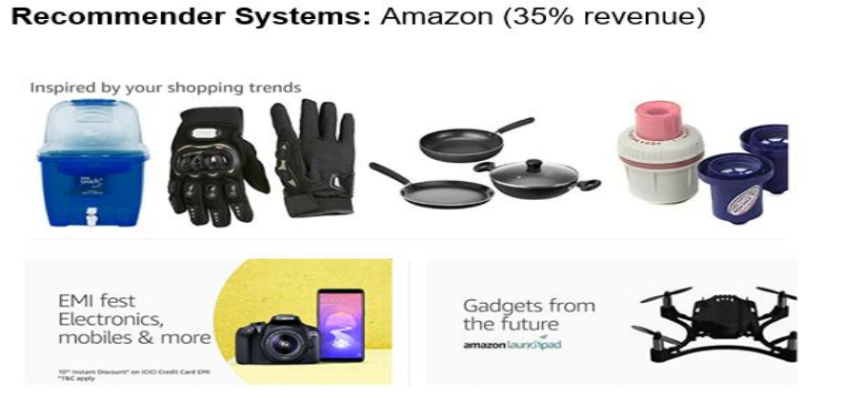
Applications/Examples
BITS Pilani, Pilani Campus

Slide 9
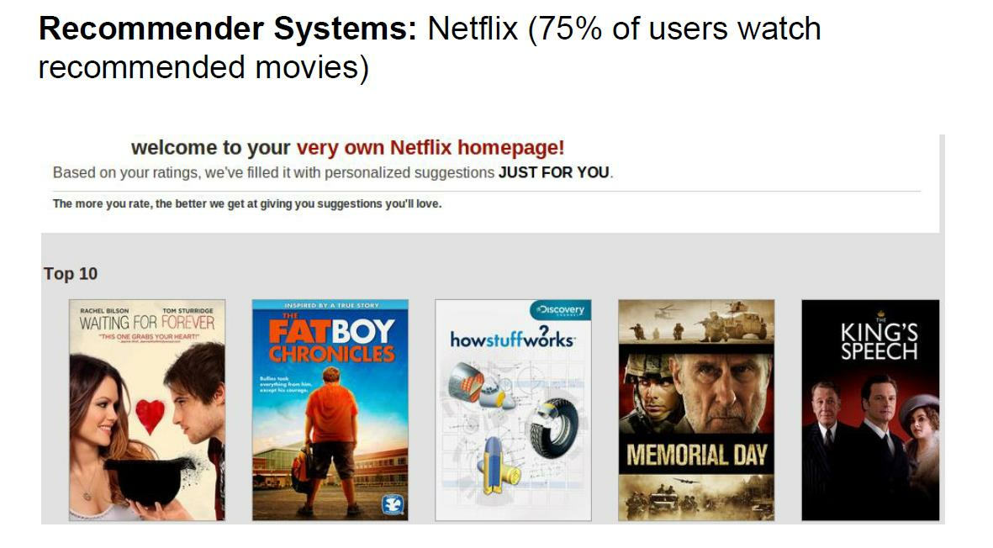
Applications/Examples
BITS Pilani, Pilani Campus

Slide 10
Applications/Examples
BITS Pilani, Pilani Campus

Slide 11
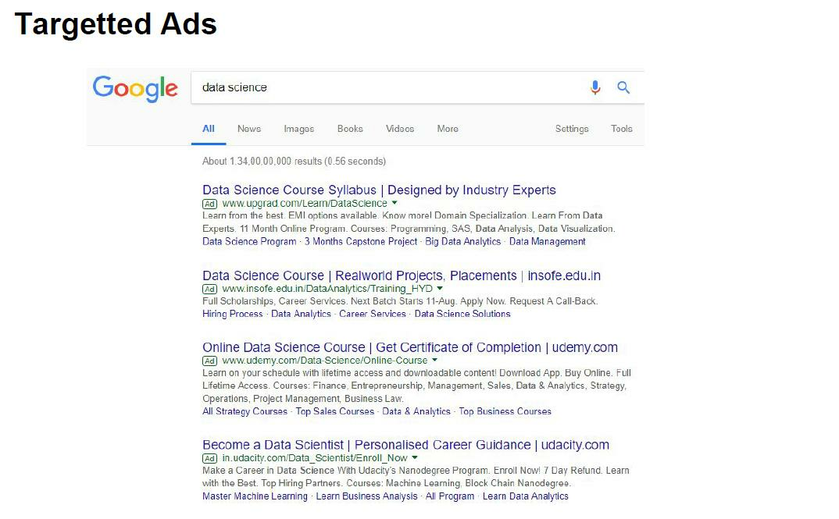
Applications/Examples
BITS Pilani, Pilani Campus

Slide 12
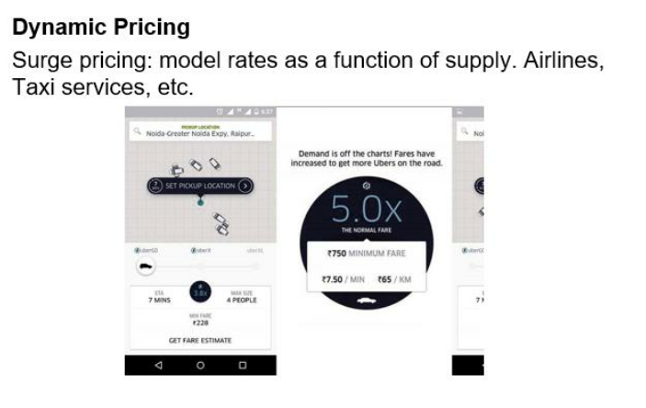
Applications/Examples
BITS Pilani, Pilani Campus

Slide 13
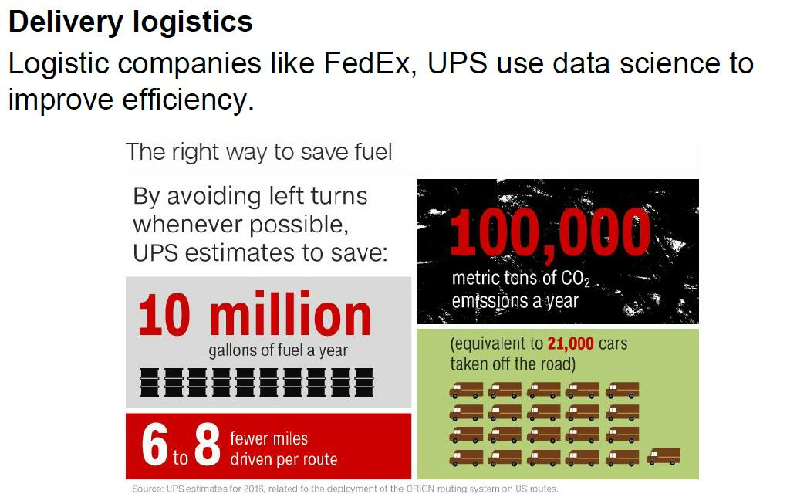
Applications/Examples
Traveler's Salesman Problem (TSP),
Vehicle routing Problem (VRP),
BITS Pilani, Pilani Campus

Slide 14
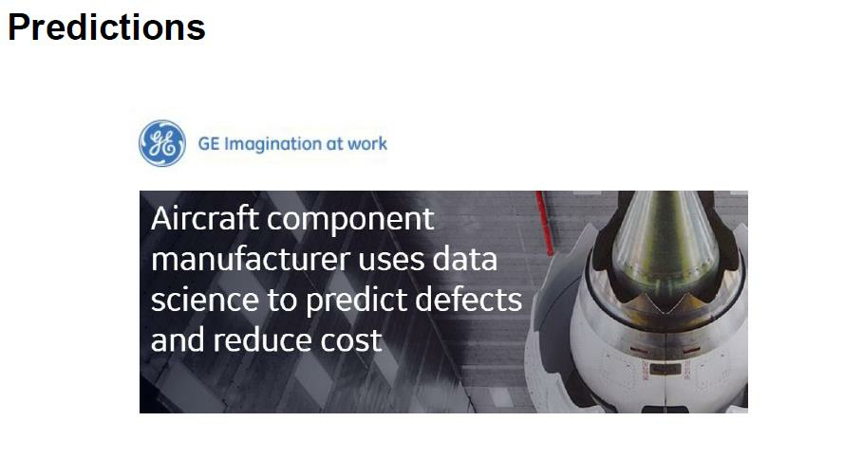
Applications/Examples
Smart Grids in IoT Network predict shelf-life of Transformers
Smart meters in IOT Network predict shelf life of meters
Prediction of HW faults in network
BITS Pilani, Pilani Campus

Slide 15

Applications/Examples
Loan Frauds/defaults
Credit Card frauds/defaults
Insurance Premium Prediction
Banking fraud detection
BITS Pilani, Pilani Campus

Slide 16

Applications/Examples
Preventive maintenance
Prediction of faults in network
Geo-location wise workforce management for fault support
Prediction of preventive maintenance life-cycle for network devices
Field Support Org cost reduction by improving First Time Right (FTR), reducing Site visits
BITS Pilani, Pilani Campus

Slide 17

Applications/Examples
Google maps
Free community using Google APIs for Geo-location, distance APIs etc. – source of data for Google maps
BITS Pilani, Pilani Campus

Slide 18
Common Applications of Data Science
Fraud & Risk Detection
Healthcare – Medical image analysis, genetics & genomics, drug development etc.
Internet Search – Knowledge Graphs (Semantic Networks) based on Resource Descriptive Framework RDF
Targeted Advertising – Facebook friends referral ads, Amazon past purchase based products ads, Google search based ads
Image Recognition – unlocking phone based on face; App which identifies object you point to; identifying celebrities in pictures; Invoice processing etc.
Speech recognition – voice recorders, human speech conversations Bots – ok google !!
Airline routing – Auto-pilot
Natural Language processing- document translation , chat bots
Augmented Reality – VR games, simulators/ training centers etc.

Slide 19
Motivational Examples of Data Science and AI
New AI Algorithm Can Now Guess What You Look Like Based Just On Your Voice https://www.analyticsindiamag.com/new-ai-algorithm-can-now-guess-what-you-look-like-based-just-on-your-voice/
How Machine Learning Can Eliminate The Emotional Aspect Of Investing Money https://www.analyticsindiamag.com/how-machine-learning-can-eliminate-the-emotional-aspect-of-investing-money/
How artificial intelligence changed the face of banking in India https://yourstory.com/2019/05/how-artificial-intelligence-changed-banking-sector
Machine Learning may help capture fusion energy on Earth https://odishatv.in/science/machine-learning-may-help-capture-fusion-energy-on-earth-371697
How artificial intelligence can slowly change the healthcare landscape https://yourstory.com/2019/05/how-artificial-intelligence-change-the-healthcare
Googles AI system better than humans at spotting lung cancer: Study https://www.business-standard.com/article/pti-stories/google-s-ai-system-better-than-humans-at-spotting-lung-cancer-study-119052100509_1.html
Machine learning overtakes humans in predicting death or heart attack https://medicalxpress.com/news/2019-05-machine-humans-death-heart.html
Machine learning could predict death or heart attack with over 90% accuracy: Study https://www.timesnownews.com/health/article/machine-learning-could-predict-death-or-heart-attack-with-over-90-accuracy-study/417593
Why machine learning could be the key to the future of gambling https://www.techradar.com/news/why-machine-learning-could-be-the-key-to-the-future-of-gambling

Slide 20
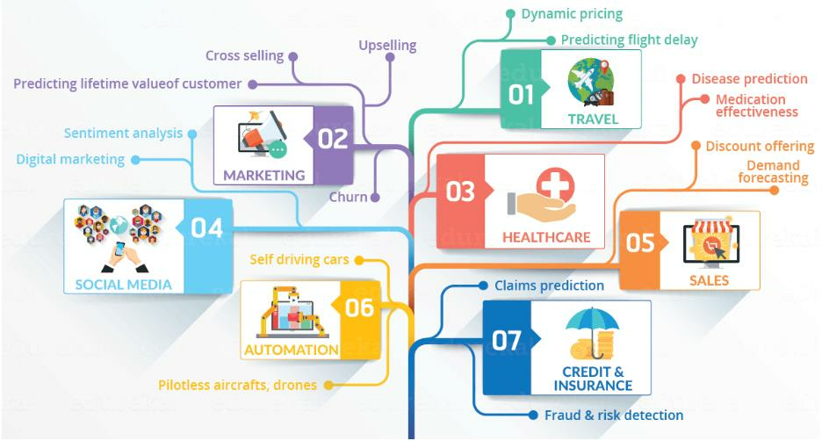
Data Science in Various Domains
14
BITS Pilani, Pilani Campus

Slide 21
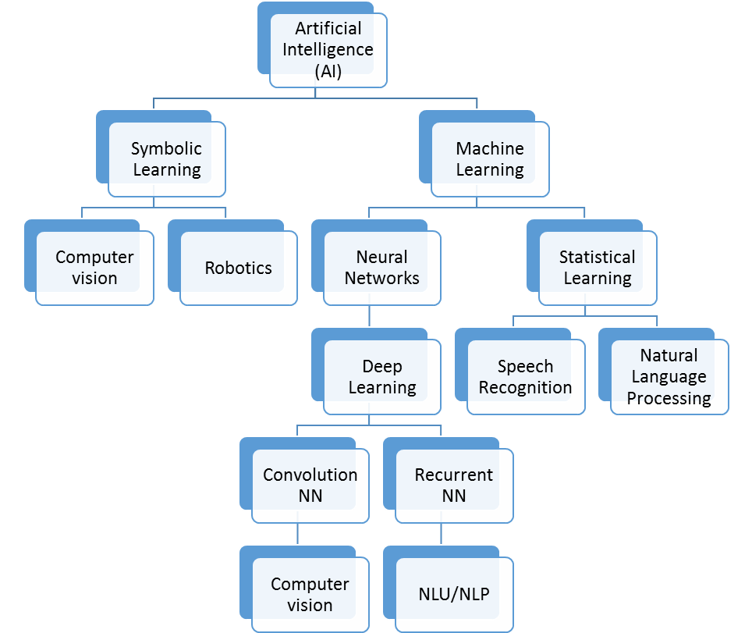
Evolution of Data Science to Artificial Intelligence
Artificial Intelligence
Machine Learning
Deep Learning
Data
Science

Slide 22
Machine Learning vs Data Science?
Machine
learning
and
statistics
both
are
part
of
data
science.
The
word learning in machine learning means that the algorithms depend on some
data, used as a training set, to fine-tune some model or algorithm parameters.
This encompasses many techniques such as regression, naive Bayes or
supervised clustering. But not all techniques fit in this category.
For instance, unsupervised clustering - a statistical and data science technique -
aims at detecting clusters and cluster structures without any a-priori knowledge or
training set to help the classification algorithm. A human being is needed to label
the clusters found. Some techniques are hybrid, such as semi-supervised
classification. Some pattern detection or density estimation techniques fit in this
category.
BITS Pilani, Pilani Campus

Slide 23
Machine Learning vs Data Science?
Data science is much more than machine learning though. Data, in data science,
may or may not come from a machine or mechanical process (survey data could
be manually collected, clinical trials involve a specific type of small data) and it
might have nothing to do with learning as I have just discussed. But the main
difference is the fact that data science covers the whole spectrum of data
processing, not just the algorithmic or statistical aspects. In particular, data
science also covers
•
data integration
•
distributed architecture
•
automating machine learning
•
data visualization
•
dashboards and BI
•
data engineering
•
deployment in production mode
•
automated, data-driven decisions
BITS Pilani, Pilani Campus

Slide 24
Data Science Vs. Statistics
The fields differ in their modeling processes, the size of their data, the types of problems studied, the background of the people in the field, and the language used. However, the fields are closely related. Ultimately, both statistics and data science aim to extract knowledge from data.
Reference Links –
https://www.educba.com/data-science-vs-statistics/
https://www.displayr.com/statistics-vs-data-science-whats-the-difference/
https://link.springer.com/article/10.1007/s42081-018-0009-3

Slide 25
Data Science Vs. Statistics
Comparison | Data Science | Statistics
1# Meaning | Data science is the business of learning from data, which is traditionally the business of statistics. Data science, is often understood as a broader, task-driven and computationally-oriented version of statistics; which is an inter-disciplinary area of scientific techniques. | Statistics is a mathematics branch, which also aims to provide methods for data representation, analysis & further evaluations.
2# Concept of models | Modelling process in data science is done by comparing the predictive accuracy of different machine learning methods, choosing the model which is most accurate. While data science focuses on comparing many methods to create the best machine learning model, statistics instead improves a single, simple model to best suit the data. | Statisticians take a different approach to building and testing their models. The starting point in statistics is usually a simple model (e.g., linear regression), and the data is checked to see if it consistent with the assumptions of that model. The model is improved by addressing any assumptions in the model that are violated.
3# Big Data | Data scientists often deal with huge databases - so big that they cannot be stored on a single computer. | Historically, the focus on statistics has been much more about what can be learned from very small quantities of data.
4# Types of problems | Data science problems often relate to making predictions and optimizing search of large databases. The end-goal of data science analysis is more often to do with a specific database or predictive model. | In contrast, the problems studied by statistics are more often focused on drawing conclusions about the world at large. The end-goal of statistical analysis is often to draw a conclusion about what causes what, based on the quantification of uncertainty.
5# Skillset & Language | Data scientists tend to come from engineering backgrounds. Language used – Machine learning, Feature engineering, Supervised learning, Labeling, one-hot coding | Statisticians are usually trained by math departments. Language used- Estimating, Classification, Covariate/predictor/independent variable; Response/output/dependent variable; dummy variable/indicator coding

Slide 26
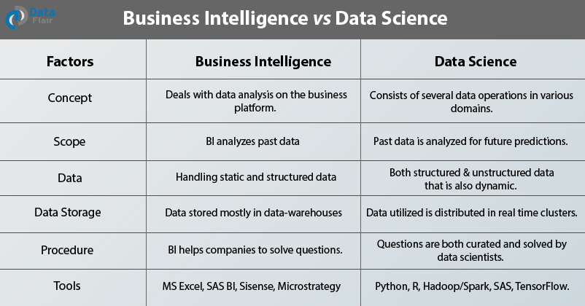
Data Science Vs. Business Intelligence (BI)

Slide 27
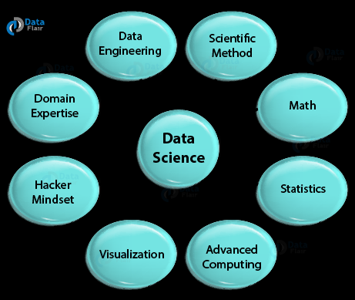
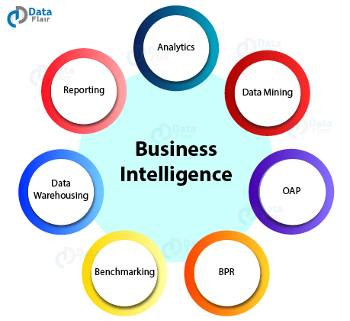
Data Science Vs. Business Intelligence (BI)
DATA SCIENCE
BUSINESS INTELLIGENCE

Slide 28
Data Science Vs. BI
References –
https://www.dataversity.net/data-science-vs-business-intelligence/#
https://towardsdatascience.com/data-science-vs-business-intelligence-same-but-completely-different-1d5900c9cc95
https://data-flair.training/blogs/business-intelligence-vs-data-science/
https://analyticsindiamag.com/business-intelligence-different-data-science/

Slide 29
Roles of Data Scientist
Key role of Data scientist is to define the data architecture i.e. rules, policies or standard that govern which data is collected, stored, arranged, integrated, and put to use in data systems.
Data Collection techniques – Interviews, Questionnaire/surveys, Observations/Transactions, Documents/records, Case studies
Data Management – DBMS -> Relational DBMS, NoSQL ( In memory, Columnar, key-value based, document based etc.)
Data Preparation – cleaning, organizing, combining, pruning, missing value handling, labelling data for visualizing data and applying machine learning
Data Analytics – Stream involves automating insights into certain data set, visualizing the results, uses queries & data aggregation procedures
Notes:
Difference between data vs information ? e.g. marks of students in a class is raw data; average score of class, top 5 percentile etc. is information
Data Preparation – R (readr, readcsv); Python (pandas, numpy) – ask for examples from audience, FSO data example

Slide 30
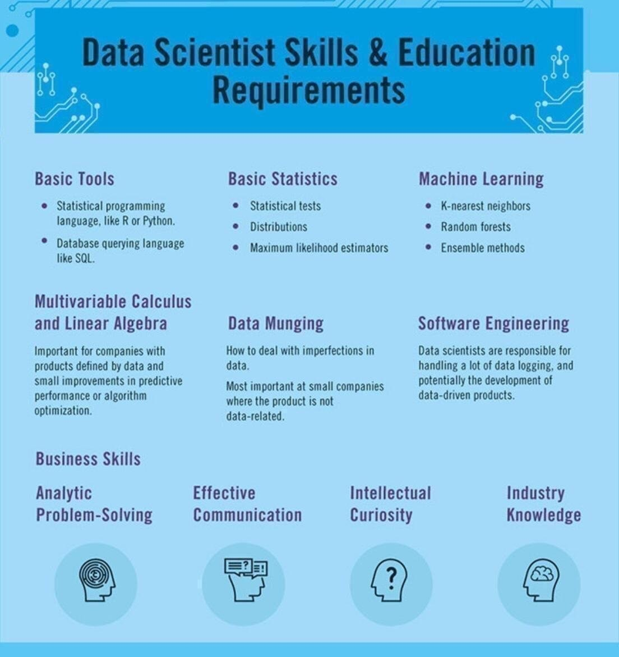
Skills Required – Data Scientist

Slide 31
Software Engineering for Data Science 1/
For data scientists, software is the generalization of a specific aspect of a data analysis. Software allows for the systematizing and the standardizing of a procedure, so that different people can use it and understand what it's doing, at any given time.
So if specific parts of a data analysis may require implementing or applying a number of procedures or tools together.
Software is the encompassing of all these tools into a specific module or procedure that can be repeatedly applied in a variety of settings
Software formalizes and abstracts the functionality of a set of procedures or tools, by developing a well defined interface to the analysis. So the software will have an interface, or a set of inputs and a set of outputs that are well understood.
So for example, most statistical packages will have a linear regression, a function which has a very well defined interface
There are basically three kind of levels of software –
1st level - Code that is encapsulating automation of a set of procedures. For example, a loop of some sort, never repeats an operation multiple times.
2nd level- Writing a function - which is used to encapsulate a set of instructions. And the key thing about a function is that you'll have to define some sort of interface, which will be the inputs to the function. And then the function may have a set of outputs or it may have some side effect for example, if it's a plotting function. Data Cleaning function, Missing Value handler etc.
Highest level is the actual software package - Which will often be a collection of functions or functions in other things. That will be a little bit more formal because there'll be a very specific interface or API that a user has to understand. And often for a software package there'll be a level of convenience features for users, like documentation, or examples, or tutorials that may come with it, to help the user, to kind of apply the software to many different settings
References –
https://towardsdatascience.com/data-science-is-becoming-software-engineering-53e31314939a
https://www.coursera.org/lecture/data-science-course/what-is-software-engineering-for-data-science-cmnBH
https://careerkarma.com/blog/data-science-vs-software-engineering/
Notes:
For data scientists, software is the generalization of a specific aspect of a data analysis. So if specific parts of a data analysis may require implementing or applying a number of procedures or tools together. Software is the encompassing of all these tools into a specific module or procedure that can be repeatedly applied in a variety of settings. So software allows for the systematizing and the standardizing of a procedure, so that different people can use it and understand what it's gonna do, at any given time. What software is useful for, is that it formalizes and abstracts the functionality of a set of procedures or tools, by developing a well defined interface to the analysis. So the software will have an interface, or a set of inputs and a set of outputs that are well understood.
So for example, most statistical packages will have a linear regression, a function which has a very well defined interface, usually. For example, you'll have to input things like the outcome and the set of predictors, and maybe there will be some other inputs like the data set or weights. But most linear regression functions kind of work in that way. And importantly the user does not have to know exactly how the linear regression calculation is done underneath the hood. Rather, they only need to know that they need to specify the outcome, the predictors, and a couple of other things. And so the linear regression function abstracts all the details that go on underneath, that are required to implement linear regression, so that the user can apply the tool in a variety of settings.
So there are basically three kind of levels of software that I can think about, going from kind of the simplest to the most abstract. And so at the first level you might just have some code that you wrote, and so this is really the first step towards encapsulating automation of a set of procedures. For example, you might have a loop of some sort, never repeats an operation multiple times. So this is the first tip. And then the next step might be some sort of function. So regardless of what language you may be using, often there will be some notion of a function, which is used to encapsulate a set of instructions. And the key thing about a function is that you'll have to define some sort of interface, which will be the inputs to the function. And then the function may have a set of outputs or it may have some side effect for example, if it's a plotting function. And then, so the user only needs to know those inputs and kind of what the outputs will be. And so this is kind of the first level of abstraction that you might encounter, where you have to actually define and interface to that function. And then the very highest level is the actual software package. Which will often be a collection of functions or functions in other things. That will be a little bit more formal because there'll be a very specific interface or API that a user has to understand. And often for a software package there'll be a level of convenience features for users, like documentation, or examples, or tutorials that may come with it, to help the user, to kind of apply the software to many different settings. So a full on software package will be most general in the sense that it should be applicable to kind of more than one setting. And maybe become more broadly useful to people. So, one question that you'll find yourself asking, is at what point do you need to systematize common tasks and procedures across projects versus, you know, recreating code or writing new code from scratch on every new project? Now it depends on a variety of factors and answering this question may require communication within your team, and with people outside of your team potentially. Because you may need to have an understanding of how often a given process is repeated, or how often a given type of data analysis is done, in order to weigh the costs and the benefits of kind of investing in either a software package or something like that. And so within your team, you may want to ask yourself, is the data analysis you're gonna do, is that something you're gonna build upon for future work, or is it just gonna be a one shot deal. Now in my experience, there are relatively few one shot deals out there. Often you will have to do a certain analysis or a certain type of analysis more than once, twice, or even three times. And at that point, it's usually often, you've kind of reached the threshold where you wanna write some code, write some software, or at least a function. So the point at which you need to systematize a given set of procedures, is probably gonna be sooner than you think it is. Because things will more likely be done more than once. Now the initial investment for developing more formal software will be higher, of course, but that will likely pay off in savings in time down the road. So my basic rule of thumb is that, if you're gonna do something once, that does happen on occasion, just write some code and document it very well. The important thing is that you wanna make sure that you understand what the code does, and so that requires both writing the code well and writing documentation. Cuz you wanna be able to reproduce it down the road, in case you ever come back to it, or in case someone else comes back to it, and needs to understand what was done. If you're gonna do something twice, write a function. This allows you to abstract a small piece of code, it forces you to define an interface, so you have well defined inputs and outputs. And that will allow for other people to access a given function and apply it to whatever situation they're in. And then if you're gonna do something three times or more, you should think about writing a small package. It doesn't have to be commercial level software. But a small package which encapsulates the set of operations that you're gonna be doing in a given analysis. And also write some real documentation so that people can understand what's supposed to be going on, and can apply the software to a different situation if they have to.
Explore our Catalog
Join for free and get personalized recommendations, updates and offers.
Get Started
Coursera

Slide 32
Software Engineering for Data Science 2/
Software Engineering was historically considered a different highly technical field as compared to Data Science, and while both have similar skill sets, there are big differences in the ways in which these skills are usually applied.
Differ in Methodologies – SDLC, Data Science Project Process (will study in session 2/3)
Differ in Objectives - Data science tends to be much more about analysis of data in practice to solve a business objective, with some aspects of programming and development thrown in. Software engineering, on the other hand, tends to focus on creating systems and software that is user-friendly and that serves a specific purpose.
Differ in Approaches - Data science is a very process-oriented field. Its practitioners ingest and analyze data sets in order to better understand a problem and arrive at a solution. Software engineering, on the other hand, is more likely to approach tasks with existing frameworks and methodologies.
Differ in Tools - A data scientist’s wheelhouse contains tools for data analytics, data visualization, working with databases, machine learning, and predictive modeling. using Amazon S3, MongoDB, Hadoop, MySQL, Postgresql, or something similar. For model building, there’s a good chance they’ll be working with Statsmodels or Scikit-learn. Distributed processing of big data requires Apache Spark. A software engineer utilizes tools for software design and analysis, software testing, programming languages, web application tools, and much more.

Slide 33
Software Engineering for Data Science 3/
Data science is becoming software engineering
In data science over the last few years, perhaps the most significant and hardest to ignore has been the increased focus on deployment and productionization of models.
The skill sets of software engineers and data scientists are converging, at least when it comes to product-facing data science applications, like building recommender systems. Data scientists are being asked to take care of deployment and productionization, and software engineers are being asked to expand their skill set to include modeling.
Historically, data science and software engineering weren’t nearly as closely integrated as they are today.
Feature Engineering which was manually done in machine learning approaches by data scientists; that is being automatically done by Deep Learning models coded in SWs (Tensorflow, Pytorch libraries)
One aspect of data science that’s often over-emphasized is model tuning. It’s very rare that your focus as a data scientist will be on making a model 1% better; typically it’s much more important to get a “good enough” model out the door and in front of users, which is why software engineering and deployment skills are increasingly growing in importance over model tuning.
2 Types of Data Science Projects
Building Data science process libraries, models, frameworks, creating algorithms
Building Services & products that use Data science libraries& solve a business problem

Slide 34
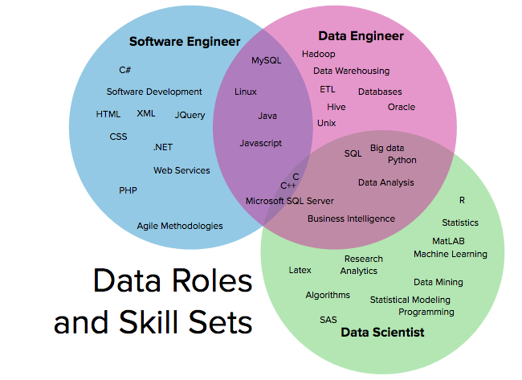
Skills Venn diagram

Slide 35
Data Scientist Toolbox
Programming Languages -R, Python, SQL, Matlab
Data Science Libraries/ frameworks – Tensorflow, Pytorch, Scikit-learn, plotlib
Data Handling Tools – RDBMS ( MYSQL, PostGres, Microsoft SQL Server, Oracle DB), NOSQL DB(MongoDB, Cassandra, HBASE), Big Data Technologies (HADOOP, SPARK, HIVE)
Analytics Modelling Tools – SAS, SPSS, Cloud-Based AI/ML Interfaces (AWS, GCP, Azure)
Reference
https://www.coursera.org/learn/data-scientists-tools

Slide 36
Ethics for Data Science
Ethics for different stages in Data Science projects –
Project Selection & Scoping - Is data science the right tool for the job/problem being solved?
Pursuing a data science project can mean pulling resources away from other initiatives that could have a greater impact. It’s important to recognize when this is not the case and resources are better directed elsewhere.
Building the Team - Does the team include and/or consider individuals and institutions who will ultimately be affected by the tool?
They should engage members of their target communities along with data scientists
Data Collection
Does collecting data impede on anyone’s privacy?
Were the systems and processes used to collect the data biased against any groups?
Data analytics
What bias is the team introducing? (dependent variable selection)
Should the team include features that could be discriminatory? Features such as race, gender, or income
Is the analysis sufficiently transparent? Machine learning models can be opaque, particularly around what variables are driving predictions
Implementation
Are the people using models aware of its shortcomings?
What are the consequences of not acting on false negatives (and acting on false positives)?
Notes:
Facebook controversial emotion experiment
Tay was an artificial intelligence chatter bot that was originally released by Microsoft Corporation via Twitter on March 23, 2016; it caused subsequent controversy when the bot began to post inflammatory and offensive tweets through its Twitter account, forcing Microsoft to shut down the service only 16 hours after its launch

Slide 37
Data Science Challenges/ Concerns
Identifying the problem
One of the major steps in analyzing a problem and designing a solution is to first figure out the problem properly and define each aspect of it. Many times Data scientists opt for a mechanical approach and start working on data sets and tools without a clear definition of the business problem or the client requirement.
Access to right data – Data quantity
For right analysis, it is very important to lay the hands on the right kind of data. Gaining access to a variety of data in the most appropriate format is quite difficult as well as time-consuming. There could be issues ranging from hidden data, insufficient volume of data or less variety in the kind of data. Data could be spread unevenly across various lines of business so getting permission to access that data can also pose a challenge.
Data Cleansing – Data quality
According to a study by MIT, Big Data has begun to cost companies up to 25% of possible revenue because cleansing bad data is eroding operating expenses.
Lack of domain expertise
Data Scientists also need to have sound domain knowledge and gain subject matter expertise. One of the biggest challenges faced by data scientists is to apply domain knowledge to business solutions. Data scientists are a bridge between the IT department and the top management.
Data security issues
Since data is extracted through a lot of interconnected channels, social media as well as other nodes, there is increased vulnerability of hacker attacks. Due to the confidentiality element of data, Data scientists are facing obstacles in data extraction, usage, building models or algorithms. The process of obtaining consent from users is causing a major delay in turnaround time and cost overruns.

Slide 38
References
Data collection
https://www.slideshare.net/priyansakthi/methods-of-data-collection-16037781;
https://research-methodology.net/research-methods/quantitative-research/;
https://cyfar.org/data-collection-techniques
Data Management
https://searchsqlserver.techtarget.com/definition/database-management-system
https://www.stoodnt.com/blog/data-engineer-vs-data-scientist/
https://www.dataspace.com/big-data-strategy/so-what-is-the-difference-between-a-programmer-and-a-data-scientist/
Data Preparation
https://searchbusinessanalytics.techtarget.com/definition/data-preparation
https://www.dataquest.io/blog/python-vs-r/
https://www.kdnuggets.com/2017/06/7-steps-mastering-data-preparation-python.html
Data Analytics
https://www.simplilearn.com/data-science-vs-big-data-vs-data-analytics-article
https://searchdatamanagement.techtarget.com/definition/data-analytics
Data analytics Ethics
https://www.coursera.org/learn/data-science-ethics
https://dssg.uchicago.edu/2015/09/18/an-ethical-checklist-for-data-science/
Data analytics Challenges/ Concerns
https://www.forbes.com/sites/laurencebradford/2018/09/06/8-real-challenges-data-scientists-face/#7105dced6d99
https://www.proschoolonline.com/blog/challenges-faced-by-data-scientists
https://www.analyticsinsight.net/what-are-the-major-challenges-faced-by-data-scientists/

Slide 39
Appendix
Additional Slides

Slide 40
Network Function Virtualization: Background

Slide 41
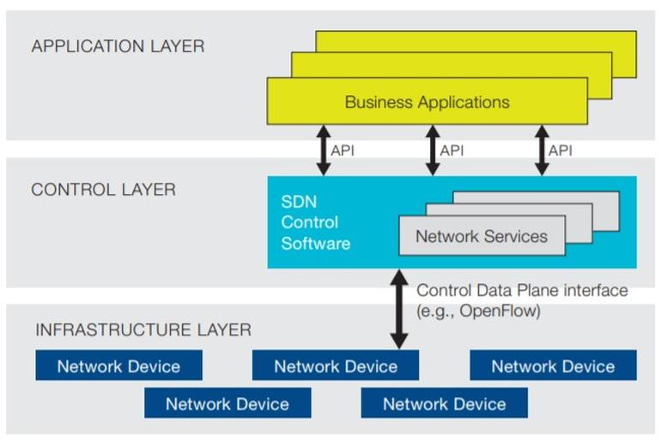
SDN Architecture / Layers
Image Source: Open Networking Foundation

Slide 42
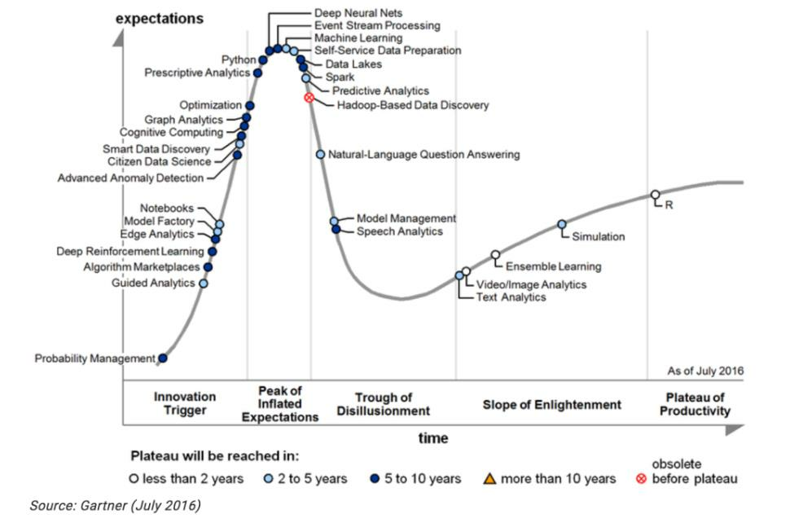
Era of Data Science
BITS Pilani, Pilani Campus

Slide 43
Data Analytics
Lecture – 2
Sumita Narang

Slide 44
Objectives
Defining Analytics
Types of data analytics
Descriptive, Diagnostic
Predictive, Prescriptive
Data Analytics – methodologies
CRISP-DM Methodology
SEMMA
BIG DATA LIFE CYCLE
SMAM
Analytics Capacity Building
Challenges in Data-driven decision making

Slide 45








What is Analytics?
Which car should I buy?
Good? Or Evil?
Doctor: What medical
treatment should I recommend?
What route should I follow today?
What grades can I expect in this course?

Slide 46
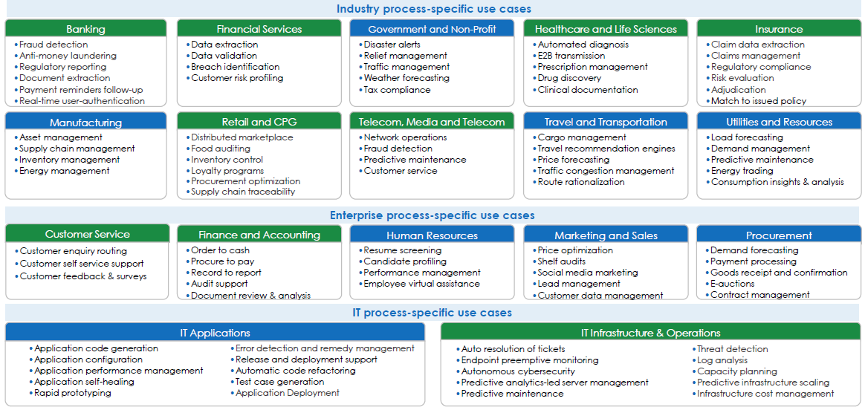
Analytics is all around us….
Source: Avasant Research

Slide 47
What is data analytics
Data or information is in raw format. The increase in size of the data has lead to a rise in need for carrying out inspection, data cleaning, transformation as well as data modeling to gain insights from the data in order to derive conclusions for better decision making process. This process is known as data analysis.
Data Mining is a popular type of data analysis technique to carry out data modeling as well as knowledge discovery that is geared towards predictive purposes.
Business Intelligence operations provide various data analysis capabilities that rely on data aggregation as well as focus on the domain expertise of businesses. In Statistical applications, business analytics can be divided into Exploratory Data Analysis (EDA) and Confirmatory Data Analysis (CDA).

Slide 48
Data Analytics – Sub Streams
Streams Business Analytics – BI (business intelligence), OLAP(online analytical processing) – offline analytic techniques with well defined business objectives
Data Mining - process of sorting through large data sets to identify patterns and establish relationships to solve problems through data analysis.
Real-time Analytics - use of, or the capacity to use, data and related resources as soon as the data enters the system
PIM – Processing in memory: A chip architecture in which the processor is integrated into a memory chip to reduce latency
In-database analytics - a technology that allows data processing to be conducted within the database by building analytic logic into the database itself
In-memory analytics - an approach to querying data when it resides in random access memory (RAM), as opposed to querying data that is stored on physical disks (e.g. Apache Spark)
Massively parallel programming (MPP) -- the coordinated processing of a program by multiple processors that work on different parts of the program, with each processor using its own operating system and memory.
Predictive Analytics - a form of advanced analytics that uses both new and historical data to forecast activity, behavior and trends. It involves applying statistical analysis techniques, analytical queries and automated machine learning algorithms to data sets to create predictive models that place a numerical value -- or score -- on the likelihood of a particular event happening
Text analytics - statistical, linguistic and structural techniques are applied to extract and classify information from textual sources, a species of unstructured data.

Slide 49
Data Analytics
:Business Analytics Types
EDA (Exploratory Data analytics) - aims to find patterns and relationships in data
Business Analytics
Real-time Analytics
Data Mining
CDA (Confirmatory Data analytics) - applies statistical techniques to determine whether hypotheses about a data set are true or false
Predictive Analytics

Slide 50
Data Analytics vs. Data Reporting
Data Analytics
Interactive process of a person tackling a problem, finding the data required to get an answer, analyzing that data, and interpreting the results in order to provide a recommendation for action
Data Reporting
Reporting refers to the process of organizing and summarizing data in an easily readable format to communicate important information.
A report will show the user what had happened in the past to avoid inferences and help to get a feel for the data while analysis provides answers to any question or issue. An analysis process takes any steps needed to get the answers to those questions.
Reporting just provides the data that is asked for while analysis provides the information or the answer that is needed actually.
We perform the reporting in a standardized way, but we can customize the analysis. There are fixed standard formats for reporting while we perform the analysis as per the requirement; we customize it as needed.
We can perform reporting using a tool and it generally does not involve any person in the analysis. Whereas, a person is there for doing analysis and leading the complete analysis process.
Reporting is inflexible while analysis is flexible. Reporting provides no or limited context about what’s happening in the data and hence is inflexible while analysis emphasizes data points that are significant, unique, or special, and it explains why they are important to the business.

Slide 51
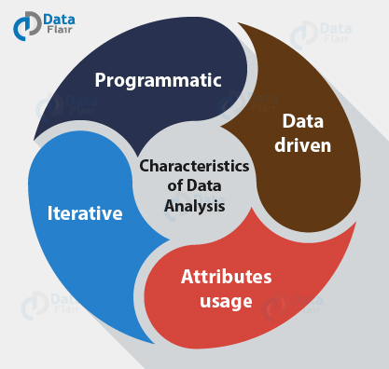
Characteristics of Data Analysis
Programmatic: There might be a need to write a program for data analysis by using code to manipulate it or do any kind of exploration because of the scale of the data.
Data-driven: A lot of data scientists depend on a hypothesis-driven approach to data analysis. For appropriate data analysis, one can also avail the data to foster analysis. This can be of significant advantage when there is a large amount of data. For example – machine learning approaches can be used in place of hypothetical analysis.
Attributes usage: For proper and accurate analysis of data, it can use a lot of attributes. In the past, analysts dealt with hundreds of attributes or characteristics of the data source. With Big Data, there are now thousands of attributes and millions of observations.
4. Iterative: As whole data is broken into samples and samples are then analyzed, therefore data analytics can be iterative in nature. Better compute power enables iteration of the models until data analysts are satisfied. This has led to the development of new applications designed for addressing analysis requirements and time frames.

Slide 52
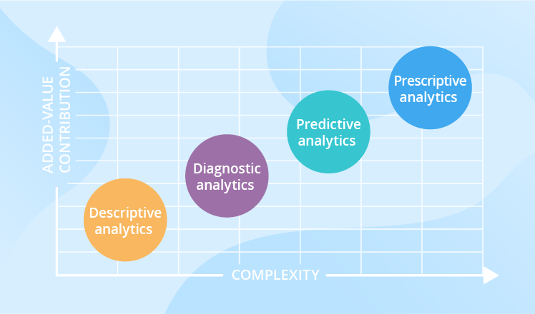
Types of Data Analytics

Slide 53
Types of Data Analytics
Descriptive Analytics
Answers “what happened”
Juggles raw data from multiple data sources to give valuable insights into the past
Signals that something is wrong or right, without explaining why
Diagnostic Analytics
Answers “why something happened”
Find out dependencies and identify patterns
Tries to find root cause why something went right or wrong
Predictive Analytics
Tells “what’s likely to happen”
Tool for forecasting
Predicts or forecast what is likely to happened in future
Prescriptive Analytics
Prescribe what action to take to eliminate a future problem or take full advantage of a promising trend
Uses advanced tools and technologies, like machine learning, business rules and algorithms, which makes it sophisticated to implement and manage.

Slide 54
Applications – Descriptive Analytics
Telecom company finding current trend of MLP customers
Telecom company finding number of site visits for tickets
Healthcare provider learns how many patients were hospitalized last month
Retailer – the average weekly sales volume
Manufacturer – a rate of the products returned for a past month, etc.
A placement agency – number of candidates being placed to top companies, candidates actually joining, candidates who accept but do not join etc.
Consultancy firm – Doing salary analysis of different work streams, stages, industries

Slide 55
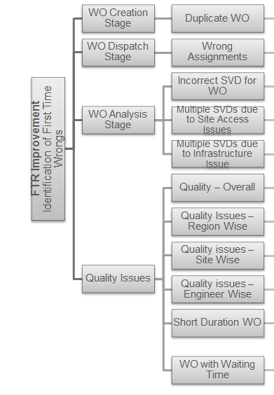
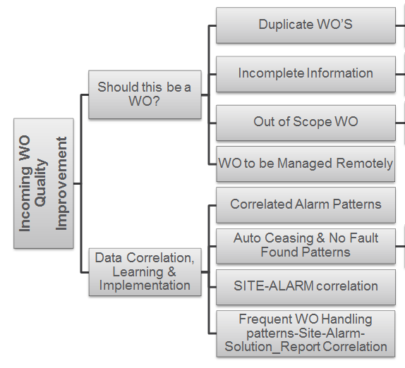
Application - Diagnostic Analytics
FSO analytics example –
Business Objective fro FSO Department: Target for 5 top clients in India, Europe, South Africa and Costa Rica Markets
FTR (Frist Time Right) Improvement by 2%
Improve incoming WO Quality by 5%

Slide 56
Industry Use Cases for Predictive/Prescriptive Analytics: Summary View
Domains | Technique/ Approach / Methodology
 |  | Knowledge Graphs | Neural Networks/ Deep Learning | Natural Language Processing (NLP) | Optimization Algorithms | Image Processing / Computer Vision / Object Recognition | Social Network Analysis
 | Transportation
 | Legal
 | Finance
 | Energy
 | Telecom
 | Logistics
 | Healthcare
 | Sales
 | Security

Slide 57
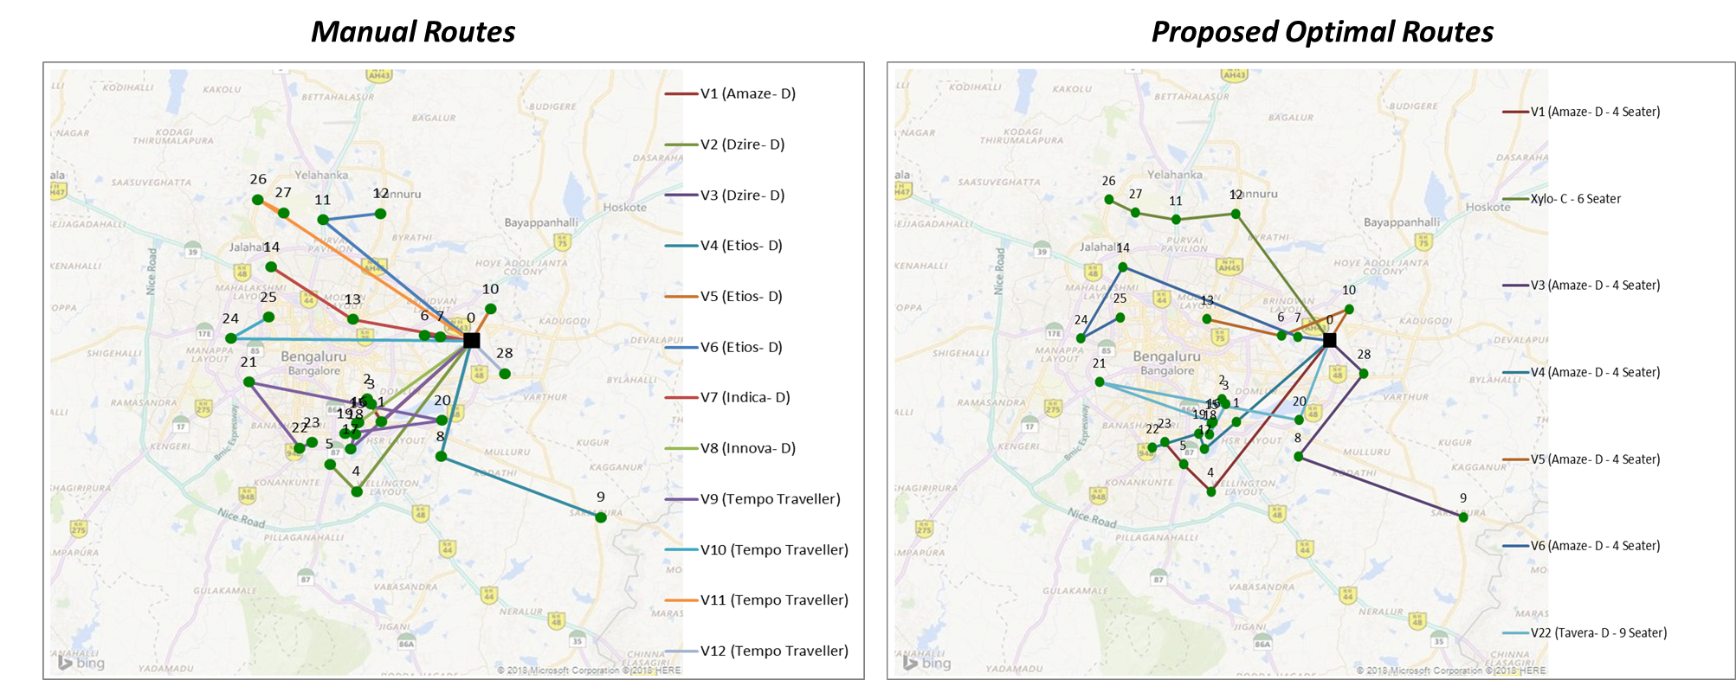
<Transportation/ Logistics><Optimization Algorithms>
Problem Statement
ABC Organization allows employees to request cab service for scheduled time slots, having well-defined drop/pick up locations
Services team manually creates routes for the given requests, which are often sub-optimal
Solution Approach
Used Large Neighborhood Search (LNS) – AI Search Metaheuristic
Constraints built into LNS as Rules
Solution Benefits
Overall Cost Optimization (Fuel, Security) and Travel Time Optimization
No tedious manual planning required; more time window for user requests
Time | Date | Savings | Total No. of Customers | No. of Manual routes | No. of proposed routes | Vehicles used in manual routes | Vehicles used in optimized routes
7:00 PM | 1/19/2018 | 56% | 28 | 12 | 7 | 1 Amaze- D, 2 Dzire D, 3 Etios D,1 Indica D,1 Innova D, 4 Tempo Traveller | 6 Amaze D 4 seater, 1 Tavera D 9 Seater
Notes:
Intelligent Traffic Management – e.g. CMU V2V traffic management system
Logistics – Delivery Route

Slide 58
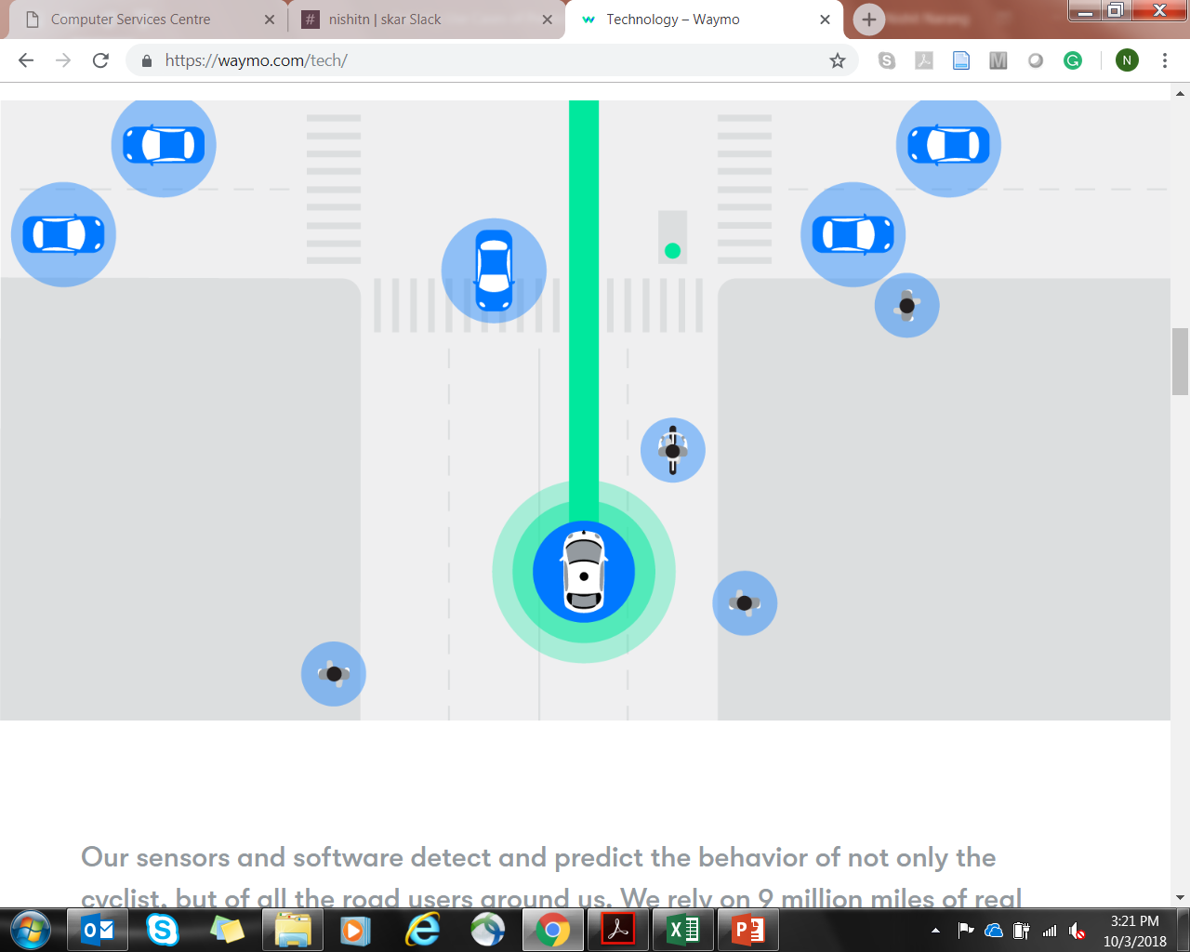
<Transportation><Computer Vision/ Object Recognition>
Problem Statement
94% or more fatalities on road happen due to human error while driving
Solution Approach
Computer Vision/ Object Recognition methods to detect pedestrians, cyclists, vehicles, road construction/repair and other events (like road signs, indicators, arm-signals)
Huge volumes of Training data from real world traffic for Predictive Algorithm tuning
Solution Benefits
Reduced fatalities due to human error, drunken driving and distractions (e.g. mobile phone calls)
Image Source: Waymo

Slide 59
<Sales><Knowledge Graphs + NLP>
Problem Statement
Group company formed via multiple acquisitions (Holding Organization)
Information about Clients, Customer Projects, Skills, Expertise distributed across multiple repositories, not easily accessible by the Client/Sales Teams
Lack of knowledge about relevant sales material leading to weaker sales pitch
Solution Approach
NLP-powered Knowledge Management System for easy access of information across divisions of the group company
Information stored as Knowledge Graphs
Efficient Search Engine based on techniques used for Internet search
Solution Benefits
Stronger sales pitch with information relevant for prospective customer/ project leading to better conversion rates
Notes:
Also, Text Analysis

Slide 60
<Telecom><Social Network Analysis>
Problem Statement
With Telecom saturation in many markets, focus changing from customer acquisition to customer retention. Telecom service providers need to control churn to maintain profitability
Existing churn prediction systems based on individual calling patterns not efficient
Solution Approach
Proposed approach uses Social Network Analysis for churn prediction (predict future churners based on direct & indirect interactions with past churners)
Diffusion-based Spreading Activation Algorithm
Start with the churners and their social relationships from the call graph
Initiate a diffusion process with the churners as seeds
Churners influence their neighbors to churn. Influence determined by strength of relationship
At end of the diffusion process examine influence on the non churners
Solution Benefits
Early prediction on possible churners who need to be retained before they churn
Source: IBM India Research Lab

Slide 61
<Healthcare><Deep Learning>
Problem Statement
Living in an age of stress, running against time all the while
WHO estimates 18.1% of adults in the U.S. have experienced an anxiety disorder
In India, about 450 million people suffer from mental or behavioral disorder.
In India, the total number of people living with depression is over 56 million, about 4.5% of total population (2015), and another 38 million suffers from anxiety disorders
Solution Approach
A wearable device that extract’s data of your mind in meditative, moving, resting or sleeping states
64 pieces of information extracted and processed to provide useful insights about the state of your mind and overall mental health
Trained model developed by Data Scientists and Neurologists using medical data of existing patients
Real-time tips and guidance to reduce stress and anxiety offered
Solution Benefits
Better tracking of mental health and cultivation of practices that lead to reduced anxiety and stress
Notes:
Also, Epidemic Early Warning System and ICU monitoring

Slide 62



<Telecom><SVM + Learning Algorithms>
Problem Statement
Requirement to reduce Field Support costs for Tier-1 Telecom OEM’s operations/support team
First Time Right (FTR) found to be low (30% to 60% across regions), leading to higher # of field visits
Solution Approach
Categorization of historical data on field visits (Duplicate issues, Wrong Assignments, Site Visit Not Required, Site Access Restrictions, Fix Quality)
Algorithms and Rule-sets to create a learning model. SVM based Prediction to categorize new incoming faults
Solution Benefits
Advisory inputs for each incoming fault reported to avoid repeated field visits and increased FTR %
Data Sampling
Creation of multiple smaller chunks of data-sets
Technology Used-SQL
1.
2.
Data Churning
Identification of dependent and independent variables in data
Relevance of data fields & Variation of values
Completeness & correctness of values in data fields
Technology used – R, SQL, Excel
3.
Build Business Logic
Data Modelling using statistical techniques
Identify relationships between variables
Build algorithm with business logic to derive dependent variables in terms of independent variables
Implement the business logic to run on complete data set
Technology Used- SQL , C#
Technology used – R, SQL

Slide 63


<Energy><Computer Vision/ Image Processing/ Object Recognition>
Problem Statement
Focus on Renewables Energy Market – Solar Energy farms being setup behind the meter
Higher cost of infrastructure needs to be offset by higher energy production to reduce per unit cost of energy
Solution Approach
Better design for solar plant leading to higher production efficiencies
Drone-based site surveys (video and image feeds) to avoid manual site visits
Computer vision based Design Software to design solar plant layout (Solar PVs)
SVM / Linear Regression based Predictive Analytics using Weather Forecast Data
Solution Benefits
Upto 25% higher energy production from the same infrastructure, reducing per unit cost of energy
Early indication of Energy Production for efficiency in Energy Trading & Storage

Slide 64

<Sales><NLP+ Knowledge Graphs>
Problem Statement
E-Commerce firm spending a lot of cost on post-order customer support/ queries
Requirement to maintain round-the-clock customer support center with Multi-lingual executives
Solution Approach
NLP-powered Chatbots and Voicebots to provide on-chat and on-call customer support
Support for English and multiple other Indian languages
Handover to human executive only for the cases that cannot be handled by Bots
Solution Benefits
Reduction in customer support costs by upto 30%
Source: Litifer

Slide 65
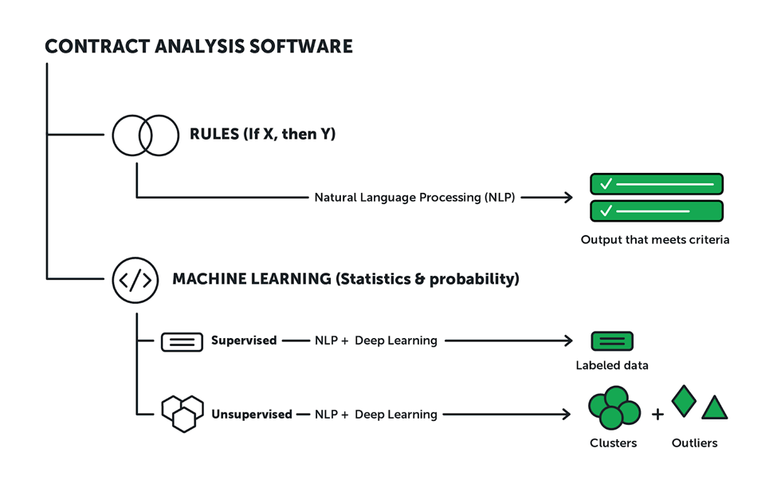
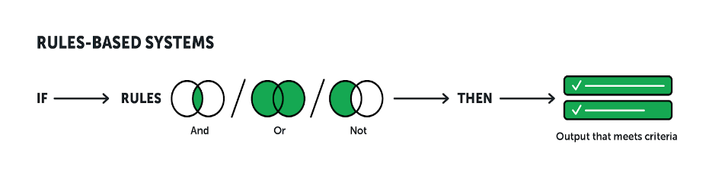
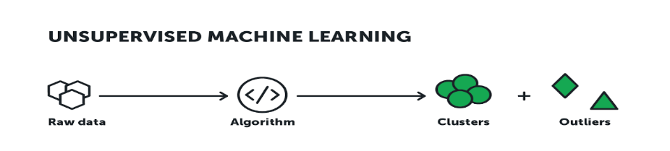
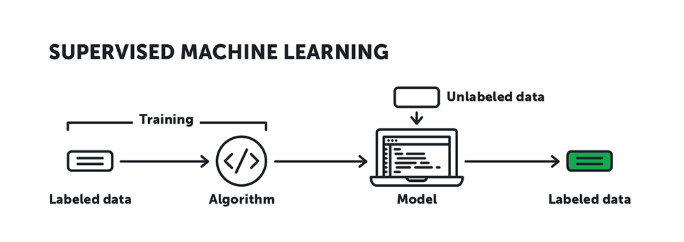
<Legal><NLP, Computer Vision & Deep Learning>
Problem Statement
Longer and error prone process for Contract Review and Due Diligence
Requirement of Legal experts and a significantly large Legal Team
Solution Approach
Using LegalTech, an AI-based solution. Two categories of solutions:
Systems that apply predetermined rules
Systems that learn by training themselves
Solution Benefits
Less overhead costs of Business
Faster contract processing time

Slide 66
<Finance><Neural Networks / Deep Learning>
Problem Statement
Stock market portfolio selection to maximize expected return, while minimizing risk
Solution Approach
Implement Markowitz’s Modern Portfolio Theory:
Stock Price prediction using Deep Learning models using TensorFlow
Portfolio weights for different stocks calculated using Logistic Regression technique
Risk computed by calculating Standard Deviation on historical data
Use of Long short-term memory (LSTM) networks, which are special kind of Recurrent Neural Network (RNN) capable of learning long-term dependencies
Solution Benefits
Optimized Risk-Reward Trade-off & Effective Portfolio Management
Notes:
Other use cases include Fraud Detection and Prevention

Slide 67



<Security><Computer Vision/ Image Processing/ Object Recognition>
Problem Statement
Security staff required round-the-clock to monitor CCTV footages from multiple cameras
Incidents / Security lapses getting missed and not reported
Solution Approach
Automated monitoring of all live CCTV feeds from multiple cameras
Configurable list of events/ incidents that need to be watched and/or reported
Conversion of detailed feeds into highlights for quick “end-of-day” watch
Solution Benefits
Better incident reporting and reduced manual monitoring required

Slide 68
Analytics Terminology
https://marketing.adobe.com/resources/help/en_US/reference/glossary.html
https://analyticstraining.com/analytics-terminology/
https://blog.hubspot.com/marketing/hubspot-google-analytics-glossary

Slide 69
Skills Required for Data Analyst
Technical skills for data analytics:
Packages and Statistical methods
BI Platform and Data Warehousing
Base design of data
Data Visualization and munging
Reporting methods
Knowledge of Hadoop and MapReduce
Data Mining
Business Skills Data analytics:
Effective communication skills
Creative thinking
Industry knowledge
Analytic problem solving

Slide 70
Tools in Data Analytics – Paid Tools
SAS: SAS is a software suite that can mine, alter, manage and retrieve data from a variety of sources and perform statistical analysis on it. SAS provides a graphical point-and-click user interface for non-technical users and more advanced options through the SAS programming language. SAS programs have a DATA step, which retrieves and manipulates data, usually creating a SAS data set, and a PROC step, which analyses the data.
WPS: WPS can use programs written in the language of SAS without the need for translating them into any other language. In this regard WPS is compatible with the SAS system. WPS is a language interpreter able to process the language of SAS and produce similar results. It is sometimes used as an alternative to SAS as it is relatively cheaper.
MS Excel: Microsoft Excel is a spreadsheet application developed by Microsoft for Microsoft Windows and Mac OS. It features calculation, graphing tools, pivot tables, and a macro programming language called Visual Basic for Applications. It has been a very widely applied spreadsheet for these platforms, especially since version 5 in 1993, and it has replaced Lotus 1-2-3 as the industry standard for spreadsheets. Excel forms part of Microsoft Office

Slide 71
Tools in Data Analytics – Paid Tools contd..
Tableau: Tableau Software is an American computer software company headquartered in Seattle, Washington. It produces a family of interactive data visualization products focused on business intelligence. Tableau offers five main products: Tableau Desktop, Tableau Server, Tableau Online, Tableau Reader and Tableau Public.
Pentaho: Pentaho is a company that offers Pentaho Business Analytics, a suite of open source Business Intelligence (BI) products which provide data integration, OLAP services, reporting, dash boarding, data mining and ETL capabilities. Pentaho was founded in 2004 by five founders and is headquartered in Orlando, FL, USA. The Pentaho suite consists of two offerings, an enterprise and community edition. The enterprise edition contains extra features not found in the community edition.
Statistica: STATISTICA is a statistics and analytics software package developed by StatSoft. STATISTICA provides data analysis, data management, statistics, data mining, and data visualization procedures. STATISTICA product categories include Enterprise (for use across a site or organization), Web-Based (for use with a server and web browser), Concurrent Network Desktop, and Single-User Desktop.

Slide 72
Tools in Data Analytics – Paid Tools contd..
Qlikview : Qlikview is a business intelligence software from Qlik. It helps its users understand the business in a better way by providing them features like consolidating relevant data from multiple sources, exploring the various associations in the data, enabling social decision making through secure, real-time collaboration etc.
KISSmetrics : KISSmetrics is a person-based analytics product that helps users identify, understand, and improve the metrics that drive their online business. They make it simple to get the information users need to make better product and marketing decisions.

Slide 73
Tools in Data Analytics – Paid Tools contd..
WeKa :The Weka workbench contains a collection of visualization tools and algorithms for data analysis and predictive modelling, together with graphical user interfaces for easy access to this functionality. The original non-Java version of Weka was a TCL/TK front-end to (mostly third-party) modelling algorithms implemented in other programming languages, plus data pre-processing utilities in C, and a Make file-based system for running machine learning experiments. This original version was primarily designed as a tool for analysing data from agricultural domains, but the more recent fully Java-based version (Weka 3), for which development started in 1997, is now used in many different application areas, in particular for educational purposes and research.
BigML: BigML is a Corvallis, Ore.based startup with a SaaS-based machine learning platform that allows everyday business users to create actionable predictive models within minutes.

Slide 74
Tools in Data Analytics – Free Tools
R : R provides a wide variety of statistical and graphical techniques, including linear and nonlinear modelling, classical statistical tests, time-series analysis, classification, clustering, and others. R is easily extensible through functions and extensions, and the R community is noted for its active contributions in terms of packages. There are some important differences, but much code written for S runs unaltered. Many of R's standard functions are written in R itself, which makes it easy for users to follow the algorithmic choices made. For computationally intensive tasks, C, C++, and FORTRAN code can be linked and called at run time. Advanced users can write C, C++, Java or Python code to manipulate R objects directly.
Google Analytics: Google Analytics is a service offered by Google that generates detailed statistics about a website's traffic and traffic sources and measures conversions and sales. The product is aimed at marketers as opposed to webmasters and technologists from which the industry of web analytics originally grew. It's the most widely used website statistics service

Slide 75
Tools in Data Analytics – Free Tools contd..
Python Pandas (python data analysis library) is an open source, BSD-licensed library providing high-performance, easy-to-use data structures and data analysis tools for the Python programming language. It provides tools for reading and writing data between in-memory data structures and different formats: CSV and text files, Microsoft Excel, SQL databases, and the fast HDF5 format and also intelligent data alignment and integrated handling of missing data: gain automatic label-based alignment in computations and easily manipulate messy data into an orderly form can be done using python
Spotfire TIBCO Spotfire is an analytics and business intelligence platform for analysis of data by predictive and complex statistics. During the 2010 World Cup, FIFA used this software to give viewers analytics on country teams' past performances.

Slide 76
Data Analytics
Lecture –3
Sumita Narang

Slide 77
Objectives
Defining Analytics
Types of data analytics
Descriptive, Diagnostic
Predictive, Prescriptive
Data Analytics – methodologies
CRISP-DM Methodology
SEMMA
BIG DATA LIFE CYCLE
SMAM
Analytics Capacity Building
Challenges in Data-driven decision making

Slide 78
Data Analytics Methodologies
Data analytics - methodologies
KDD – Knowledge Discovery in Database
(https://www.youtube.com/watch?v=a4M3GdI5UFY
http://www2.cs.uregina.ca/~dbd/cs831/notes/kdd/1_kdd.html)
CRISP-DM Methodology
SEMMA
BIG DATA LIFE CYCLE (https://www.tutorialspoint.com/big_data_analytics/big_data_analytics_lifecycle.htm)
SMAM
ASUM- DM

Slide 79
CRISP-DM https://www.kdnuggets.com/2014/10/crisp-dm-top-methodology-analytics-data-mining-data-science-projects.html https://www.datasciencecentral.com/profiles/blogs/crisp-dm-a-standard-methodology-to-ensure-a-good-outcome SEMMA https://documentation.sas.com/?docsetId=emref&docsetTarget=n061bzurmej4j3n1jnj8bbjjm1a2.htm&docsetVersion=14.3&locale=en http://jesshampton.com/2011/02/16/semma-and-crisp-dm-data-mining-methodologies/ SMAM https://www.kdnuggets.com/2015/08/new-standard-methodology-analytical-models.html KDD http://www2.cs.uregina.ca/~dbd/cs831/notes/kdd/1_kdd.html https://data-flair.training/blogs/data-mining-and-knowledge-discovery/ https://pdfs.semanticscholar.org/7dfe/3bc6035da527deaa72007a27cef94047a7f9.pdf?_ga=2.146116535.226632156.1578656398-640734799.1575775195 Big Data Lifecycle http://www.informit.com/articles/article.aspx?p=2473128&seqNum=11 https://www.linkedin.com/pulse/four-keys-big-data-life-cycle-kurt-cagle/ ASUS-DM https://www.researchgate.net/publication/326307750_Towards_an_Improved_ASUM-DM_Process_Methodology_for_Cross-Disciplinary_Multi-organization_Big_Data_Analytics_Projects_13th_International_Conference_KMO_2018_Zilina_Slovakia_August_6-10_2018_Proceeding

Slide 80
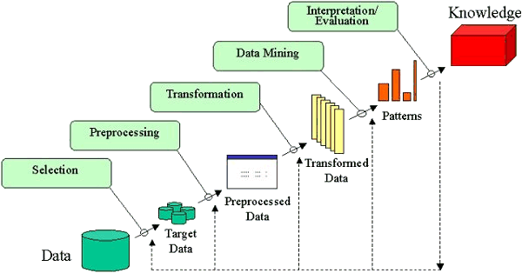
KDD – Knowledge Discovery in Database Process

Slide 81
SEMMA Process
Acronym SEMMA stands for Sample, Explore, Modify, Model, Assess.
Sample —Identify, merge, partition, and sample input data sets, among other tasks.
Explore —explore data sets statistically and graphically. plot the data, obtain descriptive statistics, identify important variables, and perform association analysis, among other tasks.
Modify —prepare the data for analysis. Examples of the tasks that you can complete for these nodes are creating additional variables, transforming existing variables, identifying outliers, replacing missing values, performing cluster analysis, and analyzing data with self-organizing maps (SOMs) or Kohonen networks.
Model —fit a predictive model to a target variable. Available models include decision trees, neural networks, least angle regressions, support vector machines, linear regressions, and logistic regressions.
Assess —compare competing predictive models. They build charts that plot the percentage of respondents, percentage of respondents captures, lift, and profit.

Slide 82
Comparison Study – KDD vs SEMMA
By doing a comparison of the KDD and SEMMA stages we would, on a first approach, affirm that they are equivalent:
Sample can be identified with Selection;
Explore can be identified with Pre processing;
Modify can be identified with Transformation;
Model can be identified with Data Mining;
Assess can be identified with Interpretation/Evaluation. Examining it thoroughly, we may affirm that the five stages of the SEMMA process can be seen as a practical implementation of the five stages of the KDD process, since it is directly linked to the SAS Enterprise Miner software.

Slide 83
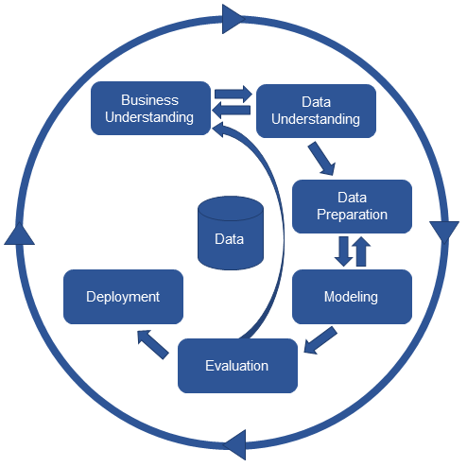
CRISP-DM Process
CRISP-DM stands for CRoss-Industry Standard Process for Data Mining. It consists on a cycle that comprises six stages

Slide 84
Comparison Study – KDD vs CRISP-DM
Comparing the KDD stages with the CRISP-DM stages is not as straightforward as in the SEMMA situation. CRISP-DM methodology incorporates the steps that, as referred above, must precede and follow the KDD process that is to say:
The Business Understanding phase can be identified with the development of an understanding of the application domain, the relevant prior knowledge and the goals of the end-user;
The Deployment phase can be identified with the consolidation by incorporating this knowledge into the system.
The Data Understanding phase can be identified as the combination of Selection and Pre processing;
The Data Preparation phase can be identified with Transformation;
The Modeling phase can be identified with Data Mining;
The Evaluation phase can be identified with Interpretation/Evaluation.

Slide 85
KDD vs SEMMA vs CRISP-DM

Slide 86
Drawbacks of CRISP-DM 1/
One major drawback is that the model no longer seems to be actively maintained. The official site, CRISP-DM.org, is no longer being maintained. Furthermore, the framework itself has not been updated on issues on working with new technologies, such as big data.
Big data technologies means that there can be additional effort spend in the data understanding phase, for example, as the business grapples with the additional complexities that are involved in the shape of big data sources.
CRISP-DM is a great framework and its use on projects helps focus them on delivering real business value. CRISP-DM has been around a long time so many projects that are using CRISP-DM are taking shortcuts. Some of these shortcuts make sense but too often they result in projects using a corrupted version of the approach like the one shown in Figure .

Slide 87
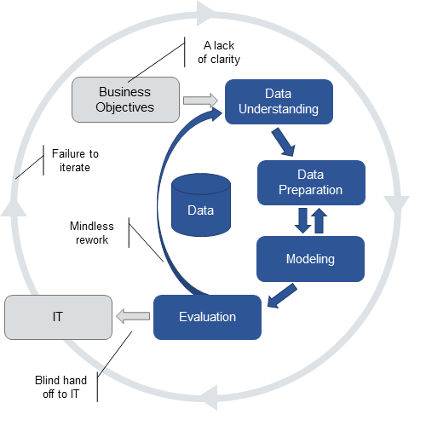
Drawbacks of CRISP-DM 2/
A lack of clarity: Rather than drill down into the details and really get clarity on both the business problem and exactly how an analytic might help, the project team make do with the business goals and some metrics to measure success.
Mindless rework: Most try to find new data or new modeling techniques rather than working with their business partners to re-evaluate the business problem.
Blind hand-off to IT: Some analytic teams don’t think about deployment and operationalization of their models at all. Fail to recognize that the models they build will have to be applied to live data in operational data stores or embedded in operational systems.
Failure to iterate Analytic professionals know that models age and that models need to be kept up to date if they are to continue to be valuable.

Slide 88
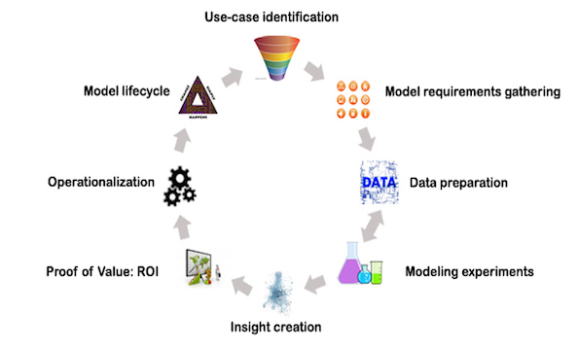
Standard Methodology for Analytical Models (SMAM)
https://www.kdnuggets.com/2015/08/new-standard-methodology-analytical-models.html

Slide 89
SMAM / 2
Phase | Description
Use-case identification | Selection of the ideal approach from a list of candidates
Model Requirements gathering | Understanding the conditions required for the model to function
Data preparation | Getting the data ready for the modeling
Modeling experiments | Scientific experimentation to solve the business question
Insight creation | Visualization and dash-boarding to provide insight
Proof of Value: ROI | Running the model in a small scale setting to prove the value
Operationalization | Embedding the analytical model in operational systems
Model lifecycle | Governance around model lifetime and refresh

Slide 90
Big Data Analytics
Big Data analytics platforms are designed to serve following needs of today’s businesses.
Massive amounts of data - It is big – typically in terabytes or even petabytes
Varied data such as video files to sql databases to text data - It is varied – it could be a traditional database, it could be video data, log data, text data or even voice data
Data that comes in at varying frequency – from days to minutes - It keeps increasing as new data keeps flowing in

Slide 91
Big Data Technologies
MapReduce To understand the beginning of Big Data technology, we will need to go back to 2004 when 2 Googlers – Sanjay Ghemawat and Jeffrey Dean wrote a paper that described how Google used the ‘Divide and Conquer’ approach to deal with its gigantic databases. This approach involves breaking a task into smaller sub-tasks and then working on sub-tasks in parallel, and results in huge efficiencies. Open source software enthusiast ‘Doug Cutting’ was one of the guys deeply inspired by the Google paper. He was able to scale his engine to process a couple of hundred million web pages but the requirement was for something 10,000 times faster than this. This is the computing power Google generates when it processes the trillions of webpages in existence.
Hadoop : Doug and his partner went about creating an Open source file system and processing framework that later came to be known as Hadoop. This formed the basis of their search engine “Nutch”. While the original Google file system was based on C++, Doug’s hadoop was based on Java.

Slide 92
Big Data Technologies contd..
Pig: As hadoop began to be implemented on a larger scale, Big Data specialists soon realized that they were wasting far too much time on writing MapReduce queries rather than actually analyzing data. MapReduce was long and time consuming to write. Developers at Yahoo soon came out with a work around – Pig. Pig is essentially an easier way to write MapReduce queries. It is similar to Python and allows for shorter and more efficient code to be written that can then be translated to MapReduce before execution.
Hive: While this solved the problem for a number of people, there were many who still found this difficult to learn. SQL is a language that most developers are familiar with and hence people at Facebook decided to create Hive – an alternative to Pig. Hive enables code to be written in Hive query language or HQL that, as the name suggests, is very similar to SQL. Thus, we now have an option – if we are familiar with Python, we can pick up Pig to write code. If we have knowledge of SQL, we can go for Hive. In either case, we get away from the time consuming job of writing MapReduce queries.So far we have understood 4 of the most popular Big Data technologies – MapReduce, Hadoop, Pig and Hive.

Slide 93
Big Data Technologies contd..
NoSQL: NoSQL refers to databases that do not follow the traditional tabular structure. This means that the data is not organized in the traditional rows and columns structure. An example of such data is the text from social media sites which can be analyzed to reveal trends and preferences. Another example is video data or sensor data. There are a number of NoSQL database technologies that work well for specific data problems. Hbase, CouchDB, MongoDB and Cassandra are some examples of NoSQL databases. Database technologies enable efficient storage and processing of data. however, in order to analyze this data, Big Data specialists require other specializd technologies.
Mahout /Impala - Mahout is a collection of algorithms that enable machine learning to be performed on hadoop databases. If you were looking to perform clustering, classification or collaborative filtering on your data, Mahout will help you do that. E-commerce companies and retailers have a frequent need to perform tasks like clustering and collaborative filtering on their data and Mahout is a great choice for this. Impala is another technology that enables analytics on Big Data. Impala is a query engine that allows Big Data specialists to perform analytics on data stored on hadoop via SQL or other BI tools. Impala as been developed and promoted by cloudera.

Slide 94
Big Data Life Cycle 1/
A big data analytics cycle can be described by the following stage −
Business Problem Definition – CRISP DM : Business understanding
Research -- new step
Human Resources Assessment – new step
Data Acquisition – new step
Data Munging – new step
Data Storage – new step
Exploratory Data Analysis – CRISP DM : Data Understanding
Data Preparation for Modeling and Assessment – CRISP DM : Data Preparation
Modeling – CRISP DM : Data Modelling
Implementation – CRISP DM : Evaluation & Deployment

Slide 95
Big Data Life Cycle 2/
Research: Analyze what other companies have done in the same situation. This involves looking for solutions that are reasonable for your company, even though it involves adapting other solutions to the resources and requirements that your company has. In this stage, a methodology for the future stages should be defined.
Human Resources Assessment: Once the problem is defined, it’s reasonable to continue analyzing if the current staff is able to complete the project successfully. Traditional BI teams might not be capable to deliver an optimal solution to all the stages, so it should be considered before starting the project if there is a need to outsource a part of the project or hire more people.
Data Acquisition: This section is key in a big data life cycle; it defines which type of profiles would be needed to deliver the resultant data product. Data gathering is a non-trivial step of the process; it normally involves gathering unstructured data from different sources. To give an example, it could involve writing a crawler to retrieve reviews from a website. This involves dealing with text, perhaps in different languages normally requiring a significant amount of time to be completed.
Data Munging: Once the data is retrieved, for example, from the web, it needs to be stored in an easy to-use format. To continue with the reviews examples, let’s assume the data is retrieved from different sites where each has a different display of the data. Suppose one data source gives reviews in terms of rating in stars, therefore it is possible to read this as a mapping for the response variable y ∈ {1, 2, 3, 4, 5}. Another data source gives reviews using two arrows system, one for up voting and the other for down voting. This would imply a response variable of the form y ∈ {positive, negative}.
In order to combine both the data sources, a decision has to be made in order to make these two response representations equivalent. This can involve converting the first data source response representation to the second form, considering one star as negative and five stars as positive. This process often requires a large time allocation to be delivered with good quality.

Slide 96
Big Data Life Cycle 3/
Data Storage: Once the data is processed, it sometimes needs to be stored in a database. Big data technologies offer plenty of alternatives regarding this point. The most common alternative is using the Hadoop File System for storage that provides users a limited version of SQL, known as HIVE Query Language. This allows most analytics task to be done in similar ways as would be done in traditional BI data warehouses, from the user perspective. Other storage options to be considered are MongoDB, Redis, and SPARK.
This stage of the cycle is related to the human resources knowledge in terms of their abilities to implement different architectures. Modified versions of traditional data warehouses are still being used in large scale applications. For example, teradata and IBM offer SQL databases that can handle terabytes of data; open source solutions such as postgreSQL and MySQL are still being used for large scale applications.
Even though there are differences in how the different storages work in the background, from the client side, most solutions provide a SQL API. Hence having a good understanding of SQL is still a key skill to have for big data analytics.
This stage a priori seems to be the most important topic, in practice, this is not true. It is not even an essential stage. It is possible to implement a big data solution that would be working with real-time data, so in this case, we only need to gather data to develop the model and then implement it in real time. So there would not be a need to formally store the data at all.

Slide 97
ASUM-DM
ftp://ftp.software.ibm.com/software/data/sw-library/services/ASUM.pdf
Analytics Solutions Unified Method - Implementations with Agile principles
The Analytics Solutions Unified Method (ASUM) is a step-by-step guide to conducting a complete implementation lifecycle for IBM Analytics solutions.
ASUM is designed to create successful and repeatable IBM Analytics deployments. The method can be utilized by IBM clients and business partners to successfully implement IBM Analytics solutions.

Slide 98
ASUM
ASUM is a methodology to implement AGILE in the project management way of working. So think of ASUM being applied in some phases of CRISP-DM or SNAM i.e. Data Preparation and Modelling.

Slide 99
ASUM

Slide 100
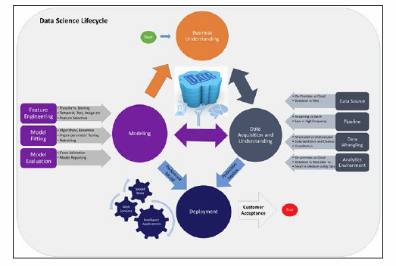
Some More Variations - TDSP
Microsoft Team Data Science Process
The TDSP process model provides a dynamic framework to machine learning solutions that have been through a robust process of planning, producing, constructing, testing, and deploying models. Here is an example of the TDSP process:
https://hub.packtpub.com/two-popular-data-analytics-methodologies-every-data-professional-should-know-tdsp-crisp-dm/

Slide 101
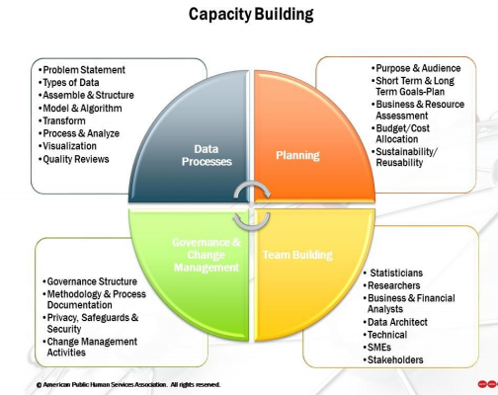
Analytics Capacity Building
Reference – Example : https://chhsdata.github.io/dataplaybook/documents/APHSA-Roadmap-to-Capacity-Building-in-Analytics-White-Paper.pdf

Slide 102
Data driven decision making
Definition – When it is data and not instincts that drives the business decisions.
Examples – Fraud detection in Loans, Credit Cards (Cibil scores); Insurance, Six sigma projects to improve efficiency; Target advertising in e-commerce; Product Roadmap planning, Team planning
6 Steps to Data Driven decision making-
Strategy – Define clear Business goals
Identifying key data focus areas – Data is everywhere, flowing from multiple sources. Based on domain knowledge define key focus data sources which seem to impact the most, easier to access, reliable and clean
Data Collection & Storage – Defining data architecture to collect, store, archive i.e. manage data. Connect multiple data sources, clean, prepare and organize
Data Analytics – Analyzing the data and derive key insights
Turning insights to Actions – business actions to be taken based on the findings from key insights from data
Operationalize and Deploy – Using IT systems, automate the data collection, storage, analysis and presenting the key highlights

Slide 103
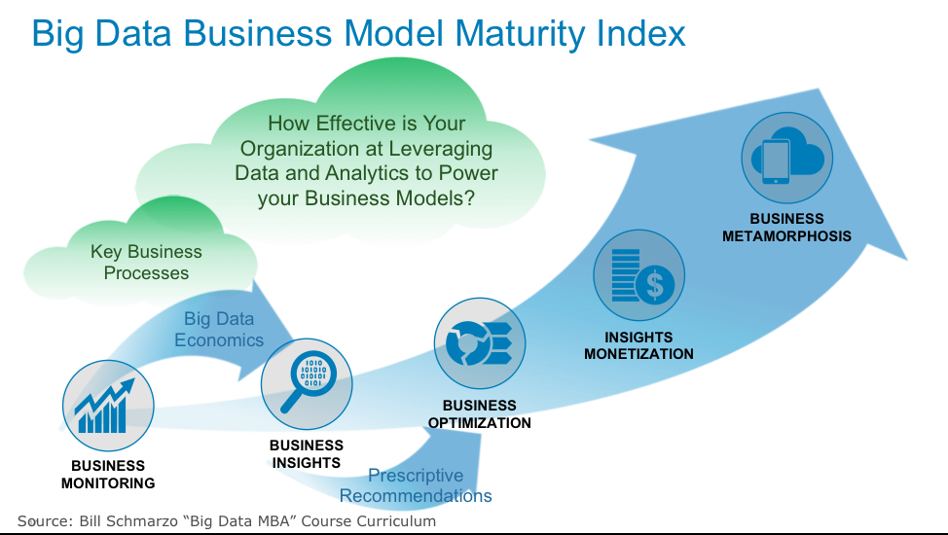
Data Business Model

Slide 104
Industry Example – FSO Analytics Tool
Business Objective fro FSO Department: Target for 5 top clients in India, Europe, South Africa and Costa Rica Markets
FTR (Frist Time Right) Improvement by 2%
Improve incoming WO Quality by 5%

Slide 105
References
https://www.scnsoft.com/blog/4-types-of-data-analytics
https://pdfs.semanticscholar.org/7dfe/3bc6035da527deaa72007a27cef94047a7f9.pdf
https://www.nap.edu/read/23670/chapter/6#57
https://www.kdnuggets.com/2017/01/four-problems-crisp-dm-fix.html
https://www.jigsawacademy.com/em/Beginners_Guide_to_Analytics.pdf
https://data-flair.training/blogs/data-analytics-tutorial/

Slide 106
Challenges/ Concerns
Identifying the problem
One of the major steps in analyzing a problem and designing a solution is to first figure out the problem properly and define each aspect of it. Many times Data scientists opt for a mechanical approach and start working on data sets and tools without a clear definition of the business problem or the client requirement.
Access to right data – Data quantity
For right analysis, it is very important to lay the hands on the right kind of data. Gaining access to a variety of data in the most appropriate format is quite difficult as well as time-consuming. There could be issues ranging from hidden data, insufficient volume of data or less variety in the kind of data. Data could be spread unevenly across various lines of business so getting permission to access that data can also pose a challenge.
Data Cleansing – Data quality
According to a study by MIT, Big Data has begun to cost companies up to 25% of possible revenue because cleansing bad data is eroding operating expenses.
Lack of domain expertise
Data Scientists also need to have sound domain knowledge and gain subject matter expertise. One of the biggest challenges faced by data scientists is to apply domain knowledge to business solutions. Data scientists are a bridge between the IT department and the top management.
Data security issues
Since data is extracted through a lot of interconnected channels, social media as well as other nodes, there is increased vulnerability of hacker attacks. Due to the confidentiality element of data, Data scientists are facing obstacles in data extraction, usage, building models or algorithms. The process of obtaining consent from users is causing a major delay in turnaround time and cost overruns.
https://www.eaie.org/blog/7-challenges-becoming-data-driven.html#:~:text=Data%20can%20play%20an%20important,and%20wrong%20or%20missing%20information.

Slide 107
Data Science Process
Lecture – 4
Sumita Narang

Slide 108
Objectives
Data Science methodology
Business understanding
Data Requirements
Data Acquisition
Data Understanding
Data preparation
Modelling
Model Evaluation
Deployment and feedback
Case Study
Data Science Proposal
Samples
Evaluation
Review Guide

Slide 109
Industry Example – FSO Analytics Tool
Business Objective fro FSO Department: Target for 5 top clients in India, Europe, South Africa and Costa Rica Markets
FTR (Frist Time Right) Improvement by 2%
Improve incoming WO Quality by 5%

Slide 110

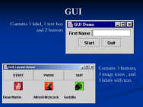

Industry Example - FSO Analytics Tool
Highlighting Key Insights based on Analysis
Aids in identifying key improvement areas in order to improve FTR & Incoming WO Quality
Key highlights & Lowlights from data depicted as textual & tabular insights in the tool
Repeated Analysis
Ease of performing repeated analysis weekly/monthly, on the same parameters, for same customer
Pre & Post Analysis
Based on actions identified from analysis, results to be monitored
Aids in doing comparison of same parameters month on month
Aids in doing comparison of same parameters across different customer/regions
Easy option to fetch reports
To support in performing the RCA for problematic areas identified through analysis, tool provides the feature of creating & downloading reports
WFM Closure Dump
FSO Analytics History DB
Data Aggregation
Analytics GUI Representation
Analysis Procedures Execution

Slide 111
Data Science Process
1. Business Requirement Understanding
2. Data Acquisition & Storage
3. Data Preparation
4. Data Model Creation
5. Evaluate and prove Model
6. Interpret and Present Results
7. Deployment & Operational Support
Notes:
SDLC – Requirement, Design, Implement, Test, Deploy, Support
Business Requirements Understanding
To define a measurable and quantifiable goal
Understand project sponsor needs and limitations
Collaborate with domain expert to understand data sources, data fields, and computational resources
Project sponsor vision to deploy and present the results

Slide 112
Data Science Process
The Team Data Science Process (TDSP) is an agile, iterative
data
science
methodology
to
deliver
predictive
analytics
solutions and intelligent applications efficiently. The process here
that can be implemented with a variety of tools.
Features:
-
Improve Team Collaboration and learning
-
Contains a distillation of the best practices and structures.
-
Helps in successful implementation of data science initiatives
Source Reference
4
BITS Pilani, Pilani Campus

Slide 113
Key components of the TDSP
TDSP comprises of the following key components:
•
A data science lifecycle definition
•
A standardized project structure
•
Infrastructure and resources for data science projects
•
Tools and utilities for project execution
5
BITS Pilani, Pilani Campus

Slide 114
Data Science Lifecycle
The Team Data Science Process (TDSP) provides a lifecycle to structure the
development of your data science projects. The lifecycle outlines the steps,
from start to finish, that projects usually follow when they are executed.
•
Designed for data science projects that ship as part of intelligent applications
•
Machine learning or artificial intelligence models for predictive analytics
•
Exploratory data science projects or ad hoc analytics projects can also
benefit
6
BITS Pilani, Pilani Campus

Slide 115
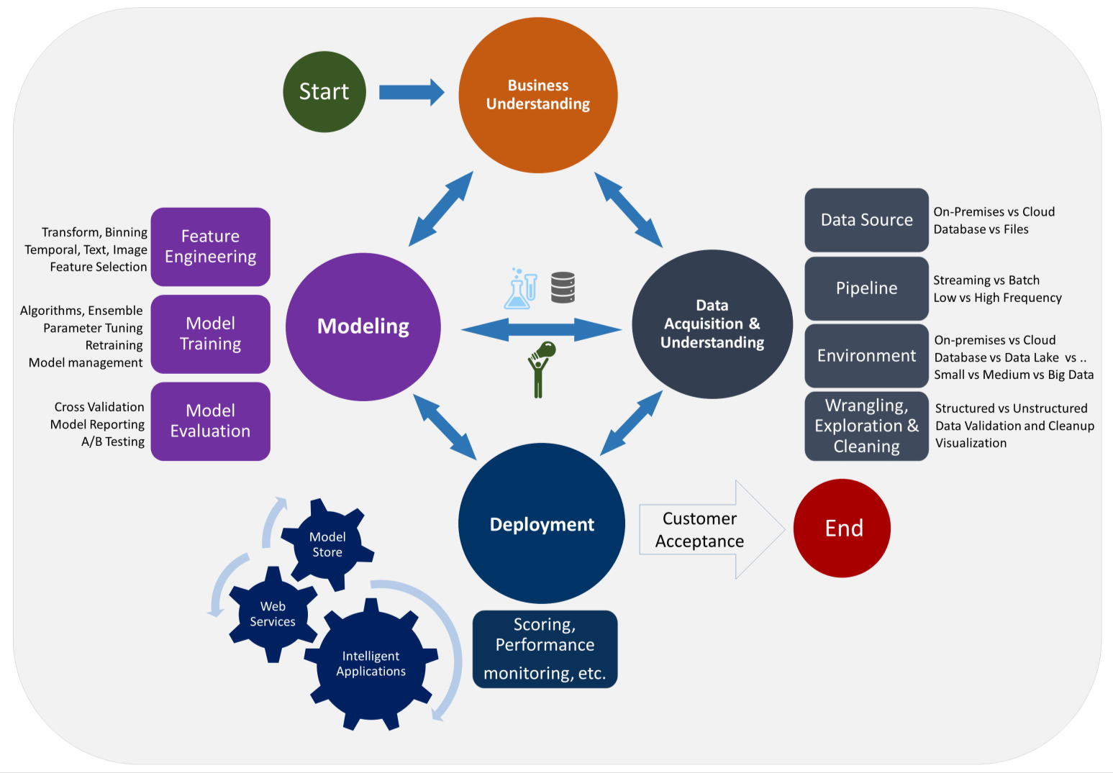
Data Science Lifecycle
7
BITS Pilani, Pilani Campus

Slide 116
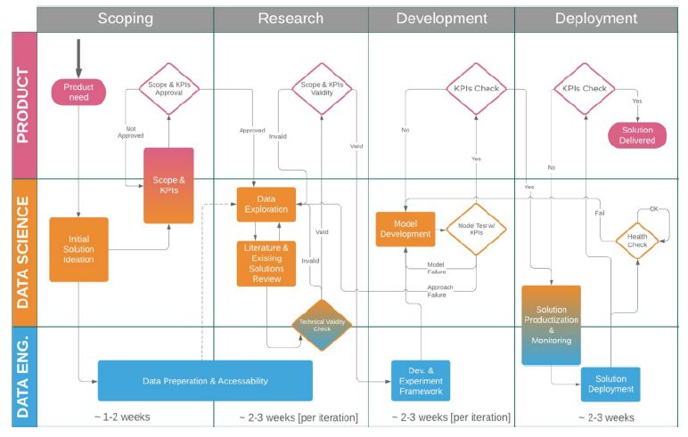
Data Science Project Lifecycle

Slide 117
Detailed stages
Details

Slide 118
Stage 1- Scoping Phase : Business Requirements Understanding
1. Product Need
Understand project sponsor needs and limitations
Understand Project sponsor vision to deploy and present the results.
2. Initial solution ideation – Data Requirements
Collaborate with SME to understand data sources, data fields, and computational resources
Collaborate with Data Engineer for possible solutions, data sources & data architecture
Decide on general algorithmic approach (e.g. unsupervised clustering vs boosted-tree-based classification vs probabilistic inference)
3. Scope & KPI
To define a measurable and quantifiable goal
E.g. predicting the expected CTR of an ad with approximation of at least X% in at least Y% of the cases, for any ad that runs for at least a week, and for any client with more than two months of historic data”
4. Scope & KPI Approval
Product sponsor approved the KPIs defined

Slide 119
Stage 2 -Data Acquisition & Management
Data Acquisition
Stage of collecting or acquiring data from various sources.
2 Types of Data Collection techniques - Primary Data & Secondary Data Collection.
Primary Data collection – Data is collected from direct sources. Observation, Interview, Questionnaire, Audit Data, Case Study, Survey Method
Secondary Data collection – Data collected and research analyzed by other agencies, universities
Develop a solution architecture of the data pipeline that refreshes and scores the data regularly
Ingest the data into the target analytic environment
Set up a data pipeline to score new or regularly refreshed data.
Notes:
CAP theorem – Consistency, Availability and Partition Tolerant – in distributed systems
Partition tolerance in CAP means tolerance to a network partition. An example of a network partition is when two nodes can't talk to each other, but there are clients able to talk to either one or both of those nodes. If you've ever used IRC and experienced a netsplit, this is a great example of that.
Key-Value: Big Hash tables of keys and values. Key is hash function based auto-generated, value can be String, JSON, BLOB
Document based – stores documents with tagged elements; These are also key value based. Key is similar to KV Store; but Value is referred as document. Document is managed data in JSON, BSON (Binary encoded JSON)
Column Based - data is stored in cells grouped in columns of data rather than as rows of data. Columns are logically grouped into column families. Column families can contain a virtually unlimited number of columns that can be created at runtime or the definition of the schema. Read and write is done using columns rather than rows.
Graph DBs – RDF based knowledge graphs

Slide 120
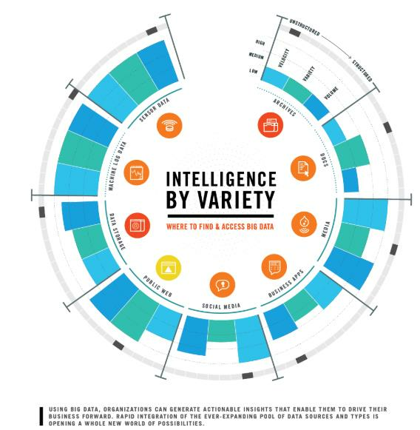
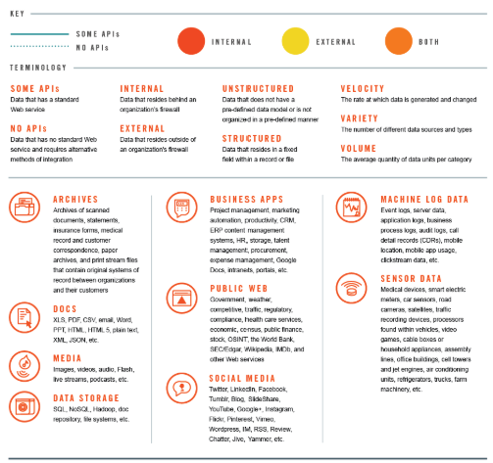
Data Acquisition from
Sources & Variety of data
https://datafloq.com/read/understanding-
sources-big-data-infographic/338
21
BITS Pilani, Pilani Campus

Slide 121
Data Management / Warehousing
Data Management/ Warehousing
Administrative process that includes acquiring, validating, storing, protecting, and processing required data to ensure the accessibility, reliability, and timeliness of the data for its users.
Relational Databases – RDBMS: Structured information & adherence to strong schema, ACID (Atomicity, Consistency, Isolation and Durability) properties, SQL based real time querying
NoSQL Databases – 4 types: 1. Key-Value (Amazon S3, Riak) 2. Document based store ( CouchDB, MongoDB ) 3. Column-Based Store (Hbase, Cassandra ) 4. Graph-Based ( Neo4J)

Slide 122
Stage 3: Data Preparation 1/
Data Preparation is the process of collecting, cleaning, and consolidating data into one file or data table, primarily for use in analysis.
Handling messy, inconsistent, or un-standardized data
Trying to combine data from multiple sources
Handling of missing values, boundary values, deleting duplicate values
Validation of data, reliability and correctness checks
Dealing with data that was scraped from an unstructured source such as PDF documents, images etc.
Feature engineering, feature reduction/scaling
Data Understanding & Exploration/ Data Preparation
Produce a clean, high-quality data set whose relationship to the target variables is understood. Locate the data set in the appropriate analytics environment so you are ready to model.
Explore dimensions; find deficiencies in data
Add more data sources if required with support from Data Engineer

Slide 123
Stage 3: Data Preparation 2/
The key steps to your data preparation:
Data analysis – The data is audited for errors ;anomalies to be corrected. For large datasets, data preparation prove helpful in producing metadata & uncovering problems.
Creating an intuitive workflow – A workflow consisting of a sequence of data prep operations for addressing the data errors is then formulated.
Validation – The correctness of the workflow is next evaluated against a representative sample of the dataset; Leading to adjustments to the workflow as previously undetected errors are found.
Transformation – Once convinced of the effectiveness of the workflow, transformation may now be carried out, and the actual data prep process takes place.
Backflow of cleaned data – Finally, steps must also be taken for the clean data to replace the original dirty data sources.

Slide 125
Stage 3- Data Pre-processing contd..
Algorithms require features with some specific characteristic to work properly. Here,
the need for feature engineering arises
•
Preparing the proper input dataset, compatible with the machine learning
algorithm requirements.
•
Improving the performance of machine learning models.
data scientists spend 80% of their time on data
preparation:
25
BITS Pilani, Pilani Campus

Slide 126
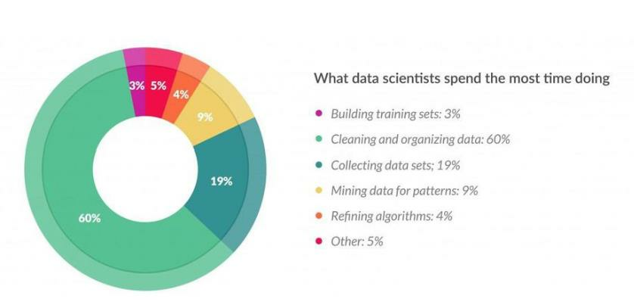
Stage 3:Data Pre-processing contd..
Data scientists spend 80% of their time on data preparation:
Source: https://www.forbes.com/sites/gilpress/2016/03/23/data-preparation-most-time-consuming-least-
enjoyable-data-science-task-survey-says/
26
BITS Pilani, Pilani Campus

Slide 127
Stage 3: Data Pre-processing steps
Data Cleaning: Data is cleansed through processes such as filling in missing
values, smoothing the noisy data, or resolving the inconsistencies in the data.
Techniques like- dropping missing values beyond a threshold, filling with mean/
Median; Imputation; Binning etc.
Data Integration: Data with different representations are put together and
conflicts within the data are resolved.
Data Transformation: Data is normalized, aggregated and generalized.
Data Reduction: This step aims to present a reduced representation of the data
in a data warehouse.
Data Discretization: Involves the reduction of a number of values of a
continuous attribute by dividing the range of attribute intervals.
27
BITS Pilani, Pilani Campus

Slide 128
Stage 3:Data Pre-processing
Techniques – Data Transformations
•
Imputation
•
Handling Outliers
•
Binning
•
Log Transform
•
One-Hot Encoding
•
Grouping Operations
•
Feature Split
•
Scaling
•
Extracting Date
https://towardsdatascience.com/feature-engineering-for-machine-learning-3a5e293a5114
28
BITS Pilani, Pilani Campus

Slide 129
Preparing The Data
Dealing with missing data
It is quite common in real-world problems to miss some values of our data
samples. It may be due to errors on the data collection, blank spaces on
surveys, measurements not applicable…etc
Missing values are tipically represented with the “NaN” or “Null” indicators. The
problem is that most algorithms can’t handle those missing values so we need
to take care of them before feeding data to our models. Once they are
identified, there are several ways to deal with them:
•
Eliminating the samples or features with missing values. (we risk to delete
relevant information or too many samples)
•
Imputing the missing values, with some pre-built estimators such as the
Imputer class from scikit learn. We’ll fit our data and then transform it to
estimate them. One common approach is to set the missing values as the
mean value of the rest of the samples.
12
BITS Pilani, Pilani Campus

Slide 130
Feature Scaling
This is a crucial step in the preprocessing phase as the majority of machine
learning algorithms perform much better when dealing with features that are on the same scale. In most cases, the numerical features of the dataset do not have a certain range and they differ from each other. In real life, it is nonsense to expect age and income columns to have the same range. But from the machine learning point of view, how these two columns can be compared? Scaling solves this problem. The continuous features become identical in terms of the range, after a scaling process. This process is not mandatory for many algorithms, but it might be still nice to apply. However, the algorithms based on distance calculations such as k-NN or k-Means need to have scaled continuous features as model input. The most common techniques are:
•
Normalization: it refers to rescaling the features to a range of [0,1], which is
a special case of min-max scaling. To normalize our data we’ll simply need
to apply the min-max scaling method to each feature column.
•
Standardization: it consists in centering the feature columns at mean 0 with
standard deviation 1 so that the feature columns have the same parameters
as a standard normal distribution (zero mean and unit variance).
14
BITS Pilani, Pilani Campus

Slide 131
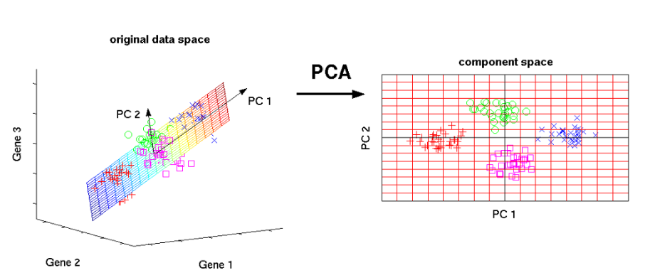
Preparing The Data -Selecting Meaningful Features
One of the most common solution to avoid overfitting is to reduce data’s
dimensionality. This is frequently done by reducing the number of features of
our dataset via Principal Component Analysis (PCA).
15
BITS Pilani, Pilani Campus

Slide 132
Central Limit Theorem
The Central Limit Theorem (CLT) is a statistical theory states that given a sufficiently large sample size from a population with a finite level of variance, the mean of all samples from the same population will be approximately equal to the mean of the population.
Larger the sample size, the more would be the normal distribution of means of samples

Slide 133
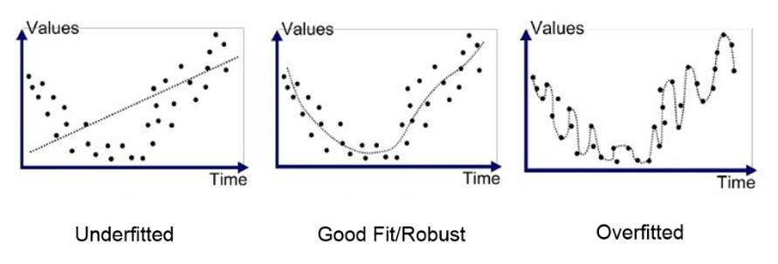
Preparing The Data-Splitting
Data Into Subsets
In general, we will split our data in three parts: training, testing and validating
sets. We train our model with training data, evaluate it on validation data and
finally, once it is ready to use, test it one last time on test data.
The ultimate goal is that the model can generalize well on unseen data, in other
words, predict accurate results from new data, based on its internal parameters
adjusted while it was trained and validated.
a) Learning Process
b) Over-fitting & Under-fitting
16
BITS Pilani, Pilani Campus

Slide 134
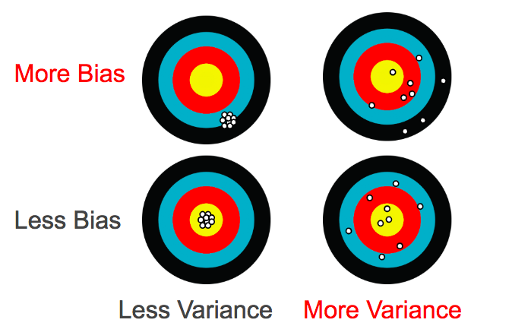
What is Bias & Variance in data
https://towardsdatascience.com/what-is-ai-bias-6606a3bcb814

Slide 135
Tools for Data Preparation
R – Data-tables and related libraries
http://www.milanor.net/blog/preparing-the-data-for-modelling-with-r/
https://www.udacity.com/course/data-analysis-with-r--ud651
https://www.datacamp.com/home (Course: Introduction to R )
https://courses.edx.org/courses/course-v1:Microsoft+DAT209x+5T2016/course/
Python – Pandas libraries, Numpy, scipy, EDA libraries
https://www.kdnuggets.com/2017/06/7-steps-mastering-data-preparation-python.html
https://www.analyticsvidhya.com/blog/2016/01/top-certification-courses-sas-r-python-machine-learning-big-data-spark-2015-16/#five
Self Service Data Preparation tools - Examples: Clearstory data, Datameer, Microsoft Power query for Excel, Pixata, Tamr, Big Data analyzeretc.
(https://www.predictiveanalyticstoday.com/data-preparation-tools-and-platforms/)

Slide 136
Extra Reading
How to depict Dependent and independent variables in data? How to depict data correlation?
http://www.sthda.com/english/wiki/visualize-correlation-matrix-using-correlogram
https://datavizcatalogue.com/search/relationships.html
https://www.khanacademy.org/math/pre-algebra/pre-algebra-equations-expressions/pre-algebra-dependent-independent/v/dependent-and-independent-variables-exercise-example-2
How to compensate for missing values ?
https://towardsdatascience.com/6-different-ways-to-compensate-for-missing-values-data-imputation-with-examples-6022d9ca0779
https://measuringu.com/handle-missing-data/

Slide 137
References
https://www.bouvet.no/bouvet-deler/roles-in-a-data-science-project
https://www.altexsoft.com/blog/datascience/how-to-structure-data-science-team-key-models-and-roles/
https://www.quora.com/What-is-the-life-cycle-of-a-data-science-project
https://towardsdatascience.com/5-steps-of-a-data-science-project-lifecycle-26c50372b492
https://www.dezyre.com/article/life-cycle-of-a-data-science-project/270
https://www.slideshare.net/priyansakthi/methods-of-data-collection-16037781
https://www.questionpro.com/blog/qualitative-data/
https://surfstat.anu.edu.au/surfstat-home/1-1-1.html
https://www.mymarketresearchmethods.com/types-of-data-nominal-ordinal-interval-ratio/
https://www.coursera.org/learn/decision-making

Slide 138
Data Science Process
Lecture – 4, 5 (Part-2)
Sumita Narang

Slide 139
Objectives
Data Science methodology
Business understanding
Data Requirements
Data Acquisition
Data Understanding
Data preparation
Modelling
Model Evaluation
Deployment and feedback
Case Study
Data Science Proposal
Samples
Evaluation
Review Guide

Slide 140
Stage 4: Data Modelling
Split correctly the data
Choose a measure of success. Set an evaluation protocol and the different protocols available.
Develop a benchmark model
Choose an adequate model and tune it to get the best performance possible. An overview of how a model learns.
What is regularization and when is appropriate to use it.
Differentiate between over and under fitting, defining what they are and explaining the best ways to avoid them
4

Slide 141
Modelling & Evaluation
1. Data Model Development & experiment framework setup
Data Modelling based on training sets
Framework to feed in new data and test the models
Framework to change training data and retrain model based on new data sets as sliding window
3 main tasks involved -
Feature Engineering: Create data features from the raw data to facilitate model training
Model Training: Find the model that answers the question most accurately by comparing their success metrics
Determine if your model is suitable for production
2. Data Model Evaluation & KPI Checks
Read papers, research material to finalize the algorithmic approaches

Slide 142
Define Appropriately the
Problem
The first, and one of the most critical things to do, is to find out what are the
inputs and the expected outputs. The following questions must be answered:
•
What is the main objective? What are we trying to predict?
•
What are the target features?
•
What is the input data? Is it available?
•
What kind of problem are we facing? Binary classification? Clustering?
•
What is the expected improvement?
•
What is the current status of the target feature?
•
How is going to be measured the target feature?
5
BITS Pilani, Pilani Campus

Slide 143
Choose a Measure of Success
“If you can’t measure it you can’t improve it”.
If you want to control something it should be observable, and in order to
achieve success, it is essential to define what is considered success: Maybe
precision? accuracy? Customer-retention rate?
This measure should be directly aligned with the higher level goals of the
business at hand. And it is also directly related with the kind of problem we are
facing:
•
Regression problems use certain evaluation metrics such as mean squared
error (MSE).
•
Classification problems use evaluation metrics as precision, accuracy and
recall.
8
BITS Pilani, Pilani Campus

Slide 144
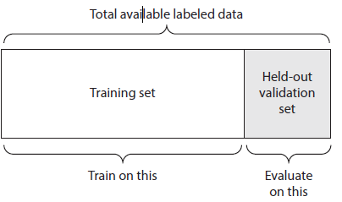
Setting an Evaluation Protocol 1/
Maintaining a Hold Out Validation Set
This method consists on setting apart some portion of the data as the test set.
The process would be to train the model with the remaining fraction of the data,
tuning its parameters with the validation set and finally evaluating its
performance on the test set.
The reason to split data in three parts is to avoid information leaks. The main
inconvenient of this method is that if there is little data available, the validation
and test sets will contain so few samples that the tuning and evaluation
processes of the model will not be effective.
This is a simple kind of cross validation technique, also known as the holdout method. Although this method doesn’t take any overhead to compute and is better than traditional validation, it still suffers from issues of high variance. This is because it is not certain which data points will end up in the validation set and the result might be entirely different for different sets.
Reduce Bias Error
Reduce Variance Error
9
BITS Pilani, Pilani Campus

Slide 145
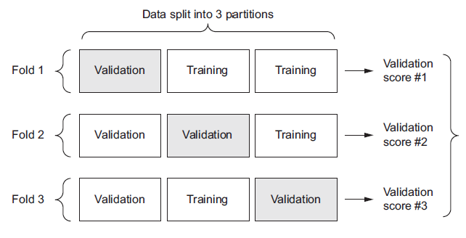
Setting an Evaluation Protocol 2/
K-Fold Validation Method
K-Fold consists in splitting the data into K partitions of equal size. For each
partition i, the model is trained with the remaining K-1 partitions and it is
evaluated on partition i.
The final score is the average of the K scored obtained. This technique is
specially helpful when the performance of the model is significantly different
from the train-test split.
As there is never enough data to train your model, removing a part of it for validation poses a problem of under-fitting. By reducing the training data, we risk losing important patterns/ trends in data set, which in turn increases error induced by bias. So, what we require is a method that provides ample data for training the model and also leaves ample data for validation. K Fold cross validation does exactly that.
K-fold cross validation significantly reduces bias as we are using most of the data for fitting, and also significantly reduces variance as most of the data is also being used in validation set.
10
BITS Pilani, Pilani Campus

Slide 146

Cross-Validation (1/3)
• Cross-Validation is a very useful technique for assessing the performance
of machine learning models.
• Helps in knowing how the machine learning model would generalize to an
independent data set.
• Helps in estimating how accurate the predictions will be in practice.
• We are given two type of data sets: known data set (training data set) and
unknown data set (test data set).
• There are different types of Cross-Validation techniques but the overall
concept remains the same:
o To partition the overall dataset into a number of subsets
o Hold out a subset at a time and train the model on remaining subsets
o Test model on hold out subset
Sources: https://towardsdatascience.com/cross-validation-explained-evaluating-estimator-performance-e51e5430ff85
https://magoosh.com/data-science/k-fold-cross-validation/
19
BAZG523(Introduction to Data Science)
https://towardsdatascience.com/cross-validation-in-machine-learning-72924a69872f

Slide 147
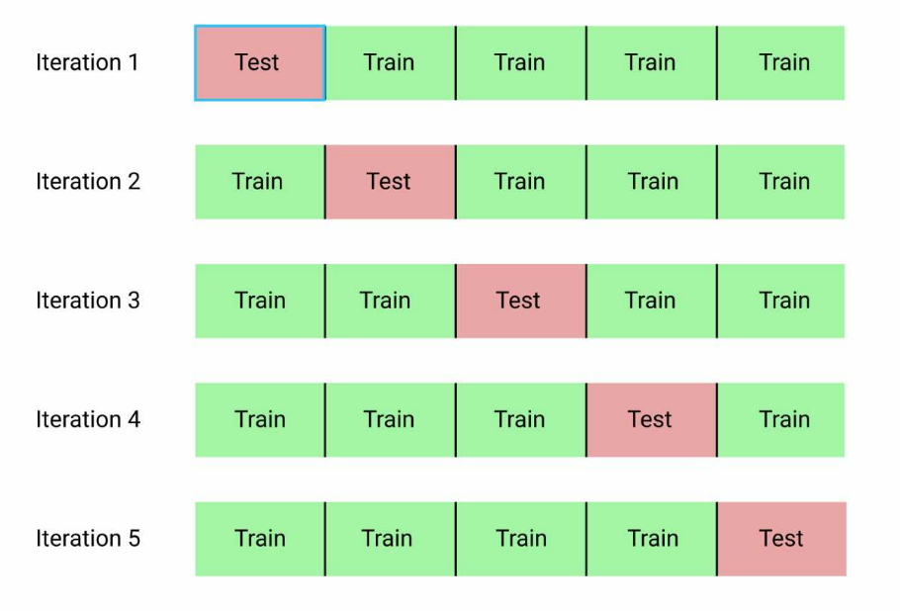
Cross-Validation (2/3)
K-Fold Cross-Validation: If k=5 the dataset will be divided into 5 equal parts
and the below process will run 5 times, each time with a different holdout set.
1. Take a group as a test data set
2. Take the remaining groups as a training data set
3. Fit a model on the training set and evaluate it on the test data set
4. Retain the evaluation score and discard the model
At the end of the above process summarize the skill of the model using the
average of model evaluation scores.
Sources: https://towardsdatascience.com/cross-validation-explained-evaluating-estimator-performance-e51e5430ff85
https://magoosh.com/data-science/k-fold-cross-validation/
20
BAZG523(Introduction to Data Science)

Slide 148
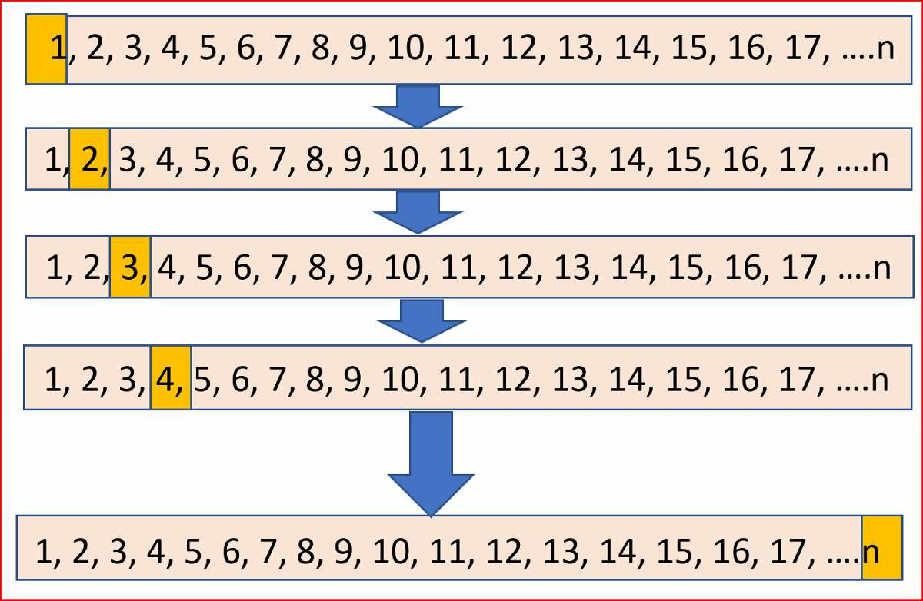
Cross-Validation (3/3)
Leave One Out Cross-Validation : It is K-fold cross validation taken to its
logical extreme, with K equal to N, the number of data points in the dataset.
Sources: https://towardsdatascience.com/cross-validation-explained-evaluating-estimator-performance-e51e5430ff85
https://magoosh.com/data-science/k-fold-cross-validation/
21
BAZG523(Introduction to Data Science)

Slide 149
Setting an Evaluation Protocol 3/
Stratified K-Fold Cross validation
In some cases, there may be a large imbalance in the response variables. For example, in dataset concerning price of houses, there might be large number of houses having high price. Or in case of classification, there might be several times more negative samples than positive samples.
For such problems, a slight variation in the K Fold cross validation technique is made, such that each fold contains approximately the same percentage of samples of each target class as the complete set, or in case of prediction problems, the mean response value is approximately equal in all the folds. This variation is also known as Stratified K Fold.

Slide 150
Setting an Evaluation Protocol 4/
Iterated K-Fold Validation with Shuffling (Random Sub-sampling)
It consist on applying K-Fold validation several times and shuffling the data
every time before splitting it into K partitions. The Final score is the average of
the scores obtained at the end of each run of K-Fold validation.
This method can be very computationally expensive, as the number of trained
and evaluating models would be I x K times. Being I the number of iterations
and K the number of partitions.
Above explained validation techniques are also referred to as Non-exhaustive cross validation methods. These do not compute all ways of splitting the original sample, i.e. you just have to decide how many subsets need to be made.
11
BITS Pilani, Pilani Campus

Slide 151
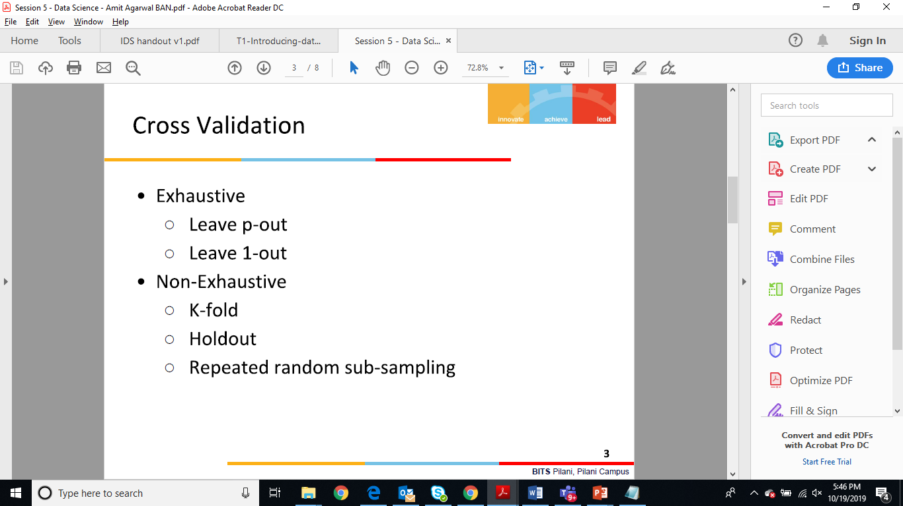
Non-Exhaustive & Exhaustive Cross-Validation Techniques
References-
https://towardsdatascience.com/cross-validation-in-machine-learning-72924a69872f
https://blog.contactsunny.com/data-science/different-types-of-validations-in-machine-learning-cross-validation

Slide 152
Exhaustive Cross Validation Methods 1/
Exhaustive Methods, that computes all possible ways the data can be split into training and test sets.
Leave-P-Out Cross Validation
This approach leaves p data points out of training data, i.e. if there are n data points in the original sample then, n-p samples are used to train the model and p points are used as the validation set.
This is repeated for all combinations in which original sample can be separated this way, and then the error is averaged for all trials, to give overall effectiveness.
This method is exhaustive in the sense that it needs to train and validate the model for all possible combinations, and for moderately large p, it can become computationally infeasible.

Slide 153
Exhaustive Cross Validation Methods 2/
Leave-1-Out Cross Validation
A particular case of this method is when p = 1. This is known as Leave one out cross validation. This method is generally preferred over the previous one because it does not suffer from the intensive computation, as number of possible combinations is equal to number of data points in original sample or n.

Slide 154
Predictive Modelling
Predictive modeling refers to the task of building a model for the target variable as a function of the explanatory variables. There are two types of predictive modeling tasks:
Classification, which is used for discrete target variables, and regression, which is used for continuous target variables. For example, predicting whether a Web user will make a purchase at an online bookstore is a classification task because the target variable is binary-valued.
On the other hand, forecasting the future price of a stock is a regression task because price is a continuous-valued attribute. The goal of both tasks is to learn a model that minimizes the error between the predicted and true values of the target variable.
Predictive modeling can be used to identify customers that will respond to a marketing campaign, predict disturbances in the Earth's ecosystem, or judge whether a patient has a particular disease based on the results of medical tests.

Slide 155
Classification Predictive Modelling Techniques
In classification problems, we use two types of algorithms (dependent on the kind of output it creates):
Class output: Algorithms like SVM and KNN create a class output. For instance, in a binary classification problem, the outputs will be either 0 or 1. However, today we have algorithms which can convert these class outputs to probability. But these algorithms are not well accepted by the statistics community.
Probability output: Algorithms like Logistic Regression, Random Forest, Gradient Boosting, Adaboost etc. give probability outputs. Converting probability outputs to class output is just a matter of creating a threshold probability.
Classification Algorithms vs Clustering Algorithms
In clustering, the idea is not to predict the target class as in classification, it’s more ever trying to group the similar kind of things by considering the most satisfied condition, all the items in the same group should be similar and no two different group items should not be similar.

Slide 156
Developing a Benchmark model
Benchmarking is the process of comparing your result to existing methods. You may compare to published results using another paper, for example. If there is no other obvious methodology against which you can benchmark, you might compare to the best naive solution (guessing the mean, guessing the majority class, etc.) or a very simple model (a simple regression, K Nearest Neighbors). If the field is well studied, you should probably benchmark against the current published state of the art (and possibly against human performance when relevant).
Null Model Bayes rate model
Single-variable models (e.g Pivot tables)
https://towardsdatascience.com/creating-benchmark-models-the-scikit-learn-way-af227f6ea977
17
BITS Pilani, Pilani Campus

Slide 157

Null Model – Null Hypothesis
Null model for Univariate regression model –
Y=α + β₁X+ ϵ
Null hypothesis would normally be that β1 is statistically no different from zero.
H0: β₁=0 (null hypothesis)
HA: β₁≠0 (alternative hypothesis)
For a univariate linear model, such as the above, if we were to reject the alternative hypothesis then we could drop β₁X from the linear model and we'd be left with
Y=α+ϵ
this is your Null model and the same as mean of Y.
Null Model (Single Variable Models) for Bi-variate regression model -
where x₁ contains the predictors you know are affecting the outcome, so are not wanting to test, while x₂ contains the predictors you are testing.
So the null hypothesis will be β₂=0 and the null model would be –

Slide 158

Naive Bayes Classifier
In simple terms, a Naive Bayes classifier assumes that the presence of a particular feature in a class is unrelated to the presence of any other feature.
Bayes theorem: This theorem helps to calculate conditional probability of occurrence of a hypothesis H, if the Evidence E is true, given the prior probability of H, and probability of occurrence of Evidence E.
P(H|E) = P(E|H) . P(H) / P (E)
https://www.khanacademy.org/partner-content/wi-phi/wiphi-critical-thinking/wiphi-fundamentals/v/bayes-theorem
Example –
P(H|E) → To find the conditional probability that I have Dengu, given the evidence that I show symptoms of Head ache.
Given -
P(H) = Prior Probability that I can have a disease like Dengu
P(E) = Probability that I can have head ache (due to any reason – dengu or not dengu)
P(E|H) = Probability that I can have Head ache, given the condition that I have dengu

Slide 159



Linear Classifiers
- Naive Bayes classifier

Slide 160

How Naive Bayes algorithm works?
https://www.analyticsvidhya.com/blog/2017/09/naive-bayes-explained/
It is easy and fast to predict class of test data set. It also perform well in multi class prediction
Step 1: Convert the data set into a frequency table
Step 2: Create Likelihood table by finding the probabilities like Overcast probability = 0.29 and probability of playing is 0.64.
Step 3: Now, use Naive Bayesian equation to calculate the posterior probability for each class. The class with the highest posterior probability is the outcome of prediction.

Slide 161
How Naive Bayes algorithm works?
Problem: Players will play if weather is sunny. Is this statement is correct?
We can solve it using above discussed method of posterior probability.
P(Yes | Sunny) = P( Sunny | Yes) * P(Yes) / P (Sunny)
Here we have P (Sunny |Yes) = 3/9 = 0.33, P(Sunny) = 5/14 = 0.36, P( Yes)= 9/14 = 0.64
Now, P (Yes | Sunny) = 0.33 * 0.64 / 0.36 = 0.60, which has higher probability.
Naive Bayes uses a similar method to predict the probability of different class based on various attributes. This algorithm is mostly used in text classification and with problems having multiple classes.

Slide 162

Stage 5: Model Evaluation Metrics
Performance Metrics vary based on type of models i.e. Classification Models, Clustering Models, Regression Models.
https://www.analyticsvidhya.com/blog/2019/08/11-important-model-evaluation-error-metrics/

Slide 163





Validating models
Identifying common model problems
Bias - Systematic Error
Variance - Undesirable (but non-systematic) distance
between predictions and actual values.
Overfit
Nonsignificance: A model that appears to show an
important relation when in fact the relation may not hold
in the general population, or equally good predictions
can be made without the relation.
29
BITS Pilani, Pilani Campus

Slide 164


Validating models
30
BITS Pilani, Pilani Campus

Slide 165
Ensuring model quality
Testing On Hold Out Data
k-fold cross-validation
The idea behind k-fold cross-validation is to repeat the construction
of the model on different subsets of the available training data and
then evaluate the model only on data not seen during construction.
This is an attempt to simulate the performance of the model on
unseen future data.
Significance Testing
“What is your p-value?”
31
BITS Pilani, Pilani Campus

Slide 166
Balancing Bias & Variance to Control Errors in Machine Learning
https://towardsdatascience.com/balancing-bias-and-variance-to-control-errors-in-machine-learning-16ced95724db
Y = f(X) + e
Estimation of this relation or f(X) is known as statistical learning. On general, we won’t be able to make a perfect estimate of f(X), and this gives rise to an error term, known as reducible error. The accuracy of the model can be improved by making a more accurate estimate of f(X) and therefore reducing the reducible error. But, even if we make a 100% accurate estimate of f(X), our model won’t be error free, this is known as irreducible error(e in the above equation). The quantity e may contain unmeasured variables that are useful in predicting Y : since we don’t measure them, f cannot use them for its prediction. The quantity e may also contain unmeasurable variation.
Bias
Bias refers to the error that is introduced by approximating a real-life problem, which may be extremely complicated, by a much simpler model. So, if the true relation is complex and you try to use linear regression, then it will undoubtedly result in some bias in the estimation of f(X). No matter how many observations you have, it is impossible to produce an accurate prediction if you are using a restrictive/ simple algorithm, when the true relation is highly complex.
Variance
Variance refers to the amount by which your estimate of f(X) would change if we estimated it using a diﬀerent training data set. Since the training data is used to ﬁt the statistical learning method, diﬀerent training data sets will result in a diﬀerent estimation. But ideally the estimate for f(X) should not vary too much between training sets. However, if a method has high variance then small changes in the training data can result in large changes in f(X).
A general rule is that, as a statistical method tries to match data points more closely or when a more flexible method is used, the bias reduces, but variance increases.
In order to minimize the expected test error, we need to select a statistical learning method that simultaneously achieves low variance and low bias.

Slide 167

Regularization 1/
https://towardsdatascience.com/regularization-in-machine-learning-76441ddcf99a
This is a form of regression, that constrains/ regularizes or shrinks the coefficient estimates towards zero. In other words, this technique discourages learning a more complex or flexible model, so as to avoid the risk of overfitting.
A simple relation for linear regression looks like this. Here Y represents the learned relation and β represents the coefficient estimates for different variables or predictors(X).
Y ≈ β0 + β1X1 + β2X2 + …+ βpXp
The fitting procedure involves a loss function, known as residual sum of squares or RSS. The coefficients are chosen, such that they minimize this loss function. Now, this will adjust the coefficients based on your training data. If there is noise in the training data, then the estimated coefficients won’t generalize well to the future data. This is where regularization comes in and shrinks or regularizes these learned estimates towards zero.

Slide 168


Regularization 2/
Ridge Regression
Above image shows ridge regression, where the RSS is modified by adding the shrinkage quantity. Now, the coefficients are estimated by minimizing this function. Here, λ is the tuning parameter that decides how much we want to penalize the flexibility of our model. The increase in flexibility of a model is represented by increase in its coefficients, and if we want to minimize the above function, then these coefficients need to be small. This is how the Ridge regression technique prevents coefficients from rising too high.
Lasso Regression
What does Regularization achieve?
A standard least squares model tends to have some variance in it, i.e. this model won’t generalize well for a data set different than its training data. Regularization, significantly reduces the variance of the model, without substantial increase in its bias. So the tuning parameter λ, used in the regularization techniques described above, controls the impact on bias and variance. As the value of λ rises, it reduces the value of coefficients and thus reducing the variance. Till a point, this increase in λ is beneficial as it is only reducing the variance(hence avoiding overfitting), without loosing any important properties in the data. But after certain value, the model starts loosing important properties, giving rise to bias in the model and thus underfitting. Therefore, the value of λ should be carefully selected.

Slide 169
Stage 6 - Data Visualization & Interpret Results
Record Information
Blueprints, photographs, seismographs, …
Analyze data to support reasoning
Understand your data better and act upon that understanding
Develop and assess hypotheses (visual exploration) Find patterns and discover errors in data
Communicate information
more effectively
Share and persuade (visual explanation)

Slide 170
Classification of Visualization 1/
5 Types of Data Visualization Categories
Temporal
2 conditions: that they are linear, and are one-dimensional.
Temporal visualizations normally feature lines that either stand alone or overlap with each other, with a start and finish time.
Easy to read graphs
Hierarchical
those that order groups within larger groups. Hierarchical visualizations are best suited if you’re looking to display clusters of information, especially if they flow from a single origin point.
more complex and difficult to read,

Slide 171
Classification of Visualization 2/
Network
Datasets connect deeply with other datasets. Network data visualizations show how they relate to one another within a network. In other words, demonstrating relationships between datasets without wordy explanations.
Multidimensional
there are always 2 or more variables in the mix to create a 3D data visualization.
Because of the many concurrent layers and datasets, these types of visualizations tend to be the most vibrant or eye-catching visuals. Another plus? These visuals can break down a ton of data down to key takeaways.
Geospatial
relate to real life physical locations, overlaying familiar maps with different data points.
These types of data visualizations are commonly used to display sales or acquisitions over time, and can be most recognizable for their use in political campaigns or to display market penetration in multinational corporations.

Slide 172
Classification of Visualization 3/
Temporal
Scatter plots
Polar area diagrams
Time series sequences
Timelines
Line graphs
Hierarchical
Tree diagrams
Ring charts
Sunburst diagrams
Network
Matrix charts
Node-link diagrams
Word clouds
Alluvial diagrams
Multidimensional
Box plots
Pie charts
Venn diagrams
Stacked bar graphs
Histograms
Geospatial
Flow map
Density map
Cartogram
Heat map
https://www.klipfolio.com/resources/articles/what-is-data-visualization

Slide 173
Sage 7 - Deployment & Iterative Lifecycle
Standard Methodology for Analytical Models (SMAM)
Operationalization –
Implementing the model as a deployable software solution

Slide 174
Deployment Phase
1. Solution Productionizing & Monitoring Setup
Research language may or may not be possible to use in productionizing
If Research and productionizing language is different; porting the algorithm; finding related libraries & writing custom code; writing wrapper APIs
If both are same; how to make models more scalable & achieve required efficiency;
Devise mechanism to continuously monitor the performance of model setup
2. Solution Deployment
Hosting solution in company’s data centers or on cloud based on company’s policies , infrastructure and cost
KPI Check
Validating that target KPIs are met

Slide 175
<Transportation/ Logistics><Optimization Algorithms>
Problem Statement
ABC Organization allows employees to request cab service for scheduled time slots, having well-defined drop/pick up locations
Services team manually creates routes for the given requests, which are often sub-optimal
Solution Approach
Used Large Neighborhood Search (LNS) – AI Search Metaheuristic
Constraints built into LNS as Rules
Solution Benefits
Overall Cost Optimization (Fuel, Security) and Travel Time Optimization
No tedious manual planning required; more time window for user requests
Time | Date | Savings | Total No. of Customers | No. of Manual routes | No. of proposed routes | Vehicles used in manual routes | Vehicles used in optimized routes
7:00 PM | 1/19/2018 | 56% | 28 | 12 | 7 | 1 Amaze- D, 2 Dzire D, 3 Etios D,1 Indica D,1 Innova D, 4 Tempo Traveller | 6 Amaze D 4 seater, 1 Tavera D 9 Seater
Notes:
Intelligent Traffic Management – e.g. CMU V2V traffic management system
Logistics – Delivery Route

Slide 176
Project Example of Data Science
- Diagnostic Analytics
FSO analytics example –
Business Objective fro FSO Department: Target for 5 top clients in India, Europe, South Africa and Costa Rica Markets
FTR (Frist Time Right) Improvement by 2%
Improve incoming WO Quality by 5%

Slide 177
References
https://www.bouvet.no/bouvet-deler/roles-in-a-data-science-project
https://www.altexsoft.com/blog/datascience/how-to-structure-data-science-team-key-models-and-roles/
https://www.quora.com/What-is-the-life-cycle-of-a-data-science-project
https://towardsdatascience.com/5-steps-of-a-data-science-project-lifecycle-26c50372b492
https://www.dezyre.com/article/life-cycle-of-a-data-science-project/270
https://www.slideshare.net/priyansakthi/methods-of-data-collection-16037781
https://www.questionpro.com/blog/qualitative-data/
https://surfstat.anu.edu.au/surfstat-home/1-1-1.html
https://www.mymarketresearchmethods.com/types-of-data-nominal-ordinal-interval-ratio/
https://www.coursera.org/learn/decision-making

Slide 178
Data Science Teams
Lecture – 6
Sumita Narang

Slide 179
Objectives
Data Science Teams
Defining Data Team
Roles in a Data Science Team
Data Scientists
Data Engineers
Managing Data Team
On boarding and evaluating the success of team
Working with other teams
Common difficulties

Slide 180



Data Science Project – Team structure
PROJECT SPONSOR
SUBJECT MATTER EXPERT
IT / OPERATIONS TEAM
DATA SCIENCE TEAM MANAGER
DATA SCIENTIST(S) Team
Researchers
Machine Learning Engineers
DATA ARCHITECT/ ENGINEER(S)
DATA ANALYST/ VISUALIZATION EXPERTS
CLIENT
Computer Science/ IT
Mathematics & Statistics
Domain / Business Knowledge
SW Development
Machine Learning
Traditional Research

Slide 181
Roles in Data Science Project
Project Sponsor
Represents business interest, maintains vision
Person who wants data science results
Decides if project is success or failure
Manage stakeholder expectations
Project Management, planning/tracking & Facilitator
Data Scientist
Data Architect/ Engineer
Data Analyst/ Visualization expert
Subject Matter Expert- SME
IT/ Operations Team
Understands business objective
Business process domain expert
Defines roadmap
Defines sources of input data, input data formats, important/non-important data
Helps in defining data dependencies, i/p vs o/p data relation
Builds application around the logic/algorithm devised by Data Team
Responsible for deploying the project in the IT infrastructure
Implements the overall f/wk for continuous data collection/feed, data cleaning/ preparation, data modelling and prediction
Depicts results visually
Design the project steps
Pick the data sources
Pick the tools to be used
Data Preparation
Performs statistical tests and procedures
Applies machine learning models
Evaluates results
Key collaborator among multiple entities -SME & project sponsor, IT Team and Data Team
Enables project vision and goals to be aligned
Build Data driven platform i.e. Data warehousing, Data Lakes, streaming platforms or other solutions to aggregate data
Operationalize Algorithms and Machine Learning models with data changing over time
Data Integration – from different data sources identified by Scientist
Business level story telling
Build Dashboards and other visualizations
Provide insights through visual means

Slide 182
Skills Required – Data Scientist

Slide 183

Data Scientist

Slide 184
Skills Required
Project Manager
Project management
Business acumen & vision
Team management
Stakeholder management
Tools – Jira, Azure, DevOps, Agile
Subject Matter Expert
Hands-on domain expert on business process
Tools: Domain specific
IT /Operations Team
Software development – C/C++, Java, Python etc.
SQL/NoSQL Database querying & scripting skills
Hands-on programming knowledge of Data science frameworks – Tensorflow, Kreas etc.
Cloud / in-house data center deployment skills
Operational skills to monitor deployment platform

Slide 185
Data Engineer vs Data Analyst vs Data Scientist
Data Scientist
Data Architect/ Engineer
Data Analyst/ Visualization expert
Design the project steps
Pick the data sources
Pick the tools to be used
Data Preparation
Performs statistical procedures
Applies machine learning models
Evaluates results
Key collaborator among multiple entities -SME & project sponsor, IT Team and Data Team
Enables project vision and goals to be aligned
Build Data driven platform i.e. Data warehousing, Data Lakes, streaming platforms or other solutions to aggregate data
Develop data set processes for Data modelling, mining & production; with data changing over time
Data Integration – from different data sources identified by Scientist
Business level story telling
Build Dashboards and other visualizations
Provide insights through visual means
SKILLSET
Data Management : SQL, No-SQL
Data preparation: Python, SAS, R, Scala
Data analytics: Power BI, SRSS, Tableau
Data Modelling – Machine learning algorithms. Statistical learning, Neural network (Tools - IBM Watson, SPSS, Deep Learning)
Data Management : SQL, No-SQL
Data Warehousing tools
Data Purging, archiving, scripting
Tools eg. – Oracle, Cassandra, MySQL, MongoDB, Hive, neo4j, Postgress, sqoop, Hadoop/HDFS etc.
Data analytics tools: Power BI, SRSS, Tableau

Slide 186
Data Scientist Vs. IT SW Programmer
IT SW Programmer
Software engineers work on front-end/back-end development, build web and mobile apps, develop operating systems and design software to be used by organizations.
A software engineer creates deterministic algorithms. Every program that a software engineer writes should produce the exact same result every time it runs.
Programmers typically work with SQL databases and programming languages like Java, Javascript, and Python.
Data Scientist
Data scientists, focus on building predictive models and developing machine learning capabilities to analyze the data captured by that software. Data scientists specialize in finding methods for solving business problems that require statistical analysis
Data scientists create probabilistic algorithms. Data scientists, however, because they are dealing with statistics, can’t always guarantee an outcome.
Data scientists typically also work with SQL databases as well as Hadoop data stores. They are more likely to work in Excel and frequently program with statistical software like SAS and R. There is also a big trend toward Python but with different libraries (Numpy, Pandas, etc.) than are used by programmer

Slide 187
Data Science -> AI Skillset
Data Science
Artificial Intelligence
Data Management : SQL, No-SQL
Data preparation: Python, SAS, R, Scala,
Data analytics - Power BI, SRSS, Tableau etc.
Statistical Learning, Neural networks
In-depth programming skills in python/C/C++/Java
Data Scientist needs software programming skills, but more focused around data preparation, modelling, presenting.

Slide 188
Skills Venn diagram

Slide 189
Managing Data Science Team 2/
- Attracting Top Talent
What’s your differentiated value proposition for candidate data scientists? List three things that make the opportunity unique, that you think will resonate with your target candidate pool. Test your pitch on your group. Get feedback.
- Hiring Process
What are the three most important attributes for your candidates?
What is your assessment plan for each?
- Onboarding
What activities and outcomes need to have been achieved in the first 30, 60, and 90 days?
What are the most important pieces of “tribal knowledge” your new hire needs to know, and how will she learn them? Examples include data sources, project methodologies, stakeholder dynamics, notable wins and losses, etc.

Slide 190
Managing Data Science Team 3/
Retention and Management
What skills do you hope this candidate develops over the first year?
What metrics will determine success of this candidate after a year? Examples include certain business metrics, community contributions, number of insights produced, or project iteration velocity.
How to Retain Your Talent
Don’t oversell the role. Half of data scientists stay at their jobs for two years or less. To reduce turnover, be truthful about the position you’re hiring for.
Understand team members’ motivations. Take out time to discover each employee’s goals, interests and personal incentives. Then you can pair them with rewarding projects and recognize accomplishments in a meaningful way.
Offer support. Data science can be a discipline of failures: Models fail, processes fail, data sources turn out to be terrible. Offer positive reinforcement and remind team members that it can take years to see an impact. Help team break the problems into manageable chunks so employees aren’t intimidated by an overwhelming project.
Create learning opportunities. Data scientists often leave their jobs because they’re bored. If core projects aren’t cutting-edge, creating opportunities for team members to learn new things, such as a weekly lunch to discuss the latest research or occasional hackathons to test a new software framework or computational technique.

Slide 191
Habits of Successful Data Science Managers
The following are the seven habits we have observed in many successful data science managers, in no particular order.
Build bridges to other stakeholders. Avoid friction and crossed wires by opening communication channels with other teams. Consider putting a data scientist and product manager in a room for an hour before each new project to ensure they’re on the same page. Making data scientists attend meetings without their laptops can force them to communicate with other stakeholders. Giving data scientists opportunities to explain their work to engineers, product managers, and others can also improve communication.
Track performance. Use a template to keep track of what you discussed, the objectives you set, and the feedback you gave during one-on-one meetings with your reports. Relying on memory won’t work.
Aim to take projects to production. Preparing teams to deploy their own API services and to productionalize code helps you move faster, and you don’t get blocked on engineering resources that might not be available.
Start on-call rotation. As teams get bigger, set up a weekly rotation of data scientists on call to fix models that break. That encourages better documentation and gives those not on-call time to focus on core projects.
Ask the dumb questions. Seemingly simple questions can open the door to identifying and solving fundamental problems.
Always be learning. Read prolifically to keep up with developments in this quickly evolving field. Consume not only technical material, but also insights about management and organizational psychology.
Get out of the way, but not forever. If you’re a new manager, consider stepping away from coding for three to six months. Otherwise, you risk never truly embracing the manager role, and might under-serve the team. After that, feel free to tackle non-critical projects or those nobody else wants to do.

Slide 192
Common Challenges 1/
Hiring a balanced data science team - build a cross-functional data science team that enables your organization to get insights from data and build production ready models.( Data Scientist, machine learning Engineer, Data Architect/Engineer, SW Developer, Research Scientist)
Retaining the team and Growing the team
Translating the business goals to smaller chunks of tasks, and defining measurable KPIs for the Data Science Team to work on achieving these KPIs.
Transforming Data Science team output/deliverables to a business understandable form, with key focus on Data Visualization. Hence try to bridge the gap between the Business Teams who relatively less/non-technical and the very technical Data Science Team
Engage and keep team motivated during the failures, and also keep the Senior leadership aligned with the fact that Data Science Projects are not like any SW Engineering project which can very Agile and give results every 7 days.

Slide 193
Common Challenges 2/
Prioritize work: team is flooded with requests for some analytics report or some other data crunching requests. These adhoc requests consume lot of time and it impacts the long term projects and other key deliverable. It’s important prioritize work and assign right priority to these adhoc tasks. It is better to an adhoc requests backlog and added priority to these tasks. The team could then manage these urgent requests better without sacrificing the time towards important tasks.
Data quality: Are you getting the right data? You may have plenty of data available, but the quality of that data isn’t a given. To create, validate, and maintain production for high-performing machine learning models, you have to train and validate them using trusted, reliable data. You need to check both the Accuracy and Quality of the data. Accuracy in data labeling measures how close the labeling is to ground truth. Quality in data labeling is about accuracy across the overall dataset. Make sure that the work of all of your annotators look same and labeling is consistently accurate across your datasets.

Slide 194
Common Challenges 3/
Tools : Tools play an important role because they allow you to automate. You should use relevant tools to do heavy lifting jobs, running scripts to automate queries and processing data to save some time which can in turn be used to make the team more productive. Choosing the right set of tools as per your needs.
Processes -Data science team projects are research oriented or start with lot of research activities , it’s difficult to predict how long it will take for them to finish. Also lot of activities like model building, data crunching are usually done by a single person, so traditional collaborative workflows don’t fit. You have to identify an approach which works best for your team. For example, we run a mix of Kanban and Scrum boards in JIRA. For Research Activities, Data Exploration/Analysis, Exploring ML models go for Kanban mode while as Productization of the models you can work as a Scrum team. So basically your Data scientists, Research Scientists and ML Engineers work mostly in Kanban mode where as Data Engineers, Software Engineers work in Scrum mode. Evaluate various options and see what best works for your team and projects.
Knowledge Management for data science team – Data and Models

Slide 195
Knowledge Management for Data Science Teams 1/
What is knowledge management?
The goal of knowledge management is to capture insight, which can be defined as “better understanding.” Insight is thus relative—it’s about constantly improving upon previous ideas.
Creating that kind of “compounding machine” requires a way to capture knowledge, a framework for users to follow and mechanisms to improve through feedback.
Why is knowledge management difficult?
Organizing knowledge in advance is difficult. Classifications are often too rigid, since you don’t know what will matter in the future.
There are few incentives to participate. As one data scientist said, “I get paid for what I build this year, not maintaining what I built last year.”
It’s a classic collective action problem. No one wants to be the first to spend time on documentation. When knowledge is being captured, it can be hard to know how to act on it.
Systems always lag behind reality. If knowledge management takes extra time and is done in a different system from the core work, its quality will suffer.

Slide 196
Knowledge Management for Data Science Teams 2/
Other obstacles are unique to data science teams:
People use different tools. Knowledge management is tougher when some team members work in R and others in Python, and when some store code on GitHub and others in email. Training people to use the same systems is difficult because of high turnover.
The components of a single project are scattered. Artifacts and insights may be spread across a Docker store, a wiki, a PowerPoint presentation, etc.
If you have code, that doesn’t mean you can rerun it. A meta-analysis of 600 computational research papers found that only 20 percent of the code could be re-run; of that share, many second attempts yielded slightly different results.
How to improve knowledge management
There are four steps that can help data science leaders improve knowledge management in their enterprise organizations:
Capture as much knowledge as possible in one place.
The more things are in there, the more connections you have across them, and the value grows that way. You don’t want people operating on the fringes. A common platform that encompasses both the core work and knowledge management is key to ensure it gets done and minimizes the burden. If you can’t capture everything, start with the most valuable model or knowledge, and build a system around that.
Choose a knowledge management system that allows for discovery, provenance, reuse, and modularity
Discovery: Data scientists spend much of their time searching for information, cutting into productivity. Teams have to decide whether to curate knowledge (the Yahoo approach) or index it (the Google approach). Curation makes sense when the domain is relatively stable. Indexing and searching is best when the domain is fluid, and you can’t possibly know beforehand what the taxonomy should look like.

Slide 197
Knowledge Management for Data Science Teams 3/
Provenance: Let people focus on the aspects of knowledge management that matter. Use a platform that allows people to synthesize their work, not have to track which software version they used.
Reuse: If it won’t run, it won’t get reused. That requires access to not only code, but also historical versions of datasets.
Decompose and Modularize: Ensure that people have the incentives and tools to create building blocks that can be reused and built upon.
3. Identify the right unit of knowledge
Compounding systems rely on units of knowledge. In academia, those are books and papers; in software, it’s code. In data science, the model is the right thing to organize around, because it’s the thing data scientists make. The model includes the data, code, parameters and results.
Data Annotation and Quality Assurance(QA)- Data is Key to success of any data science team. Having a well trained Data labeling team can provide significant value particularly during the iterative machine learning model testing and validation stages. Machine learning is an iterative process. You need to validate the model predictions and also need to prepare new datasets and enrich existing datasets to improve your algorithm’s results. You can either hire or outsource data annotation but challenge remains to have a consistency in labeling data and validating results.
4. Think beyond technology
Changes at the people and process levels are also important. Reframe how people see their jobs: They should spend less time doing and more time codifying and learning. Make collaboration a priority in hiring and compensation. Finally, while knowledge management should be seen as everyone’s job, some organizations create new roles for curating or facilitating knowledge.

Slide 198
Managing the Team
Focus –
- On boarding and evaluating the success of team
- Working with other teams
References –
https://hbr.org/2018/10/managing-a-data-science-team
https://www.dominodatalab.com/resources/field-guide/managing-data-science-teams/
https://towardsdatascience.com/building-and-managing-data-science-teams-77ba4f43bc58
https://towardsdatascience.com/so-youre-going-to-manage-a-data-science-team-31f075809ffd

Slide 199
Data driven decision making
Definition – When it is data and not instincts that drives the business decisions.
Examples – Fraud detection in Loans, Credit Cards (Cibil scores); Insurance, Six sigma projects to improve efficiency; Target advertising in e-commerce; Product Roadmap planning, Team planning
6 Steps to Data Driven decision making-
Strategy – Define clear Business goals
Identifying key data focus areas – Data is everywhere, flowing from multiple sources. Based on domain knowledge define key focus data sources which seem to impact the most, easier to access, reliable and clean
Data Collection & Storage – Defining data architecture to collect, store, archive i.e. manage data. Connect multiple data sources, clean, prepare and organize
Data Analytics – Analyzing the data and derive key insights
Turning insights to Actions – business actions to be taken based on the findings from key insights from data
Operationalize and Deploy – Using IT systems, automate the data collection, storage, analysis and presenting the key highlights

Slide 200
Data Business Model

Slide 201
Industry Example – FSO Analytics Tool
Business Objective fro FSO Department: Target for 5 top clients in India, Europe, South Africa and Costa Rica Markets
FTR (Frist Time Right) Improvement by 2%
Improve incoming WO Quality by 5%

Slide 202
Data Science Project – Team structure
PROJECT SPONSOR – FSO HEAD
SUBJECT MATTER EXPERT – TELECOM EXPERT
IT / OPERATIONS TEAM
(4 members)
SW Architect -1
WebApp Developers -1
DotNet Developers (2)
DATA SCIENCE TEAM MANAGER
DATA SCIENTIST(S) Team (3)
Researchers (1)
Machine Learning Engineers (2)
DATA ARCHITECT/ ENGINEER(S) - 2
DATA ANALYST/ VISUALIZATION EXPERTS- 1

Slide 203
Data and Data Models
Lecture – 7
Sumita Narang

Slide 204
Objectives
Types of Data, and Datasets
Data Format
High dimensional data
Data representation - Graphs and networks, Matrices, Vectors, Data Frames, list Libraries of Graph, Matrices and vectors
Data quality
Epicycles of Data Analysis
Data Models
Model as expectation
Comparing models to reality
Reactions to Data
Refining our expectations
Six Types of the Questions
Characteristics of Good Question
Formal modelling
General Framework
Associational Analyses
Prediction Analyses

Slide 205
Data Behavior
Static data is the data which has its size/value defined at the state of
initialization. the value/size cannot be change further
Dynamic data is the data which also has its size/value defined at the
state of initialization. But unlike static data its value or size can be
changes as per the need.
22
BITS Pilani, Pilani Campus

Slide 206
Data Types & Scales 1/
TYPES OF DATA
Qualitative Data
Binary
Discrete
Quantitative Data
Binary
Discrete
Continuous
SCALES OF DATA MEASUREMENT
Qualitative Data
Nominal
Ordinal
Quantitative Data
Interval
Ratio
Notes:
Binary (0 or 1)
Discrete (specific value at a given time stamp)
Continuous (e.g. electric voltage, current, any wave)

Slide 207
Types of Data 2/
Qualitative Data - Data that approximates and characterizes.
Data type is non-numerical in nature.
Statistically also known as categorical data as can be arranged categorically/grouped based on the attributes and properties of a thing or a phenomenon.
e.g. Females have brown, black, blonde, and red hair (qualitative).
e.g. Feedback to training is good, bad, average (qualitative)
Scales
Nominal sub-type- if there is no natural order between the categories (e.g. eye colour, gender, direction); used for labelling the data
Ordinal sub-type - if an ordering exists (e.g. exam results, socio-economic status, Satisfaction score, happiness index). order of the values is what’s important and significant, but the differences between each one is not really known.

Slide 208
Types of Data 3/
Quantitative data – Data which is numeric in nature
Discrete if the measurements are integers (e.g. number of people in a household, number of cigarettes smoked per day) and
Continuous if the measurements can take on any value, usually within some range (e.g. weight).
Binary, if measurement can take just two values 0 or 1
Scales
Interval – Interval scales are numeric scales in which we know both the order and the exact differences between the values. E.g. Temperature in Degree Celsius etc.
Note- In the case of interval scales, zero doesn’t mean the absence of value, but is actually another number used on the scale, like 0 degrees celsius. So there is no true zero in value
Ratio – Ratio scale tell us about the order, they tell us the exact value between units, AND they also have an absolute zero–which allows for a wide range of both descriptive and inferential statistics to be applied.
Examples of ratio variables include height, weight, and duration

Slide 209

Data Formats
24
BITS Pilani, Pilani Campus

Slide 210
Exercise
Data | Type | Subtype | Scale
Age in Years | Quantitative | Discrete | Ratio
Time in AM/PM | Qualitative | Binary | Ordinal
Brightness as measured by light meter | Quantitative | Continuous | Ratio
Brightness as measured by people’s judgement | Qualitative | Discrete | Ordinal
Angles measured in degrees 0 to 360 | Quantitative | Continuous | Ratio
Bronze, Silver, Gold medals as awarded | Qualitative | Discrete | Ordinal
Height above sea level | Quantitative | Continuous | Ratio/Interval
Number of patients in a hospital | Quantitative | Discrete | Ratio
ISBN numbers for books | Qualitative | Discrete | Ordinal
Ability to pass light in terms of the following values: opaque, translucent, transparent. | Qualitative | Discrete | Ordinal
Military rank | Qualitative | Discrete | Ordinal
Distance from the center of campus | Quantitative | Continuous | Ratio/Interval
Density of a substance in grams per cubic centimeter | Quantitative | Discrete | Ratio/Interval

Slide 211
Data-set Descriptions
Source Courtesy: Some of the contents of this PPT are sourced from materials provided by publishers of prescribed books

Slide 212
Types of Data Sets
Record
Relational records
Data matrix, e.g., numerical matrix, crosstabs
Document data: text documents: term-frequency vector
Transaction data
Graph and network
World Wide Web
Social or information networks
Molecular Structures
Ordered
For some types of data, the attributes have relationships that involve order in time or space e.g. Video data: sequence of images
Temporal data: time-series
Sequential Data: transaction sequences
Genetic sequence data
Spatial, image and multimedia: -Spatial auto-correlation
Spatial data: maps
Image data:
Video data:
Notes:
May we categorize data along the following dimensions?
- structured, semi-structured, and unstructured
- numeric and categorical
- static and dynamic (temporal?)
- by application

Slide 213
Important Characteristics of Structured Data 1/
Dimensionality
The dimensionality of a data set is the number of attributes, that the objects in the data set possess. Data with a small number of dimensions, tends to be qualitatively different than moderate or high-dimensional data. Indeed, the difficulties associated with analyzing high-dimensional data are sometimes referred to as the curse of dimensionality. Because of this, an important motivation in preprocessing the data is dimensionality reduction.
Sparsity
For some data sets, such as those with asymmetric features, most attributes of an object have values of 0; in many cases fewer than 1% of the entries are non-zero. In practical terms, sparsity is an advantage because usually only the non-zero values need to be stored and manipulated. This results in significant savings with respect to computation time and storage. Furthermore some data mining algorithms work well only for sparse data.

Slide 214
Important Characteristics of Structured Data 2/
Resolution
It is frequently possible to obtain data at different levels of resolution, and often the properties of the data are different at different resolutions. For instance, the surface of the Earth seems very uneven at a resolution of a few meters, but is relatively smooth at a resolution of tens of kilometers. The patterns in the data also depend on the level of resolution. If the resolution is too fine, a pattern may not be visible or may be buried in noise; if the resolution is too coarse, the pattern may disappear. For example, variations in atmospheric pressure on a scale of hours reflect the movement of storms and other weather systems. On a scale of months, such phenomena are not detectable.
Distribution
Centrality and dispersion

Slide 215
Data Objects
Data sets are made up of data objects.
A data object represents an entity.
Examples:
sales database: customers, store items, sales
medical database: patients, treatments
university database: students, professors, courses
Also called samples , examples, instances, data points, objects, tuples.
Data objects are described by attributes.
Database rows -> data objects; columns ->attributes.

Slide 216
Attributes
Attribute (or dimensions, features, variables): a data field, representing a characteristic or feature of a data object.
E.g., customer _ID, name, address
Types:
Nominal
Binary
Numeric: quantitative
Interval-scaled
Ratio-scaled

Slide 217
Attribute Types
Nominal: categories, states, or “names of things”
Hair_color = {auburn, black, blond, brown, grey, red, white}
marital status, occupation, ID numbers, zip codes
Binary
Nominal attribute with only 2 states (0 and 1)
Symmetric binary: both outcomes equally important
e.g., gender
Asymmetric binary: outcomes not equally important.
e.g., medical test (positive vs. negative)
Convention: assign 1 to most important outcome (e.g., HIV positive)
Ordinal
Values have a meaningful order (ranking) but magnitude between successive values is not known.
Size = {small, medium, large}, grades, army rankings

Slide 218
Numeric Attribute Types
Quantity (integer or real-valued)
Interval
Measured on a scale of equal-sized units
Values have order
E.g., temperature in C˚or F˚, calendar dates
No true zero-point
Ratio
Inherent zero-point
We can speak of values as being an order of magnitude larger than the unit of measurement (10 K˚ is twice as high as 5 K˚).
e.g., temperature in Kelvin, length, counts, monetary quantities

Slide 219
Discrete vs. Continuous Attributes
Discrete Attribute
Has only a finite or countably infinite set of values
E.g., zip codes, profession, or the set of words in a collection of documents
Sometimes, represented as integer variables
Note: Binary attributes are a special case of discrete attributes
Continuous Attribute
Has real numbers as attribute values
E.g., temperature, height, or weight
Practically, real values can only be measured and represented using a finite number of digits
Continuous attributes are typically represented as floating-point variables

Slide 220
Basic Statistical Descriptions of Data
Motivation
To better understand the data: central tendency, variation and spread
Data dispersion characteristics
median, max, min, quantiles, outliers, variance, etc.
Numerical dimensions correspond to sorted intervals
Data dispersion: analyzed with multiple granularities of precision
Boxplot or quantile analysis on sorted intervals
Dispersion analysis on computed measures
Folding measures into numerical dimensions
Boxplot or quantile analysis on the transformed cube
Notes:
Note to self (MK): last part of slide does not clearly match slides that follow
Introduction slides:
In the current version, we only talk about numeric data. Can we add some materials about non-numeric data.
- text statistics, TF/IDF
- visualization of text statistics such as word cloud
- distribution of Internet (IN, SCC, OUT, …)
- visualization of social relationship (e.g., http://renlifang.msra.cn/)

Slide 221

Measuring the Central Tendency
Mean (algebraic measure) (sample vs. population):
Note: n is sample size and N is population size.
Weighted arithmetic mean:
Trimmed mean: chopping extreme values
Median:
Middle value if odd number of values, or average of the middle two values otherwise
Estimated by interpolation (for grouped data):
Mode
Value that occurs most frequently in the data
Unimodal, bimodal, trimodal
Empirical formula:
Median interval

Slide 222


Symmetric vs. Skewed Data
Median, mean and mode of symmetric, positively and negatively skewed data
symmetric
positively skewed
negatively skewed

Slide 223
Measuring the Dispersion of Data
Quartiles, outliers and boxplots
Quartiles: Q₁ (25th percentile), Q₃ (75th percentile)
Inter-quartile range: IQR = Q₃ – Q₁
Five number summary: min, Q₁, median, Q₃, max
Boxplot: ends of the box are the quartiles; median is marked; add whiskers, and plot outliers individually
Outlier: usually, a value higher/lower than 1.5 x IQR
Variance and standard deviation (sample: s, population: σ)
Variance: (algebraic, scalable computation)
Standard deviation s (or σ) is the square root of variance s² ⁽or σ²⁾

Slide 224

Boxplot Analysis
Five-number summary of a distribution
Minimum, Q1, Median, Q3, Maximum
Boxplot
Data is represented with a box
The ends of the box are at the first and third quartiles, i.e., the height of the box is IQR
The median is marked by a line within the box
Whiskers: two lines outside the box extended to Minimum and Maximum
Outliers: points beyond a specified outlier threshold, plotted individually
Notes:
Redraw the boxplot! Yes, we need a more real boxplot graph!

Slide 225
Graphic Displays of Basic Statistical Descriptions
Boxplot: graphic display of five-number summary
Histogram: x-axis are values, y-axis repres. frequencies
Quantile plot: each value x_{i} is paired with f_{i} indicating that approximately 100 f_{i} % of data are ≤ x_{i}
Quantile-quantile (q-q) plot: graphs the quantiles of one univariant distribution against the corresponding quantiles of another
Scatter plot: each pair of values is a pair of coordinates and plotted as points in the plane
Notes:
JH: Maybe we can remove Loess curve

Slide 226
Histogram Analysis
Histogram: Graph display of tabulated frequencies, shown as bars
It shows what proportion of cases fall into each of several categories
Differs from a bar chart in that it is the area of the bar that denotes the value, not the height as in bar charts, a crucial distinction when the categories are not of uniform width
The categories are usually specified as non-overlapping intervals of some variable. The categories (bars) must be adjacent
Notes:
JH: A better and BASIC histogram figure --- because this one overlaps with a later one!

Slide 227
Histograms Often Tell More than Boxplots
The two histograms shown in the left may have the same boxplot representation
The same values for: min, Q1, median, Q3, max
But they have rather different data distributions

Slide 228
Handling Non-Record Data
Unstructured data, which is not available as records.
Most data mining algorithms are designed for record data or its variations, such as transaction data and data matrices. Record-oriented techniques can be applied to non-record data by extracting features from data objects and using these features to create a record corresponding to each object.
Consider spatio-temporal data consisting of a time series from each point on a spatial grid. This data is often stored in a data matrix, where each row represents a location and each column represents a particular point in time.
However, such a representation does not explicitly capture the time relationships that are present among attributes and the spatial relationships that exist among objects. This does not mean that such a representation is inappropriate, but rather that these relationships must be taken into consideration during the analysis.
For example, it would not be a good idea to use a data mining technique that assumes the attributes are statistically independent of one another.

Slide 229
Prescribed Text Books
 | Author(s), Title, Edition, Publishing House
T1 | Tan P. N., Steinbach M & Kumar V. “Introduction to Data Mining” Pearson Education
T2 | Data Mining: Concepts and Techniques, Third Edition by Jiawei Han, Micheline Kamber and Jian Pei Morgan Kaufmann Publishers

Slide 230
Data Representation
Source Courtesy: Some of the contents of this PPT are sourced from materials provided by publishers of prescribed books

Slide 231
Vector in Data Science
A vector is a tuple of one or more values called scalars.
Vectors can be represented in Python in different ways; known as Sequence Data Types
Lists
Tuples
Ranges
Arrays
Vector Arithmetic
Vector Addition -> c = a + b
a + b = (a1 + b1, a2 + b2, a3 + b3)
Vector Subtraction
Vector Multiplication
Vector Division
Vector Dot Product

Slide 232
Sequence Types in Python - Lists, tuples , Range 1/
https://docs.python.org/3/library/stdtypes.html#sequence-types-list-tuple-range
A list is simply an ordered collection of items.
Lists, Tuples, and Strings are all data types that, in python, are called sequence data types. All of them are containers of items and all of them have items that are ordered.
A Tuple is also an ordered collection of items.
Similarity –
Both lists and tuples are sequence data types that can store a collection of items.
Each item stored in a list or a tuple can be of any data type.
And you can also access any item by its index.
Differences –
The main difference between lists and a tuples is the fact that lists are mutable whereas tuples are immutable
List defined via List () function; assigned values by [ l1, l2 ,l3] i.e. square brackets. Tuples are defined via round brackets (l1,l2,l3) is tuple
Lists can grow dynamically as they are mutable objects.

Slide 233
Sequence Types in Python - Lists, tuples , Range 2/
The range type represents an immutable sequence of numbers and is commonly used for looping a specific number of times in for loops.
list(range(10)) is same as [0, 1, 2, 3, 4, 5, 6, 7, 8, 9]
list(range(1,11) is same as [1, 2, 3, 4, 5, 6, 7, 8, 9, 10]
list(range(0, 30, 5)) is same as [0, 5, 10, 15, 20, 25]
list(range(0, 10, 3)) is same as [0, 3, 6, 9]
list(range(0, -10, -1)) is same as [0, -1, -2, -3, -4, -5, -6, -7, -8, -9]
list(range(0)) is same as []
list(range(1, 0)) is same as []

Slide 234
Lists and Arrays
https://medium.com/backticks-tildes/list-vs-array-python-data-type-40ac4f294551
https://www.pythoncentral.io/the-difference-between-a-list-and-an-array/
Apparently, an Array is a data type in Python also, meaning we have the array type and list type (the list type being more popular).
The most popular type of array used in Python is the numpy array.
Similarities-
Both can be used to store any data type (real numbers, strings, etc)
Both can be indexed and iterated
Both can be sliced
Both are mutable
Differences-
The main difference between these two data types is the operation you can perform on them. Arrays are specially optimized for arithmetic computations so if you’re going to perform similar operations you should consider using an array instead of a list. E.g. x = array([3, 6, 9, 12])
x/3.0
print(x) -> array([1, 2, 3, 4])
Also lists are containers for elements having differing data types but arrays are used as containers for elements of the same data type.
It does take an extra step to use arrays because they have to be declared while lists don't because they are part of Python's syntax,

Slide 235
Exercise – Lists, Arrays, tuples
https://www.w3resource.com/python-exercises/list/
https://www.w3resource.com/python-exercises/tuple/
https://www.w3resource.com/python-exercises/array/

Slide 236
2-Dimensional Data
Data can be stored in python in 3 ways –
2D array or 2D List
Matrix
Pandas Data frame
Details –
2D Arrays - https://www.tutorialspoint.com/python/python_2darray.htm
Two dimensional array is an array within an array. It is an array of arrays. In this type of array the position of an data element is referred by two indices instead of one. So it represents a table with rows and columns of data. In the below example of a two dimensional array, observer that each array element itself is also an array.

Slide 237
Matrix
https://www.tutorialspoint.com/python/python_matrix.htm
Matrix is a special case of two dimensional array where each data element is of strictly same size. So every matrix is also a two dimensional array but not vice versa.
For example following 2 D array is allowed, but this data cannot go into a matrix –
2 | 3 | 4
1 | 12 | 14
1 | 2
The above data can be represented as a two dimensional array as below.
[['Mon' '18' '20' '22' '17']
['Tue' '11' '18' '21' '18']
['Wed' '15' '21' '20' '19']
['Thu' '11' '20' '22' '21']
['Fri' '18' '17' '23' '22']
['Sat' '12' '22' '20' '18']
['Sun' '13' '15' '19' '16']]
from numpy import * a = array([['Mon',18,20,22,17],['Tue',11,18,21,18], ['Wed',15,21,20,19],['Thu',11,20,22,21], ['Fri',18,17,23,22],['Sat',12,22,20,18], ['Sun',13,15,19,16]]) m = reshape(a,(7,5)) print(m)

Slide 238

Data Frames
https://www.geeksforgeeks.org/python-pandas-dataframe/
Pandas DataFrame is two-dimensional size-mutable, potentially heterogeneous tabular data structure with labeled axes (rows and columns). A Data frame is a two-dimensional data structure, i.e., data is aligned in a tabular fashion in rows and columns. Pandas DataFrame consists of three principal components, the data, rows, and columns.

Slide 239
Graphs Representation
https://www.geeksforgeeks.org/graph-and-its-representations/
https://www.scribd.com/doc/104543388/Graph-Representation
G=(V,E)
•A graph is a set of vertices and edges. A vertex may represent a state or a condition while the edge may represent a relation between two vertices.
Following two are the most commonly used representations of a graph. 1. Adjacency Matrix 2. Adjacency List

Slide 240

Adjacency Matrix
Adjacency Matrix is a 2D array of size V x V where V is the number of vertices in a graph. Let the 2D array be adj[][], a slot adj[i][j] = 1 indicates that there is an edge from vertex i to vertex j. Adjacency matrix for undirected graph is always symmetric. Adjacency Matrix is also used to represent weighted graphs. If adj[i][j] = w, then there is an edge from vertex i to vertex j with weight w.
Pros: Representation is easier to implement and follow. Removing an edge takes O(1) time. Queries like whether there is an edge from vertex ‘u’ to vertex ‘v’ are efficient and can be done O(1).
Cons: Consumes more space O(V^2). Even if the graph is sparse(contains less number of edges), it consumes the same space. Adding a vertex is O(V^2) time.

Slide 241


Adjacency Matrix

Slide 242
Adjacency List
An array of lists is used. Size of the array is equal to the number of vertices. Let the array be array[]. An entry array[i] represents the list of vertices adjacent to the ith vertex. This representation can also be used to represent a weighted graph. The weights of edges can be represented as lists of pairs. Following is adjacency list representation of the above graph.

Slide 243
Where to use what
• Adjacency matrix is good for dense graphs.
• Adjacency lists is good for sparse graphs and also for changing the no of nodes.

Slide 244


Incidence Matrix Representation
The Incidence matrix of a graph G with N vertices and E edges is N x E.
Mij = 1 if ej is incident on vi
Mij = 0 otherwise

Slide 245
Sparse Matrix (1/3)
• Sparse Matrix is a matrix which contains very few non-zero elements.
• When a sparse matrix is represented with a 2-dimensional array, we waste a
lot of space to represent that matrix.
• For example, consider a matrix of size 100 X 100 containing only 10 non-
zero elements. In this matrix, only 10 spaces are filled with non-zero values
and remaining spaces of the matrix are filled with zero. That means, we
allocate 100 X 100 X 2 = 20000 bytes of space to store this integer matrix.
• Sparse Matrix Representations can be done in many ways following are two
common representations:
o Array Representation
o Linked List representation
Sources: http://btechsmartclass.com/data_structures/sparse-matrix.html
https://www.geeksforgeeks.org/sparse-matrix-representation/
10
BAZG523(Introduction to Data Science)

Slide 246

Sparse Matrix (2/3)
Array Representation
2D array is used to represent a sparse matrix in which there are three rows
named as follows:
• Row: Index of row, where non-zero element is located
• Column: Index of column, where non-zero element is located
• Value: Value of the non zero element located at index – (Row, Column)
Sources: http://btechsmartclass.com/data_structures/sparse-matrix.html
https://www.geeksforgeeks.org/sparse-matrix-representation/
11
BAZG523(Introduction to Data Science)

Slide 247

Sparse Matrix (3/3)
Linked List Representation
In linked list, each node has four fields, which are defined as follows:
• Row: Index of row, where non-zero element is located
• Column: Index of column, where non-zero element is located
• Value: Value of the non zero element located at index – (row, column)
• Next node: Address of the next node.
Sources: http://btechsmartclass.com/data_structures/sparse-matrix.html
https://www.geeksforgeeks.org/sparse-matrix-representation/
12
BAZG523(Introduction to Data Science)

Slide 248
Libraries – Graphs and Networks in Python
https://www.python-course.eu/graphs_python.php
https://www.python.org/doc/essays/graphs/
graph = { "a" : ["c"],
"b" : ["c", "e"],
"c" : ["a", "b", "d", "e"],
"d" : ["c"],
"e" : ["c", "b"],
"f" : [] }

Slide 249
Data Coding Formats
Data Format defines the format in which data is coded.
The information is coded in such a way that a program or application can recognize, read and use the data.
If software/hardware is no longer used, data can become unreadable. In order to prevent this, it is vital to choose an open format: that is a software format that is not attached to a certain software supplier (proprietary software).
Data formats are often indicated by their MIME type. MIME stands for Multipart (Multipurpose) Internet Mail Extension. MIME provides web browser information on how to deal with a file.
A MIME type is noted as two indications separated by a slash (MIME type/subtype). Example: text/plain is the MIME type for plain text.

Slide 250
Data Coding Formats
Application/subtypes | Text/subtypes | Numerical data formats
Application/pdf: In transferring a file from one program to another, text layout has a tendency to shift or disappear. To prevent this, applications exist that ensure a universally identical rendering of the document. One example is the PDF (Portable Document Format) type, a universal file format for the electronic exchange of documents while maintaining their layout. | Text/plain: means that the text has not been given any layout. | application/x-matlab-data numerical data type: MATLAB is an advanced scientific computation program.
Application/gml+xml: GML stands for Geographic Markup Language: a standard way of describing geographic information. Geographic data describe the world in spatial terms, in regular plain text. As such, this is a language independent of any sort of data visualization | Text/HTML (HyperText Markup Language) is a format that indicates how the information should be visualized on a website. Its code allows you to indicate what text should look like, for example bold or in italics. This kind of layout is not present in plain text format. | HDF5 (application/x-hdf5) & NetCDF (application/x-netcdf): : store large amounts of numerical data (information in the form of numbers). A file containing numerical data is also called a binary file. Represent dataset with multidimensional arrays. HDF5 and NetCDF allow you to add metadata to the dataset as a whole, but also to the variables and dimensions within the set. Both HDF5 and NetCDF have standard definitions for the values plotted on specific axes.
Application/vnd.google-earth.kml+xml: geographic data is encoded in such a way that it can be read by so-called earth browsers, such as Google Earth, Google Maps, and Google Maps for mobile. Unlike the standard GML format, earth browsers do visualize data. | Text/XML (eXtensible Markup Language) format does not include layout either, but allows you to provide additional information about the contents of the file. Metadata can be added, such as <title> for a title and <creator> for the person who created the document
Application/x-java-archive: dataset is related to the Java programming language.
Application/octet-stream: This MIME type covers a general kind of binary data not otherwise defined. It is a residual category used for datasets of an unclear or uncertain nature

Slide 251
Data Formats
Still Image | Geospatial | Graphic Image | Audio | Video | Database
TIFF, JPEG 2000, PNG, JPEG/JFIF, DNG (digital negative), BMP, GIF. | Shapefile (SHP, DBF, SHX), GeoTIFF, NetCDF. | raster formats: TIFF, JPEG2000, PNG, JPEG/JFIF, DNG, BMP, GIF. | WAVE, AIFF, MP3, MXF, FLAC. | MOV, MPEG-4, AVI, MXF. | XML, CSV, TAB
 |  | vector formats: Scalable vector graphics, AutoCAD Drawing Interchange Format, Encapsulated Postscripts, Shape files. |  |  | RDBMS
 |  | cartographic: Most complete data, GeoTIFF, GeoPDF, GeoJPEG2000, Shapefile. |  |  | NOSQL

Slide 252
Data Quality
Source Courtesy: Some of the contents of this PPT are sourced from materials provided by publishers of prescribed books

Slide 253
Data Quality 1/
Data quality is a perception or an assessment of data's fitness to serve its purpose in a given context.
Accuracy
Measure of correctness of measured values
Precision of values – 32 bit, 64 bit
Completeness
Measure of data availability for all real-time scenarios
Handling Missing values
Reliability/Comparability
Measure of consistency in data
Degree to which data can be compared over time and domain
Relevance
Data collected for the same purpose which is relevant for the current use case under observation
Timeliness And Punctuality
Defines if data is latest/current
With change in environmental factors, older data may become outdated and hence unusable
Accessibility / Clarity
Ease with which data can be accessed. Formats in which data is available & supporting information defining those formats
Clarity implies sufficiency of metadata, supportive information

Slide 254
Data Quality
What kinds of data quality problems?
How can we detect problems with the data?
What can we do about these problems?
Examples of data quality problems:
Measurement and Collection Errors
Accuracy, Precision and Bias in data
Noise and Outliers
Missing values
Duplicate data

Slide 255

Data Quality – Accuracy Measure Statistically
Accuracy – Measure of how close the current value is to the “True/Reference value”.
The term measurement error refers to any problem resulting from the measurement process. A common problem is that the value recorded differs from the true value to some extent. For continuous attributes, the numerical difference of the measured and true value is called the error.
The term data collection error refers to errors such as omitting data objects or attribute values, or inappropriately including a data object. For example, a study of animals of a certain species might include animals of a related species that are similar in appearance to the species of interest.
Both measurement errors and data collection errors can be either systematic or random.
Precision refers to unreproducible random measurement error that leads to variation among multiple measurements of the same quantity; how close the data is with each other. Definition 2.3 (Precision). The closeness of repeated measurements( of the same quantity) to one another.
Definition 2.4 (Bias). A systematic variation of measurement from the quantity being measured
Variance (S²) = average squared deviation of values from mean
[squaring deviation from the mean] ÷ number of observations = variance
Standard deviation (S) = square root of the variance
Standard deviation of this random noise characterizes the precision of the measurement instrument (where a larger standard deviation corresponds to poorer precision).
Variance is a measure of heterogeneity in a given data. Higher the variance, more heterogeneous is it and smaller the variance, more homogeneous is it.
https://www.youtube.com/watch?v=0IiHPKAvo7g

Slide 256
What is Bias & Variance in data
https://towardsdatascience.com/what-is-ai-bias-6606a3bcb814

Slide 257
Noise
Noise is the random component of a measurement error. It may involve the distortion of a value or the addition of spurious objects.
The term noise is often used in connection with data that has a spatial or temporal component.
In such cases, techniques from signal or image processing can frequently be used to reduce noise and thus, help to discover patterns(signals) that might be "lost in the noise." Nonetheless, the elimination of noise is frequently difficult, and much work in data mining focuses on devising robust algorithms that produce acceptable results even when noise is present.
(a) Time series.
(b) Time series with noise.

Slide 258
Outliers
Outliers are either
(1) data objects that, in some sense, have characteristics that are different from most of the other data objects in the data set, or
(2) values of an attribute that are unusual with respect to the typical values for that attribute. Alternatively, we can speak of anomalous objects or values.
Furthermore, it is important to distinguish between the notions of noise and outliers. Outliers can be legitimate data objects or values. Thus, unlike noise, outliers may sometimes be of interest.
In fraud and network intrusion detection, for example, the goal is to find unusual objects or events from among a large number of normal ones.

Slide 259

Data Dimensions
A Data Dimension is a set of data attributes pertaining to something of interest to a business.
Dimensions store the textual descriptions of the business. With out the dimensions, we cannot measure the facts. The different types of dimension tables are explained in detail below.
For example, a business might want to know how may blue widgets were sold at a specific store in India last month.

Slide 260
High Dimensionality of Data
High Dimensional means that the number of dimensions are staggeringly high — so high that calculations become extremely difficult. With high dimensional data, the number of features can exceed the number of observations.
For example, microarrays, which measure gene expression, can contain tens of hundreds of samples. Each sample can contain tens of thousands of genes.
So if “p” is the number of dimensions and “n” is the number of observations, then if “p > n” it is a high dimension dataset i.e. the number of features available in dataset is more that the number of observations available.

Slide 261
Curse of Dimensionality
The curse of dimensionality usually refers to what happens when you add more and more variables to a multivariate model. Each added variable results in an exponential decrease in predictive power.
The statistical curse of dimensionality refers to a related fact: a required sample size n will grow exponentially with data that has d dimensions. In simple terms, adding more dimensions could mean that the sample size you need quickly become unmanageable.

Slide 262
Epicycle of Data Analysis
Source Courtesy: Some of the contents of this PPT are sourced from materials provided by publishers of prescribed books

Slide 263

Epicycle of Data Analysis
https://bookdown.org/rdpeng/artofdatascience/epicycles-of-analysis.html
There are 5 core activities of data analysis:
Stating and refining the question
Exploring the data
Building formal statistical models
Interpreting the results
Communicating the results
More specifically, for each of the five core activities, it is critical that you engage in the following steps:
Setting Expectations,
Collecting information (data), comparing the data to your expectations, and if the expectations don’t match,
Revising your expectations or fixing the data so your data and your expectations match.
Iterating through this 3-step process is what we call the
“epicycle of data analysis.” As you go through every stage of an analysis, you will need to go through the epicycle to continuously refine your question, your exploratory data analysis, your formal models, your interpretation, and your communication.

Slide 264
References
https://unstats.un.org/unsd/dnss/docs-nqaf/UK-Guidelines_Subject.pdf
https://www.folkstalk.com/2010/01/types-of-dimensions.html?m=1
https://www.folkstalk.com/2010/01/data-warehouse-dimensional-modelling.html
https://www.metrology-journal.org/articles/ijmqe/full_html/2017/01/ijmqe160046/ijmqe160046.html

Slide 265
Appendix
Extra Read

Slide 266
Type of Data Dimensions
Dimensions Types
Conformed Dimensions
Junk Dimensions
Degenerated Dimensions
Role-playing Dimensions
Conformed dimensions mean the exact same thing with every possible fact table to which they are joined; e.g. The date dimension connected to the sales facts is identical to the date dimension connected to the inventory facts
Junk dimension is a collection of random transactional codes or text attributes; to correlate some unrelated attributes. E.g. gender & marital status dimension can be combined as one junk attribute which stores all possible combinations of these 2 attribute values
Degenerated Dimension is a dimension which is derived from the fact table and doesn't have its own dimension table. E.g. Transactional Ids in fact table.
Role-playing dimensions are dimensions which are often used for multiple purposes within the same database. For example, a date dimension can be used for “date of sale", as well as "date of delivery", or "date of hire"

Slide 267



Data Dimensions- Storage Schemas
Star Schema: A schema is the one in which a central fact table is surrounded by de-normalized dimensional tables. A star schema can be simple or complex. A simple star schema consists of one fact table where as a complex star schema have more than one fact table.
Snow flake Schema: A snow flake schema is an enhancement of star schema by adding additional dimensions. Snow flake schema are useful when there are low cardinality attributes in the dimensions
Galaxy Schema: Galaxy schema contains many fact tables with some common dimensions (conformed dimensions). This schema is a combination of many data marts
Notes:
In the context of databases, cardinality refers to the uniqueness of data values contained in a column. High cardinality means that the column contains a large percentage of totally unique values. Low cardinality means that the columncontains a lot of “repeats” in its data range

Slide 268
Data and Data Models
Lecture – 8
Sumita Narang

Slide 269
Objectives
Types of Data and Datasets
Data Quality
Epicycles of Data Analysis
Data Models
Model as expectation
Comparing models to reality
Reactions to Data
Refining our expectations
Six Types of the Questions
Characteristics of Good Question
Formal modelling
General Framework
Associational Analyses
Prediction Analyses

Slide 270
Modelling & Evaluation
1. Data Model Development & experiment framework setup
Data Modelling based on training sets - At its core, a statistical model provides a description of how the world works and how the data were generated.
Framework to feed in new data and test the models
Framework to change training data and retrain model based on new data sets as sliding window
3 main tasks involved -
Feature Engineering: Create data features from the raw data to facilitate model training
Model Training: Find the model that answers the question most accurately by comparing their success metrics
Determine if your model is suitable for production
2. Data Model Evaluation & KPI Checks
Read papers, research material to finalize the algorithmic approaches

Slide 271
1. Define Appropriately the Problem
The first, and one of the most critical things to do, is to find out what are the
inputs and the expected outputs. The following questions must be answered:
•
What is the main objective? What are we trying to predict?
•
What are the target features?
•
What is the input data? Is it available?
•
What kind of problem are we facing? Binary classification? Clustering?
•
What is the expected improvement?
•
What is the current status of the target feature?
•
How is going to be measured the target feature?
5
BITS Pilani, Pilani Campus

Slide 272
2. Developing a Benchmark
Model
Benchmark Model
The goal in this step of the process is to develop a benchmark model that
serves us as a baseline, upon we’ll measure the performance of a better and
more attuned algorithm.
Benchmarking requires experiments to be comparable, measurable, and
reproducible. It is important to emphasize on the reproducible part of the last
statement. Now a day’s data science libraries perform random splits of data,
this randomness must be consistent through all runs. Most random generators
support setting a seed for this purpose. In Python we will use the random.seed
method from the random package.
Null Model Bayes rate model
Normal Model
17
BITS Pilani, Pilani Campus

Slide 273

Ideal models to calibrate against
Null Model
A null model is the best model of a very simple form
you’re trying to outperform. The two most typical null
model choices are a model that is a single constant
(returns the same answer for all situations) or a model
that is independent (doesn’t record any important
relation or interaction between inputs and outputs).
We use null models to lower-bound desired
performance, so we usually compare to a best null
model.
17
BITS Pilani, Pilani Campus

Slide 274
Ideal models to calibrate against
P(A | B) = (P(B | A) * P(A)) / P(B)
Bayes rate model
The Bayes Optimal Classifier is a probabilistic model that makes the most probable prediction for a new example. A Bayes rate model (also sometimes called a saturated model) is a best possible model given the data at hand.
The Bayes rate model is the perfect model and it only makes mistakes when there are multiple examples with the exact same set of known facts (same xs) but different outcomes (different ys).
It isn’t always practical to construct the Bayes rate model, but we invoke it as an upper bound on a model evaluation score.
P(vj | D) = sum {h in H} P(vj | hi) * P(hi | D)
Where vj is a new instance to be classified, H is the set of hypotheses for classifying the instance, hi is a given hypothesis, P(vj | hi) is the posterior probability for vi given hypothesis hi, and P(hi | D) is the posterior probability of the hypothesis hi given the data D.
https://machinelearningmastery.com/bayes-optimal-classifier/
18
BITS Pilani, Pilani Campus

Slide 275
Ideal models to calibrate against
Normal Model
This model says that the randomness in a set of data can be explained by the Normal distribution, or a bell-shaped curve. The Normal distribution is fully specified by two parameters—the mean and the standard deviation.

Slide 276
3. Comparing Model Expectation to Reality
We may be very proud of developing our statistical model,
but ultimately its usefulness will depend on how closely it
mirrors the data we collect in the real world.
Price Survey Data with Normal Distribution

Slide 277
Choose a Measure of Success
“If you can’t measure it you can’t improve it”.
If you want to control something it should be observable, and in order to
achieve success, it is essential to define what is considered success: Maybe
precision? accuracy? Customer-retention rate?
This measure should be directly aligned with the higher level goals of the
business at hand. And it is also directly related with the kind of problem we are
facing:
•
Regression problems use certain evaluation metrics such as mean squared
error (MSE).
•
Classification problems use evaluation metrics as precision, accuracy and
recall.
8
BITS Pilani, Pilani Campus

Slide 278
Model Evaluation Metrics
Performance Metrics vary based on type of models i.e. Classification Models, Clustering Models, Regression Models.
https://www.analyticsvidhya.com/blog/2019/08/11-important-model-evaluation-error-metrics/

Slide 279
Setting an Evaluation Protocol
Maintaining a Hold Out Validation Set
This method consists on setting apart some portion of the data as the test set.
The process would be to train the model with the remaining fraction of the data,
tuning its parameters with the validation set and finally evaluating its
performance on the test set.
The reason to split data in three parts is to avoid information leaks. The main
inconvenient of this method is that if there is little data available, the validation
and test sets will contain so few samples that the tuning and evaluation
processes of the model will not be effective.
9
BITS Pilani, Pilani Campus

Slide 280
Setting an Evaluation Protocol
K-Fold Validation
K-Fold consists in splitting the data into K partitions of equal size. For each
partition i, the model is trained with the remaining K-1 partitions and it is
evaluated on partition i.
The final score is the average of the K scored obtained. This technique is
specially helpful when the performance of the model is significantly different
from the train-test split.
10
BITS Pilani, Pilani Campus

Slide 281
Setting an Evaluation Protocol
Iterated K-Fold Validation with Shuffling
It consist on applying K-Fold validation several times and shuffling the data
every time before splitting it into K partitions. The Final score is the average of
the scores obtained at the end of each run of K-Fold validation.
This method can be very computationally expensive, as the number of trained
and evaluating models would be I x K times. Being I the number of iterations
and K the number of partitions.
11
BITS Pilani, Pilani Campus

Slide 282
4. Reacting to Data: Refining Our
Expectations
Okay, so the model and the data don’t match very well, as
was indicated by the histogram above. So what do do? Well, we can either
1. Get a different model; or
2. Get different data
Price Survey Data with Gamma Distribution

Slide 283
Validating models
Identifying common model problems
Bias - Systematic Error
Variance - Undesirable (but non-systematic) distance
between predictions and actual values.
Overfit
Nonsignificance: A model that appears to show an
important relation when in fact the relation may not hold
in the general population, or equally good predictions
can be made without the relation.
29
BITS Pilani, Pilani Campus

Slide 284
Validating models
30
BITS Pilani, Pilani Campus

Slide 285
Ensuring model quality
Testing On Held - Out Data
k-fold cross-validation
The idea behind k-fold cross-validation is to repeat the construction
of the model on different subsets of the available training data and
then evaluate the model only on data not seen during construction.
This is an attempt to simulate the performance of the model on
unseen future data.
Significance Testing
“What is your p-value?”
31
BITS Pilani, Pilani Campus

Slide 286
Balancing Bias & Variance to Control Errors in Machine Learning
https://towardsdatascience.com/balancing-bias-and-variance-to-control-errors-in-machine-learning-16ced95724db
Y = f(X) + e
Estimation of this relation or f(X) is known as statistical learning. On general, we won’t be able to make a perfect estimate of f(X), and this gives rise to an error term, known as reducible error. The accuracy of the model can be improved by making a more accurate estimate of f(X) and therefore reducing the reducible error. But, even if we make a 100% accurate estimate of f(X), our model won’t be error free, this is known as irreducible error(e in the above equation).
The quantity e may contain unmeasured variables that are useful in predicting Y : since we don’t measure them, f cannot use them for its prediction. The quantity e may also contain unmeasurable variation.
Bias
Bias refers to the error that is introduced by approximating a real-life problem, which may be extremely complicated, by a much simpler model. So, if the true relation is complex and you try to use linear regression, then it will undoubtedly result in some bias in the estimation of f(X). No matter how many observations you have, it is impossible to produce an accurate prediction if you are using a restrictive/ simple algorithm, when the true relation is highly complex.
Variance
Variance refers to the amount by which your estimate of f(X) would change if we estimated it using a diﬀerent training data set. Since the training data is used to ﬁt the statistical learning method, diﬀerent training data sets will result in a diﬀerent estimation. But ideally the estimate for f(X) should not vary too much between training sets. However, if a method has high variance then small changes in the training data can result in large changes in f(X).
A general rule is that, as a statistical method tries to match data points more closely or when a more flexible method is used, the bias reduces, but variance increases.
In order to minimize the expected test error, we need to select a statistical learning method that simultaneously achieves low variance and low bias.

Slide 287
When Do We Stop Training & Model fitment process?
Six Types of the Questions
Are you out of data?
Iterative data analysis will eventually begin to raise questions that simply cannot be answered with the data at hand.
Another situation in which you may find yourself seeking out more data is when you’ve actually completed the data analysis and come to satisfactory results, usually some interesting finding. Then, it can be very important to try to replicate whatever you’ve found using a different, possibly independent, dataset.
Do you have enough evidence to make a decision?
It’s important to always keep in mind the purpose of the data analysis as you go along because you may over or under-invest resources in the analysis if the analysis is not attuned to the ultimate goal.
The question of whether you have enough evidence depends on factors specific to the application at hand and your personal situation with respect to costs and benefits.

Slide 288
Six Types of the Questions
Can you place your results in any larger context?
Are results working on larger dataset in a bigger context, matching with past observations
Is model working well on multiple variations in the data or on different data sets
Are you out of time?
project timelines are approaching
Is model able to give results in define application SLAs Is model running for hours to give results,
Is your model overfitting?
Is your model able to handle noisy, messy data, outliers?

Slide 289
Formal Modelling
7.2 General Framework
Source Courtesy: Some of the contents of this PPT are sourced from materials provided by publishers of prescribed books

Slide 290
General Framework
1. Setting expectations. Setting expectations comes in the form of developing a primary model that represents. your best sense of what provides the answer to your question. This model is chosen based on whatever information you have currently available.
2. Collecting Information. Once the primary model is set, we will want to create a set of secondary models that challenge the primary model in some way. We will discuss examples of what this means below.
3. Revising expectations. If our secondary models are successful in challenging our primary model and put the primary model’s conclusions in some doubt, then we may need to adjust or modify the primary model to better reflect what we have learned from the secondary models.

Slide 291
Primary Model
It’s often useful to start with a primary model. This model will likely be derived from any exploratory analyses that you have already conducted and will serve as the lead candidate for something that succinctly summarizes your results and matches your expectations. It’s important to realize that at any given moment in a data analysis, the primary model is not necessarily the final model.
Through the iterative process of formal modeling, you may decide that a different model is better suited as the primary model. This is okay, and is all part of the process of setting expectations, collecting information, and refining expectations based on the data.

Slide 292
Secondary models
Once you have decided on a primary model, you will then typically develop a series of secondary models. The purpose of these models is to test the legitimacy and robustness of your primary model and potentially generate evidence against your primary model. If the secondary models are successful in generating evidence that refutes the conclusions of your primary model, then you may need to revisit the primary model and whether its conclusions are still reasonable.

Slide 293
Association Analysis
There are three classes of variables that are important to think about in an associational analysis.
1. Outcome. The outcome is the feature of your dataset that is thought to change along with your key predictor. Even if you are not asking a causal or mechanistic question, so you don’t necessarily believe that the outcome responds to changes in the key predictor, an outcome still needs to be defined for most formal modeling approaches.
2. Key predictor. Often for associational analyses there is one key predictor of interest (there may be a few of them). We want to know how the outcome changes with this key predictor. However, our understanding of that relationship may be challenged by the presence of potential confounders.
3. Potential confounders. This is a large class of predictors that are both related to the key predictor and the outcome. It’s important to have a good understanding what these are and whether they are available in your dataset. If a key confounder is not available in the dataset, sometimes there will be a proxy that is related to that key confounder that can be substituted instead.
The basic form of a model in an associational analysis will be –

Slide 294
Linear Regression
https://towardsdatascience.com/regularization-in-machine-learning-76441ddcf99a
This is a form of regression, that constrains/ regularizes or shrinks the coefficient estimates towards zero. In other words, this technique discourages learning a more complex or flexible model, so as to avoid the risk of overfitting.
A simple relation for linear regression looks like this. Here Y represents the learned relation and β represents the coefficient estimates for different variables or predictors(X).
Y ≈ β0 + β1X1 + β2X2 + …+ βpXp
The fitting procedure involves a loss function, known as residual sum of squares or RSS. The coefficients are chosen, such that they minimize this loss function. Now, this will adjust the coefficients based on your training data. If there is noise in the training data, then the estimated coefficients won’t generalize well to the future data. This is where regularization comes in and shrinks or regularizes these learned estimates towards zero.

Slide 295
Regularization
Ridge Regression
Above image shows ridge regression, where the RSS is modified by adding the shrinkage quantity. Now, the coefficients are estimated by minimizing this function. Here, λ is the tuning parameter that decides how much we want to penalize the flexibility of our model. The increase in flexibility of a model is represented by increase in its coefficients, and if we want to minimize the above function, then these coefficients need to be small. This is how the Ridge regression technique prevents coefficients from rising too high.
Lasso Regression
What does Regularization achieve?
A standard least squares model tends to have some variance in it, i.e. this model won’t generalize well for a data set different than its training data. Regularization, significantly reduces the variance of the model, without substantial increase in its bias. So the tuning parameter λ, used in the regularization techniques described above, controls the impact on bias and variance. As the value of λ rises, it reduces the value of coefficients and thus reducing the variance. Till a point, this increase in λ is beneficial as it is only reducing the variance(hence avoiding overfitting), without loosing any important properties in the data. But after certain value, the model starts loosing important properties, giving rise to bias in the model and thus underfitting. Therefore, the value of λ should be carefully selected.

Slide 296
Predictive Modelling
Predictive modeling refers to the task of building a model for the target variable as a function of the explanatory variables. There are two types of predictive modeling tasks:
Classification, which is used for discrete target variables, and regression, which is used for continuous target variables. For example, predicting whether a Web user will make a purchase at an online bookstore is a classification task because the target variable is binary-valued.
On the other hand, forecasting the future price of a stock is a regression task because price is a continuous-valued attribute. The goal of both tasks is to learn a model that minimizes the error between the predicted and true values of the target variable.
Predictive modeling can be used to identify customers that will respond to a marketing campaign, predict disturbances in the Earth's ecosystem, or judge whether a patient has a particular disease based on the results of medical tests.

Slide 297
Classification Predictive Modelling Techniques
In classification problems, we use two types of algorithms (dependent on the kind of output it creates):
Class output: Algorithms like SVM and KNN create a class output. For instance, in a binary classification problem, the outputs will be either 0 or 1. However, today we have algorithms which can convert these class outputs to probability. But these algorithms are not well accepted by the statistics community.
Probability output: Algorithms like Logistic Regression, Random Forest, Gradient Boosting, Adaboost etc. give probability outputs. Converting probability outputs to class output is just a matter of creating a threshold probability.
Classification Algorithms vs Clustering Algorithms
In clustering, the idea is not to predict the target class as in classification, it’s more ever trying to group the similar kind of things by considering the most satisfied condition, all the items in the same group should be similar and no two different group items should not be similar.

Slide 298

ML Models
summary of ML models, Source
BITS Pilani, Pilani Campus

Slide 299

Algorithms
BITS Pilani, Pilani Campus

Slide 300
Model - Tuning its
Hyperparameters
Finding a Good Model
One of the most common methods for finding a good model is cross validation.
In cross validation we will set:
•
A number of folds in which we will split our data.
•
A scoring method (that will vary depending on the problem’s nature —
regression, classification…).
•
Some appropriate algorithms that we want to check.
We’ll pass our dataset to our cross validation score function and get the model
that yielded the best score. That will be the one that we will optimize, tunning its
hyperparameters accordingly.
18
BITS Pilani, Pilani Campus

Slide 301
Model - Tuning its
Hyperparameters
# Test Options and Evaluation Metrics
num_folds = 10
scoring = "neg_mean_squared_error"
# Spot Check Algorithms
models = []
models.append(('LR', LinearRegression()))
models.append(('LASSO', Lasso()))
models.append(('EN', ElasticNet()))
models.append(('KNN', KNeighborsRegressor()))
models.append(('CART', DecisionTreeRegressor()))
models.append(('SVR', SVR()))
results = []
names = []
for name, model in models:
kfold = KFold(n_splits=num_folds, random_state=seed)
cv_results = cross_val_score(model, X_train, y_train, cv=kfold, scoring=scoring)
results.append(cv_results)
names.append(name)
msg = "%s: %f (%f)" % (name, cv_results.mean(), cv_results.std())
print(msg)
19
BITS Pilani, Pilani Campus

Slide 302

Model - Tuning its
Hyperparameters
# Compare Algorithms
fig = pyplot.figure()
fig.suptitle('Algorithm Comparison')
ax = fig.add_subplot(111)
pyplot.boxplot(results)
ax.set_xticklabels(names)
pyplot.show()
20
BITS Pilani, Pilani Campus

Slide 303
Exercise towards
Applications
Implementation of Modeling for Customer Churn in Telecom Industry
Data Set:
https://www.kaggle.com/becksddf/churn-in-telecoms-dataset
Implementation of Modeling for Health Industry – Heart Diseases
Data Set:
https://www.kaggle.com/ronitf/heart-disease-uci
BITS Pilani, Pilani Campus

Slide 304
References
https://www.bouvet.no/bouvet-deler/roles-in-a-data-science-project
https://www.altexsoft.com/blog/datascience/how-to-structure-data-science-team-key-models-and-roles/
https://www.quora.com/What-is-the-life-cycle-of-a-data-science-project
https://towardsdatascience.com/5-steps-of-a-data-science-project-lifecycle-26c50372b492
https://www.dezyre.com/article/life-cycle-of-a-data-science-project/270
https://www.slideshare.net/priyansakthi/methods-of-data-collection-16037781
https://www.questionpro.com/blog/qualitative-data/
https://surfstat.anu.edu.au/surfstat-home/1-1-1.html
https://www.mymarketresearchmethods.com/types-of-data-nominal-ordinal-interval-ratio/
https://www.coursera.org/learn/decision-making

